Slide 1
Annual Conference
May 19 – 22, 2015
St. Augustine, FL

Slide 2
PROMOTING HEALTHY CREDIT AWARENESS
Presenter’s Name, Presenter’s Title
Updated July 2014

Slide 4
Live Within Your Means
Knowing the difference between “wants and needs” puts you in control of your spending and helps:
Set spending priorities
Make wise choices about spending
Get the most value for your money
Be a more thoughtful consumer
Save money
Notes:
Speaker Notes
Since many of us have never learned to distinguish our wants from our needs, we spend a lot of money on "wants"—things that we don't really need.
For example, we need clothes that are warm in the winter and cool in the summer. Our clothes need to be of good quality so they’ll last a while, and they need to fit us. However, we may want the newest trendy jeans, expensive running shoes, or an outfit that needs to be dry cleaned after each wearing. Here’s another example. We may need a vehicle to get to work, but we want the newest four-wheel-drive truck or latest sports car. Here's a quick way to determine whether something is a want or a need:
It's probably a want if: It’s possible to delay the purchase, substitute a less-expensive item, or use something you already have or own.
It's likely a need if: You’re purchasing something you need to survive.
Once you understand the difference between wants and needs you can begin thinking about your spending differently by setting priorities & making choices about what to buy, you can get the most value for your money, become a thoughtful consumer and ultimately save money.

Slide 5
The Budgeting Process
Follow these steps:
Communicate
Consider personal or family situation
Set goals
Estimate income
Estimate expenses
Balance the budget plan
Put the budget into action
Keep track of income and spending
Adjust the budget as necessary
Use for future planning
Notes:
Speaker Notes

Slide 6
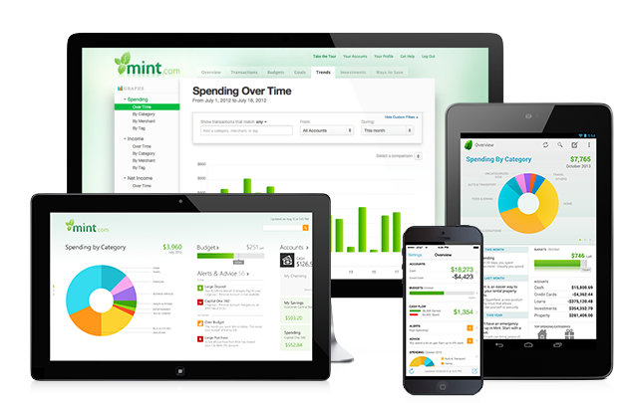
Make a Spending Plan
Where does my money go?
Create a spending plan
Set priorities
Practice good spending habits:
Look for sales
Use coupons
Buy store brands
Price compare
Don’t use credit cards for things you can’t afford
Notes:
Speaker Notes
Have you ever had $20 at the beginning of the week and by Wednesday it was gone? Even worse, you can't remember how you spent it? One way to figure it out is by keeping a spending diary. A small spiral notebook makes it easy. Keep this notebook in your purse or pocket and write down everything you buy over the course of a day and how much it costs. Include everything, even small purchases such as a cup of coffee or a pack of gum. Or better yet, Mint.com offers a free mobile app (for Android & iPhone) that helps you track your spending habits as well as manage your spending budget. Once you’ve determined where your money's going, you can start reducing—or better yet, eliminating— your spending, you'll find you have more money to apply to bills, add to your savings, and, ultimately, reach your goals. Here are some common spending habits that cause us to overspend:(Soft drinks, Fast-food meals, snack foods, coffee, magazines & books, movies, lottery tickets, gifts, mobile phone svc)
Creating a spending plan is about comparing your income against your spending. When you compare the two against each other and your income is more than your spending – then you are in great shape. If however, you find your expenses are more than your income – you will need to set priorities to get your expenses under control. As we spoke earlier, review your list of expenses and evaluate “wants” vs “needs”.
Of course regardless of the outcome of the spending plan you should always practice good spending habits:
Look for sales & off-season bargains, Use coupons & buy store brands when possible and compare prices before you make significant purchases

Slide 7
Saving for Today & Tomorrow
Saving allows you to achieve your financial goals and provides a safety net during challenging times
Set specific savings goals
Emergency fund (Today)
Short term: cell phone (Today)
Long term: down payment on a house (Tomorrow)
Budget monthly savings into your spending plan
Explore options based on goals:
Saving Accounts
Certificate of Deposit (CD)
Money Market Deposit Account
Money Market Mutual Funds
U.S. Treasury Bills
Money market funds are a type of mutual fund managed so as to preserve a stable value of $1.00 per share; however, there is no guarantee that the share value will not drop below $1.00. Investors should refer to the particular fund’s prospectus for additional information and/or consult a financial advisor.
US Treasury Bills are general obligations of the US Government. While these investments generally involve less risk than other investments,
all investments involve risk and are subject to terms and conditions. Please consult your financial advisor for more information.
Notes:
Speaker Notes
Saving is a way to manage your money and allows you to achieve your financial goals and also can provide a safety net during financially-challenging times. You should have both short & long term goals, things for today (like an emergency fund or new cell phone) and tomorrow (down payment on a house), and have monthly savings targets in your spending plan that we spoke about.
There are many options to place your savings in to assist you with your goals from traditional savings accounts, CD’s & Money Markets to Mutual Funds. You should explore each and compare the benefits against your savings goals.
There are many techniques that can be used to jump-start your saving:
Have a portion of your paycheck directly deposited into your savings account.
Set up a regular automatic transfer from your checking account to your savings account. (What you don’t see, you don’t miss.)
When you receive a raise, put the extra cash in savings instead of spending it.
Deposit bonuses, income tax refunds, and cash gifts from birthdays, holidays, or other special occasions into savings.
Save all of your loose change. A quarter here and a dime there will add up.
Once you’ve paid off your car or other debt, start putting the same amount in savings
Save even if you have debt. If your debt carries a high rate of interest, it is to your financial benefit to concentrate on repayment, but you should find a sensible balance. By saving even a little as you are repaying debt, you’ll start an emergency account, kick the habit of borrowing, and establish a savings routine.

Slide 8
Save Money on Everyday Spending with Upromise® by Sallie Mae®
Upromise Online Shopping
You can earn 5% or more cash back for college on eligible online purchases through Upromise’s 800+ online partners*
Upromise Dining
Earn cash back for college at thousands of participating restaurants -
on food, drinks and tip!
Grocery Coupons
Register your grocery or drug store cards, activate the grocery e-coupons, and earn cash back for college
*Exclusions and limitations to the 5% cash back apply. Go to http://shop.upromise.com and click on 'Store Info' next to the online partner to see the applicable cash back amount and product exclusions for that partner, if any.
Notes:
Upromise® by Sallie Mae® is helping students turn everyday purchases into cash back for college expenses — from textbooks to housing to tuition. Upromise is free to join, and simple to use. It’s also a smart way for students to earn cash back by shopping online, going out to eat, booking travel, and more!

Slide 9
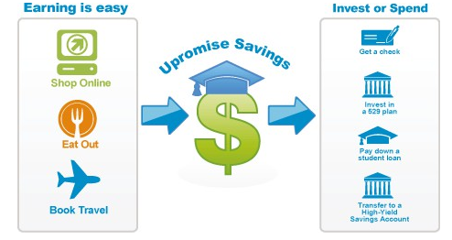
Save Money on Everyday Spending (continued)
Upromise makes it easy to save money everyday
How can parents and other family members get involved?
Family and Friends program lets others link their Upromise account to the student’s account
Money goes right into the student’s Upromise account
Notes:
How can students and families benefit from Upromise Cash Back?
Grow their earnings by opening a Sallie Mae High-Yield Savings Account (competitive interest rate plus you may be eligible for a 10% annual match of Upromise earnings)
Help pay down existing eligible student loans with Upromise Loan Link®, a service that lets them automatically transfer their Upromise earnings periodically
Get a check that can be used for day-to-day college expenses (rent, books and more)
Plus family and friends can help link their savings to the student’s account to save even more!

Slide 11
10 Rules of Smart Credit Management
Credit plays an important role in managing your money – do not take on more than you can handle.
Live within your means
Know what you owe
Borrow only what you can afford
Maintain a good credit rating
Check your credit report annually
Use credit wisely
Recognize the warning signs of financial difficulty
Know a scam when you see one
Guard against identity theft
View bankruptcy as a last resort
Notes:
Speaker Notes
The basics of responsible credit management are actually quite straightforward.
Review the list.
Not all debt is bad. Student loans are an investment in your future; Having a credit card, using it sparingly, and paying the balance in full each month will get you on the road to good credit; and making on-time monthly payments on a car loan or student loan will also put you on the right path.

Slide 12
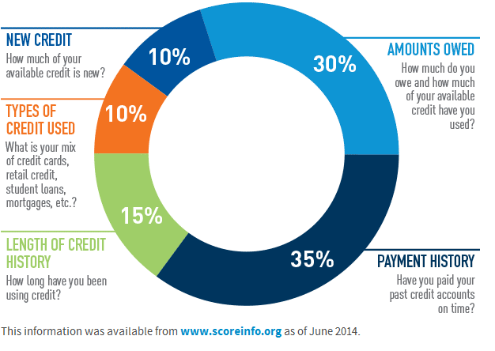
Understanding FICO® Scores
What is a FICO® Score?
A FICO® Score is a numerical expression based on a statistical analysis of a person’s credit file developed by Fair Isaac Company.
A person’s FICO® Score can impact how much they will pay for loans, insurance, and other financial services.
The FICO® Score can range from a maximum of 850 to lowest of 300 - the average national score is 692.
Notes:
Speaker Notes
What is a FICO Score? It is a numerical expression that is calculated from a lot of different credit data in your credit report. This data can be grouped into five categories as outlined below. The percentages in the chart reflect how important each of the categories is in determining your FICO score.
These percentages are based on the importance of the five categories for the general population.
35% of your Credit Score is determined by your Payment Behavior. This would include missed payments, collections, bankruptcies and the like. Additionally, payments made as scheduled, will over time, have a positive impact. The older the information the less of an impact on your overall score. 30% of your Credit Score is based on Utilization. This is the amount of credit you have in use as compared to your available credit. It is recommended that less than 10% of your available credit be utilized. 15% of your Credit Score is impacted by your Credit History. Effectively how long you’ve had accounts open and obviously takes some time to build. 10% of your Credit Score is based on Inquiries. If you apply for various forms of credit and then don’t get that credit it will impact you negatively. Checking your own credit does not impact this number. 10% of your Credit Score is determined by Types of Credit. This would be different forms of credit such as mortgages, auto loans, revolving credit and installments.
Please note that:
A FICO score takes into consideration all these categories of information, not just one or two. No one piece of information or factor alone will determine your score.
Your FICO score only looks at information in your credit report. However, lenders look at many things when making a credit decision including your income, how long you have worked at your present job and the kind of credit you are requesting.
Your score considers both positive and negative information in your credit report. Late payments will lower your score, but establishing or re-establishing a good track record of making payments on time will raise your FICO credit score.

Slide 13
Ways to Improve Your Credit Score
Credit scores are continually changing, depending on how well - or poorly- the person manages their credit.
To build and maintain a strong credit score:
Pay bills on time
Apply for credit only when necessary
Keep credit card balances to less than 50% of the available credit limit
Make more than the minimum payment
Have a mix of credit account types
Review your credit report regularly
at annualcreditreport.com
Tip: The longer your credit history, the better!
Tip: The longer your credit history, the better!
Notes:
Speaker Notes
These are some ways to build and maintain a high credit score: > Pay bills on time
> Apply for credit only when necessary. Opening too many credit cards in a short time can be harmful to the credit score.
> The longer the credit history, the better. Canceling an old credit card could hurt the credit score, because it may shorten the length of credit history.
> Keep credit card balances to less than 50% of the available credit limit on the credit card.
> Make more than the minimum payment on credit cards.
> Have a mix of credit account types, such as revolving (varied monthly payments, such as credit cards) and installment (regular monthly payments, like you make on a student loan).
> Check for errors on credit report periodically, and to ensure that you have not become the victim of identity theft. A free copy of your credit report can be requested every 12 months at AnnualCreditReport.com.

Slide 14
Good Credit vs. Poor Credit – What Does it Mean?
GOOD
CREDIT
BAD
CREDIT
Lower interest rates
Could save hundreds, if not thousands, of dollars in interest costs
Allows you to be more selective when choosing a lender
Can mean preferred rate on car insurance
Higher interest rates
Result in loan applications being rejected
Can get denied for basic services
Can mean high cost premium on car insurance
Can cost you that job
Notes:
Speaker Notes
Good Credit often times means high likelihood of approved loan applications along with lower interest rates
Good Credit shows the person has a responsible credit history
Good Credit shows that the person is a low-risk borrower who is less likely to default on their loans
Good Credit could save the borrower hundreds, if not thousands, of dollars in interest costs.
Good Credit allows a person to be more selective when choosing a lender
Having lenders compete against each other can mean a more competitive interest rate
Good Credit allows a person to qualify for a preferred rate on car insurance
Poor Credit may mean a loan application is rejected
Poor Credit can get a person denied for basic services
Like renting an apartment and signing up for utilities
Poor Credit can even cost a person their job!
Prospective employers may check your credit rating to judge your degree of responsibility.
No Credit can sometimes be just as much of a problem as having poor credit
It means that lenders have no record to assess borrowing behavior.

Slide 15
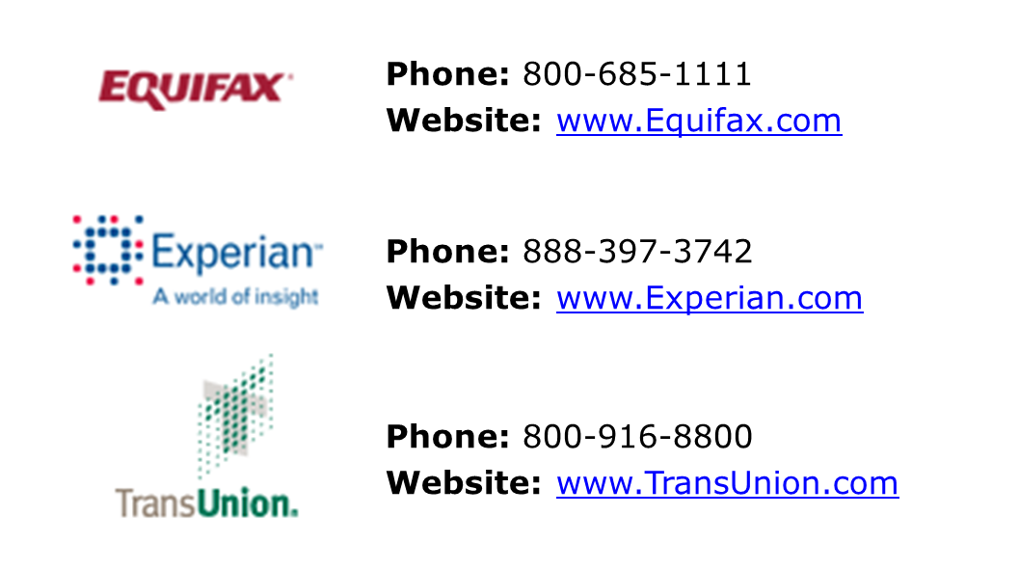
National Credit Bureau Agencies

Slide 16
Know What You Owe
Put together a snapshot of what you owe
Student loans | $
Other loans:
Credit card balance(s) | +$
Automobile loan | +$
Mortgage loan or rent | +$
Other money owed:
Utilities, cable, internet | +$
Phone | +$
TOTAL | $
Notes:
Speaker Notes
You Can’t Manage What You Can’t Measure – you need to know what you owe.
Start by getting a clear view of your existing debt.
This includes student loans, credit card balances, car loans, and other expenses
Walk thru developing the snapshot….
Though the total amount of your education debt may look high, the long-range view is
reassuring. Your higher education means your earning potential is greater.
**A good budget should include all recurring expenses (monthly bills such as cell phone, gas or other transportation expenses, and more) - a budget will only work if you account for all spending.

Slide 17
Don’t Borrow More than You Need
Calculate your debt-to-income ratio:
Minimum debt payments Monthly gross income
(including mortgage or rent)
Example: You earn $5,000 each month in gross income, and a yearly bonus nets you a $500 a month. Your total monthly income is $5,500.
You pay $200 a month in student loans, $500 in rent, $150 on a car payment, and $150 on your credit card and other expenses. Your total monthly debt payments are $1,000.
$1,000 (debt) divided by $5,500 (income) = a ratio of 18.2%
Notes:
Speaker Notes
Don’t borrow more than you need or can afford. But how much is too much? A debt-to-income ratio is the comparison between what you owe and what you earn (every month), and
is a key number lenders use in addition to FICO score to determine whether a loan application is approved.
Typically lenders only look at the lines of credit reflected on the credit report, not at utilities, phone, etc. [walk thru the example of the calculation].
What does your debt-to-income ratio mean?
36% or less: This is a healthy debt load to carry for most people. 37%-42%: Not bad, but start paring down debt now before you get in real trouble.
43%-49%: Financial difficulties are probably imminent unless you take immediate action.
50% or more: Get professional help to aggressively reduce debt.

Slide 18
Using Credit Cards the Right Way
Start small with one card and a low credit limit
Make small everyday purchases – not extra purchases to get rewards
Understand your spending by
analyzing the statement each month
Pay off your balance each month
Know and watch the interest rate
Get the “full scoop” on special introductory rates
Stay out of the “penalty” box
Notes:
Speaker Notes
Starting small and taking is slow are keys to getting the most out of credit card usage.
For students who are new to credit cards you should take your time and make sure you understand your rights and obligations.
Start small with one card and a low credit limit – To avoid the number one mistake people make with overspending. The idea is to build your credit history and learn about how to properly use credit cards in the future when you’ll have access to higher limits. Remember once you are comfortable managing your credit card, you can request a credit line increase.
Make small everyday purchases – Don’t change your spending habits just because you have a credit card. Get used to using the card for your everyday purchases and not just to earn rewards.
Understand your spending by analyzing the statement- Each month you will be able to view how you spent your money and can gain insights into where you can cut and save.
Pay off your balance each month- that means paying the full amount shown on your statement by the due date. Paying this amount helps you avoid paying interest and spiraling into debt.
Some other tips:
Watch the interest rate
(Might be good to whiteboard this example for the audience) If you have a balance of $8,000 at 16%, the interest charges would be $1,280 a year. Transfer that balance to a card that charges just 4.9% instead, and your interest costs would be only $392, for an annual savings of almost $900.
Get the “full scoop” on special introductory rates
How long does the “teaser” rate last? What happens after the introductory period expires? Is there a fee for balance transfers? What happens if you’re late with a payment (or two)?
Stay out of the “penalty” box
Penalty fees for missed payments can be as high as $35 (or more) an occurrence. Even more costly though are interest rates that increase as a result of a late payment, in which you can see a very attractive rate increase to over 20% APR.
Pay the minimum, pay the price
(Might be good to whiteboard this example for the audience) For example, if you have a $5,000 balance and pay the minimum $200 per month at an interest rate of 14%, it will take you approximately 11 years to pay off this debt. However, if you paid $300 per month, you would repay the debt in just 19 months.

Slide 19
Most Common Mistakes to Avoid With Credit Cards
Overspending
Spending just to earn more rewards
Making only minimum payments
Not paying your bill on time
Using convenience checks or other cash advance features
Notes:
Speaker Notes
Mistake #1: Overspending
Of the many ways young people get into trouble with credit cards, the biggest is by overspending. Buying something just because you can is never a good idea. Even though a credit card is different than cash, thinking of them as the same is helpful.
Mistake #2: Spending just to earn more rewards
This is really just a sub-mistake of overspending. Many credit cards offer the ability to earn rewards points that can be redeemed for merchandise, cash back, or travel. This feature is tempting to maximize, but the reality is if you can't afford the purchases, no amount of rewards will help you pay back the credit card company.
Mistake #3: Making only minimum payments
The only payment a credit card company requires you to make each month is what's called a minimum payment, and it's usually so small that you would never end up paying off your balance if that's all you paid.
In all likelihood, the added interest will be more than your minimum required payment, so the balance that you owe will continue to rise and rise until you can't pay it off. To avoid interest charges, pay your statement balance in full every month.
Mistake #4: Not paying your bill on time
If you pay your bill late, in some cases even minutes late, you will most likely be charged a late fee that can be as much as $40!
Late payments can also start the interest clock on your unpaid balance, costing you more money. But remember, the main reason for student cards is to build a credit history.
If you make late payments, you're hurting your credit score and you're also missing out on the opportunity to build your credit, which is a big swing in the wrong direction.
Mistake #5: Using convenience checks or other cash advance features
When you use your credit card at an ATM for a purchase at a store and receive cash back, or when you use convenience checks, you are triggering the cash advance feature of your card. Interest rates for cash advances are generally higher and usually start accumulating immediately. Many people don't know this and are surprised to see large fees in their statements.
Convenience checks are often included in mailings with your statement. You can use the checks to write a check drawn on your credit card account. This makes certain purchases very convenient. The downside is that these checks are often plagued by the same high interest rates and also typically come with a 3-4% fee on the amount borrowed. All these fees add up and cost you money.

Slide 20
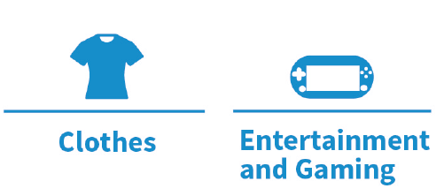
Do’s and Don’ts for Spending and Rewards Programs
The average college student can spend thousands of dollars per year on discretionary spending.
Using a rewards program that offers points, miles, or cash back can be a great savings tool if you use the rewards wisely.
DO:
Join rewards programs
Prioritize spending on NEEDS
Use credit cards wisely
DON’T:
Assume that buying more equates to saving more
Splurge on WANTS
Assume that if you can charge it, you can afford it
Notes:
Speaker Notes
DO:
Join rewards programs that can help you earn cash back for making purchases you would make anyway.
Prioritize spending on NEEDS: books, educational supplies, food, toiletries.
Use credit cards wisely and always pay your balance in full each month to avoid interest charges and fees.
DON’T:
Assume that buying more equates to saving more. Rewards programs don’t work if you overspend or carry balances month after month.
Splurge on WANTS: Slow down on all those apps and downloads. Those “only a dollar” downloads can add up fast.
Assume that if you can charge it, you can afford it. Balances not paid in full every month make EVERY purchase more expensive.

Slide 21
Recognize the Signs of Financial Difficulties
Financial problems, once started, tend to get worse if they are left unsolved
Some warning signs of financial problems:
You have to wait for your paycheck or other income to pay bills
Your credit cards are charged up to the maximum
The amount you owe gets bigger every month
You overdraw your account
You’ve received letters or calls from creditors
Actions you can take:
Review your spending plan/budget
Ask for assistance from parents or mentor
Consider credit counseling
Notes:
Speaker Notes
Recognize the signs of financial difficulties and Pay attention to the warning signs. If you spot trouble (review the warning signs), start turning things around — by taking action early:
See where your money goes. Review your spending plan/budget that we spoke about earlier -see where you can cut back on expenses.
Ask for parental assistance. Asking parents or a mentor for help doesn't necessarily mean you're asking to be bailed out of a financial problem. Chances are they have had some valuable experience in money management and can work with you to develop a budget and a strategy for reducing debt.
Consider credit counseling. Many credit grantors can offer advice and are very willing to discuss repayment strategies with customers. The credit grantor wants to be repaid and so is often willing to work out new or temporarily reduced payment schedules.
Contact your local Consumer Credit Counseling Service (CCCS), a division of the nonprofit National Foundation for Credit Counseling (NFCC). These agencies are in nationwide and can help you develop a plan to help get your financial problems resolved. CCCS is a free service. To find one near you, go to www.nfcc.org or call (800) 388-2227.

Slide 22
Bankruptcy: It’s Not an Easy Out
Bankruptcy is filed by people who are unable to pay their debts
Bankruptcy allows the court to “erase” your bills and allows you to start over
Bankruptcy filings stay on your credit report
for up to 10 years
Bankruptcy courts are reluctant to
discharge student loans
Should only be used as an
absolute last resort
Notes:
Speaker Notes
If you’re having difficulty making monthly payments on your credit card, student loan or car payment, think twice before considering filing bankruptcy. Filing bankruptcy does not make it all go away….and is not an easy out as it greatly impacts your credit score.
You aren't quite home free: Bankruptcy filings stay on your credit report for 10 years and will likely limit your ability to get a mortgage, borrow money, or get a job.
Bankruptcy and Student Loans
Generally education loans are non-dischargeable in bankruptcy , unless a court determines that debt presents an undue hardship.
But I thought...
Several laws were passed in the 1990s to protect taxpayers from the high number of student loans (estimated at one-fifth) in default or included in a bankruptcy. Even today, with student loan bankruptcies greatly reduced, it's estimated that the average U.S. family pays about $400 per year in taxes toward bankruptcy court costs, regulations, and staffing.
No one benefits or profits when people default on their student loans or declare bankruptcy. Lenders lose money, and taxpayers lose money. Federal bankruptcy laws are there to protect you. If you're having trouble making your payments, contact your lenders and see if you can arrange an easier repayment plan.

Slide 24
Know a Scam When you See one
Debt relief scams
Advance-fee loan scams
Credit repair scams
Be aware of the following:
Organizations that have no website or cannot be found in Google
Organization that asks for credit card information, bank account information, social security, drivers license, or other personal information
Return address is a free domain (Hotmail, Gmail, Yahoo)
Offer contains a lot of hype and promotional language but little on how it works and the cost
Offers a prize, in which you have to pay “processing fees”
Notes:
Speaker Notes There are plenty of scam artists out there, each promising you a deal that seems too good to be
true. Although there are many kinds of scams, the following are three you should be aware of:
Debt relief scams
"Wipe out your debts and stop credit harassment."
Be cautious. There are no quick fixes. In most cases, the way these agencies spell R-E-L-I-E-F is B-A-N-K-R-U-P-T-C-Y, and that's something to consider only as an absolute last resort. (The negative repercussions from bankruptcy will be with you for years.)
Advance-fee loan scams
"Got credit problems? For an upfront fee, we can guarantee you'll get the loan you want."
Although many legitimate creditors require an advance application fee, they never guarantee a loan approval. If you come across an agency that does, you're likely to be dangerously near a scammer. These con artists often use "900" numbers (charges show up on your phone bill) and they use delivery methods other than the U.S. Postal Service to avoid detection.
Credit repair scams
"Erase your bad credit.“ Some outfits will try to convince you that they can make bankruptcy, judgments, tax liens, and defaulted loans disappear from your credit record like magic.
The Federal Trade Commission (www.ftc.gov) warns consumers not to do business with any company that:
Wants you to pay for credit repair before any services are provided.
Suggests you invent a "new" credit report by applying for an Employer Identification Number.
Recommends that you not contact a consumer reporting company directly.
Does not tell you your legal rights and what you can do yourself — for free.

Slide 25
Guarding Against Identity Theft
If someone steals your ID, your credit is at risk
Guard your social security number
Keep your card out of your wallet
Don’t put it on your driver’s license or checks
Pick passwords carefully
Pay attention to your mail and trash
Check your credit reports annually
Be careful when purchasing items online
Read your monthly statements
Do not sign up for unfamiliar contests
Don’t reply to messages asking for personal or financial information
After a disaster, give only to established charities
Notes:
Speaker Notes You protect your wallet, lock your car, and hide your jewelry. Are you as careful with your identity? If someone steals your ID, your credit rating is at risk.
Make sure it doesn't happen to you. In this case, prevention is definitely easier than the cure: It can take years to straighten out your records. Here are some ways to protect yourself.
Guard your Social Security number
Do not carry your Social Security card with you.
Do not put your SSN on your driver's license or on bank checks.
For more information on uses and security issues of SSNs, read My Social Security Number: How Secure Is It? from the Privacy Rights Clearinghouse.
Pick passwords carefully
Avoid using passwords that are easy to guess (such as your pet's name, your birthdate, or consecutive numbers or letters).
Use a mix of letters and numbers that is special to you but not obvious.
Pay attention to your mail and trash
Tear or shred charge receipts, copies of credit applications, insurance forms, credit card offers, and bank statements.
Check your credit reports for unauthorized activity
An amendment to the Fair Credit Reporting Act requires the three national credit bureaus to provide you a free copy of your credit report once every 12 months at your request.
To order your copy, visit www.annualcreditreport.com or call toll-free (877) 322-8228.
Use common sense
The list continues: Be careful when purchasing items online. Make sure the site is secure before giving credit card information.
Do not sign up for unfamiliar contests. Identity thieves may create phony promotions to capture your personal information.
Be wary of telephone solicitors. Do not provide personal information unless you initiated the call.

Slide 26
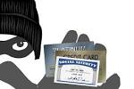
What If My Identity is Stolen?
Alert a credit reporting agency
Place a fraud alert (free)
Ask them to contact the other 2 agencies on your behalf
Alert stays on your credit report for 90 days
Get copies of your free credit report from each of the agencies
Contact the fraud department at each of the companies with impacted accounts
Follow up in writing & keep copies
Create an Identity Theft Report
FTC Identity Theft Affidavit (www.ftccomplaintassistant.gov)
Police Report
Identity Theft
Affidavit
Police
Report
Identity Theft Report
Notes:
Speaker Notes If you think your identity has been stolen, there are three steps you should immediately take that can limit the amount of damage to your finances and credit score.
Act fast — file a police report and alert the proper authorities to ensure all necessary steps are taken to limit your liability.
Step 1: Alert a credit reporting agency
The three major credit reporting agencies collect credit history on consumers and deliver a calculated score based on factors such as repayment behavior. An identity thief may attempt to contact one of these agencies to change the name or address associated with your account. Alerting the agency will allow them to closely monitor your account for suspicious requests and to contact you when such requests are made.
Contact one of the agencies. Each can quickly assist your request to monitor your account for unusual activity and shares the alert with the others.
Step 2: Contact your bank or any other company that you believe has an account that has been tampered with.
Credit cards are often the first and favorite target for identity theft. Whether your wallet has been stolen or hackers have snatched your credit card details, your personal information can be used immediately to make purchases and borrow cash against your credit limit. By closing these accounts, you prevent further financial damage in your name.
Call the customer service number on the back of your credit cards. If your wallet has been stolen, find the contact information on past bills or get a general number through an operator. The customer service representatives can help ensure that you will not be responsible for any purchases made through identity theft.
Also, while you may not need to close your checking or savings accounts, contact your bank or financial institution and alert them of the identity theft. This allows the bank to monitor your account for suspicious activity.
Step 3: Contact the Federal Trade Commission (FTC) & File a Police Report
The FTC has an initiative to collect details about victims of identity theft. By filing your complaint, you help federal authorities understand the methods and targets of identity thieves and aid them in tracking down these criminals to prevent future theft.
Contact the FTC through their toll-free hotline (877) IDTHEFT (877-438-4338) or you can file your complaint online.

Slide 27
Notes:
Speaker Notes
Using credit wisely can help you get and have more through the course of your life and can be used as a way to secure your future. However, it is important to manage credit to ensure that you do not overburden yourself with debt.

Slide 28
Important Things to Know
Understand your student loan portfolio
Know what types of loans you have
Know your lenders and servicers
Know how much you owe
Know what your interest rate is
Know what your total monthly payments will be
Know what borrower benefits are available
Understand interest capitalization and its impact
Know grace, deferment and forbearance options
Know federal loan repayment plan options
Avoid delinquency and default
Keep good records
Know your resources
Notes:
Speaker Notes
The key to managing your Student Loans is to understand what your student loan portfolio looks like:
Know what types of loans you have: Perkins, Direct Loans (Stafford, Graduate PLUS) and Private Loans
Know your lenders and servicers: Buying and selling of student loans is very common. Your original lender may have sold your student loan which means you know have a new “holder” or “servicer”. The terms of the loan will not change if sold or transferred to another servicer and you must be notified if the service provider of the loan changes. But since the life of a student loan can be longer than 10 years it is important to keep track of all notifications so you know who your servicer is at all times.
Key servicers include: Great Lakes, Nelnet; FedLoan Servicing (PHEAA) and Sallie Mae (Navient)
Know how much you owe (remember what you borrowed may not be same as what you owe – due to capitalized interest & fees)
Know what your interest rate is
Know what your total monthly payments will be (factor in total of all your loans)
Know what borrower benefits are available (many lenders offer incentives for interest rate reductions and credits; research what is available to you)
It’s also important for you to understand Capitalization; what it means and what the impact is which we will review. You should also be aware of the loan repayment options.
Most importantly, keep good records and now the resources available to you to help you manage your loans.

Slide 29
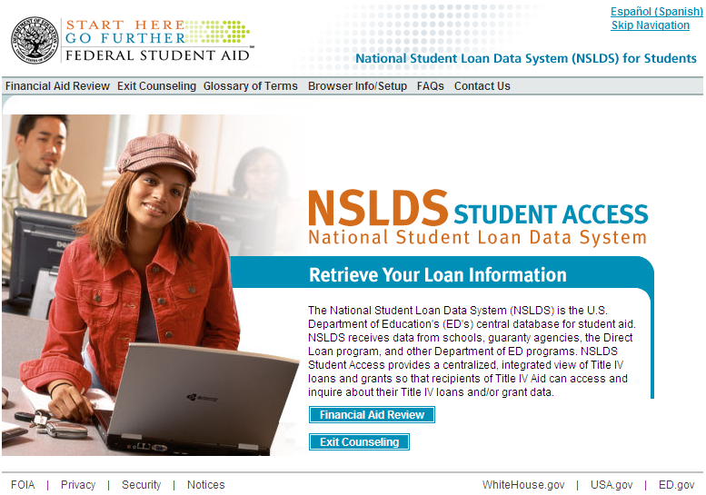
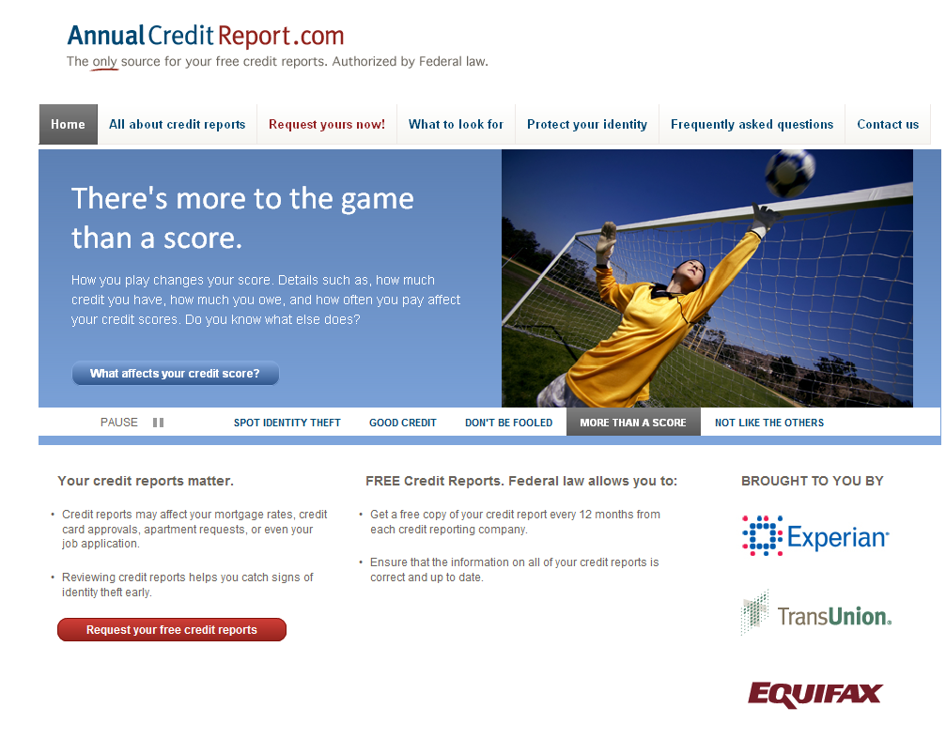
Finding Your Federal and Private Student Loans
Federal Student Loans
National Student Loan Data System
www.nslds.ed.gov
Private Student Loan
www.annualcreditreport.com
Notes:
Speaker Notes
To locate any federal student loan you have (Stafford, Perkins, Grad PLUS or Consolidation loan ) go the National Student Loan Data System (www.nslds.ed.gov)
Students shouldn’t let the fact that they no longer remember their PIN numbers from accessing their records on NSLDS.
There’s a special Web site to request a duplicate PIN—this means ask the Department of Education to remind you what the PIN is.
Takes just a few minutes to make the request. Typically it takes just a few hours to get a response.
To get duplicate FAFSA PIN, go to: www.pin.ed.gov
To find private student loans – the best source is to request a copy of your credit report. You are able to get a FREE copy every 12 months – go to www.annualcreditreport.com

Slide 30
Interest Capitalization and Its Impact
Interest on most loans accrues from the date funds are disbursed until the loan is paid in full
The chart provides estimates, for a $5,000 Stafford loan with a 4.66% interest rate, of the monthly payments due at the end of a 12 month forbearance for a 10 year term
Treatment of Interest During Forbearance Status | Principal at Repayment | Cap. Int. During Forbearance | Principal at end of Forbearance | Term | Payment Amount | Total Amount Repaid | Total Interest Cost
Interest is paid as it accrues | $5,000 | $0 | $5,000 | 120 | $52 | $6,498 | $1,551
Interest is capitalized at end of status | $5,000 | $233 | $5,233 | 120 | $55 | $6,557 | $1,610
Interest is capitalized quarterly and at end of status | $5,000 | $237 | $5,237 | 120 | $55 | $6,562 | $1,615
TIP: Students should consider asking family to help with interest.
Notes:
Speaker Notes
Undergraduate student with 5,000 loan
Interest on most loans accrues from the date funds are disbursed until the loan is paid in full
Capitalization is the addition of unpaid accrued interest to the principal balance of a loan. The less frequent the better.
Capitalization may occur more frequently for certain loans during forbearance

Slide 31
Understanding Grace, Deferment and Forbearance Options
Grace Period - period of time after a borrower graduates, leaves school or drops to less than half-time
No payments required during this period
Time varies based on loan type
Does not adversely impact credit
Deferment - period when borrower who meets certain criteria may suspend loan payments
Common types of deferment:
In-school
Economic Hardship
Military
Does not adversely impact credit
Forbearance - typically sought for temporary repayment relief and provides temporary adjustment of no payments or reduced payments
Be careful to use because it adds expense
Can be very useful to help avoid delinquency and default
Does not adversely impact credit
Unemployment
Graduate Fellowship

Slide 32
Federal Loan Repayment Plans
Standard Repayment
Level monthly payments that cover accruing interest and a portion of principal over a 10-year period
Higher monthly payments
Lowest overall cost
Graduated Repayment
Payments start low, increase over time
Interest only payments followed by standard principal and interest
Finish in 10 years
Higher overall cost – but provides lower initial payment amount
Can be combined with Extended Repayment
Notes:
Standard
Level monthly payments that cover accruing interest and a portion of principal over a 10-year period
Higher monthly payments
Lowest overall cost
Graduated
Payments start low, increase over time
Interest only payments followed by standard principal and interest
Finish in 10 years
Higher overall – but good for early cash flow

Slide 33
Federal Loan Repayment Plans (Continued)
Income Sensitive Repayment (Non-direct Federal Loans)
Payments are based on percentage of your monthly income
Payments must be sufficient to cover accruing interest
Finish in 10 years (may be extended to 15 years)
Income-Contingent Repayment (Direct Loans Only)
Payment is based on income
Negative amortization is allowed
Up to 25 years to repay
Balance remaining after 25 years’ worth of payments can be forgiven
Notes:
Speaker Notes Income Sensitive
Payments are based on percentage of your monthly income
Payments must be sufficient to cover accruing interest
Finish in 10 years (may be extended to 15 years)
Income-Contingent (Direct Loans Only)
Payment is based on income
Negative amortization is allowed
Up to 25 years to repay
Balance remaining after 25 years’ worth of payments can be forgiven
NOTE: You have to apply and be approved yearly for both of these options.

Slide 34
Federal Loan Repayment Plans (Continued)
Extended Repayment
Available to borrowers who have accumulated more than $30K in Direct or FFELP Federal Stafford, PLUS and Consolidation loans first disbursed on or after October 7, 1998
Direct and FFELP Federal Loans are accumulated separately in determining eligibility
Repayment can be extended up to 25 years
Payments may be fixed or graduated
Permits you to manage monthly cash flow needs, but will increase your cost
Income-Based Repayment
Available to borrowers of most federal student loans experiencing financial hardship
Borrower qualifies if annual amount due on all eligible student loans under a standard repayment period exceeds 15% of “discretionary income”
If eligible for IBR, borrower’s monthly payment will be determined by a formula that takes into account household size and adjusted gross income. Increases in income will impact the required monthly payment amount
Unpaid balance may be forgiven after 25 years of scheduled monthly payments
Changes effective for Direct Loans made to new borrowers on or after July 1, 2014:
Borrower qualifies if annual amount due under a standard repayment plan exceeds 10% of discretionary income and unpaid balance may be forgiven after 20 years of payments
Notes:
Speaker Notes Extended
Available to borrowers who have accumulated more than $30K in Federal Stafford, PLUS & Consolidation loans first disbursed on or after October 7, 1998
Repayment can be extended up to 25 years
Permits you to manage monthly cash flow needs, but will increase your cost
Income Based Repayment
***Borrower must apply each year to stay on IBR**
Available to federal loan borrowers experiencing financial hardship
Borrower qualifies if annual amount due on all eligible student loans under a standard repayment period exceeds 15% of “discretionary income”
If eligible for IBR, borrower’s monthly payment will be determined by a formula that takes into account household size and adjusted gross income. Increases in income will impact the required monthly payment amount
Unpaid balance may be forgiven after 25 years of scheduled monthly payments
Periods of deferment and forbearance are not counted in this 25 years.
“25 years of scheduled monthly payments” under “Income Based Repayment” may include scheduled IBR payments which could be $0, certain other payments under another repayment plan, and periods of economic hardship deferment. All would potentially be counted toward the 25 year period for forgiveness purposes.

Slide 35
Federal Loan Repayment Plans (Continued)
Pay As You Earn (Direct Loans Only)
Announced by ED December 21, 2012
Available to new Direct loan borrowers (except Parent PLUS) experiencing financial hardship
No loan balance as of October 1, 2007, and
Received a Direct loan on or after October 1, 2011
Borrower qualifies if annual monthly student loan payments exceed 10% of “discretionary income”
Similar to IBR, borrower’s monthly payment will be determined by a formula that takes into account family size and adjusted gross income. Increases in income will impact the required monthly payment amount
Unpaid balance may be forgiven after 20 years of qualifying repayment

Slide 36
Federal Loan Repayment Plans (Continued)
Loan Consolidation
Provides the ability for borrowers to consolidate all of their federal loans into one new loan
FFEL and Direct Stafford Loans, Perkins Loans and PLUS Loans may be consolidated
Interest Rate: weighted average of the interest rates on the loans being consolidated rounded to the nearest higher one-eighth of one percent
Multiple Repayment Options: Standard, Graduated, Extended, Income Contingent, Income Based
Benefits:
Possible longer repayment period
Potential lower monthly payment
Single servicer
Application Process: www.studentloans.gov

Slide 37
Federal Loan Repayment Comparison – Undergraduate Example
Plan | Initial Monthly Payment | Long-term Monthly Payment | Total Interest Paid | Years in Repayment
Standard | $292.00 | 292.00 | $6,855.00 | 10
Graduated | $165.00 | $494.00 | $8,589.00 | 10
Extended - Fixed | n/a | n/a | n/a | n/a
Extended - Graduated | n/a | n/a | n/a | n/a
Income Based | $281.00 | $292.00 | $6,939.54 | 10.1
Income Contingent | $221.00 | $273.00 | $9,209.00 | 12.8
Income Sensitive | $105.00 | $292.14 | $8,080.10 | 11
Pay as You Earn | $187.00 | $292.00 | $8,966.06 | 11.8
Consolidation | $178.03 | $178.03 | $14,793.40 | 20
Assumes $27,000 in undergraduate Stafford loans ($19,000 in subsidized and $8,000 in unsubsidized loans) over a 4 year period. Subsidized interest rates ranged from 3.4% to 4.66% based on statutory limits for each AY. Unsubsidized Stafford loans ranged from 3.86% to 6.8%.
Notes:
Speaker Notes
Undergraduate Student
Assumes $40,000 of income for IBR calculation

Slide 38
Federal Loan Repayment Comparison – Graduate Example
Plan | Initial Monthly Payment | Long-term Monthly Payment | Total Interest Paid | Years in Repayment
Standard | $756.00 | $756.00 | $23,045.00 | 10
Graduated | $433.00 | $1,299.00 | $29,245.00 | 10
Extended - Fixed | $442.00 | $442.00 | $64,837.00 | 25
Extended - Graduated | $346.00 | $659.00 | $76,396.00 | 25
Income Based | $281.19 | $756.59 | $40,939.48 | 14.3
Income Contingent | $472.00 | $737.00 | $36,315.00 | 14
Income Sensitive | $346.49 | $756.48 | $27,229.00 | 11
Pay as You Earn | $187.46 | $756.59 | $44,694.03 | 15.3
Consolidation | $412.05 | $412.05 | $81,356.29 | 30
Assumes $61,500 in graduate Stafford Loans ($25,500 subsidized and $36,000 unsubsidized) over a 3 year period. Interest rates for subsidized Stafford Loans were 6.8% and unsubsidized Stafford interest rates ranged from 5.41% to 6.8% based on statutory limits for each AY.
Notes:
Speaker Notes
Assumes $40,000 of income for IBR and PAYE calculation
IBR and PAYE 4 Yrs assumes borrower only meets poverty guidelines for 4 years and then transitions to standard payment amount for 10 years (if applicable
Why is total paid under 4 years less than life: when you increase the payment amounts, you will be paying down more principal. This reduces the interest = paying off faster with less interest paid. With any loan, if you increase the payment amount above the calculated loan amount, there will be less interest over the life of the loan.

Slide 39
Private Loan Repayment
Private loans are almost always unsubsidized for the life of the loan
Repayment terms vary
Choice of repayment plans
may be available
Residency and internship deferments may be available
Forbearances may be available
Consult your loan servicer
TIP:
Refer to your promissory note and/or your servicer to determine your available options

Slide 40
Paying Loans Off Early
Borrowers can always prepay federal and private student loans without penalty
Be aware of the relative cost and make payments towards unsubsidized loans while still in school/during deferments that have the highest rates and/or most frequent capitalization. This should save more money over time.
Unless otherwise noted, loan payments typically are applied first toward late fees, then interest, and finally principal
Notes:
Speaker Notes

Slide 41
Delinquency & Default (Federal/Private Loans)
Delinquency & defaults on student loans can adversely impact your credit history
Delinquency
Failure to make payment(s) when due
Reported to credit bureaus; affects borrowers history
Default
Collection agencies may take over adding to cost
Lender can take legal action
School can withhold records
Federal defaults could include wage garnishment & withholding of federal tax refunds
Student loans are rarely discharged in bankruptcy
Notes:
Speaker Notes
Loan Delinquency is a failure to make loan payments when they are due. Extended delinquency can result in loan default. Loan Default is the failure to repay a loan according to the terms agreed to in the promissory note. A lender may take legal action to get the money back
Defaulting on a loan can adversely affect credit for many years. Default occurs when a loan receives no payment for 270 days. The loan leaves repayment status and is due in full when the lender requests. New collection costs are added to the loan’s balance, and the loan becomes drastically more expensive than before, although you usually can reduce or eliminate these costs through negotiation or legal action..
There are other negative consequences resulting from a defaulted loan. A student who wishes to return to school cannot qualify for federal aid in the United States until satisfactory payment arrangements are made on the defaulted loan or the loan is rehabilitated, a process that can take as long as a full year of on-time payments.
In addition, the IRS can take the borrower’s income tax refund until the defaulted loan is paid in full. This is a popular way of collecting on loan debt, and the Department of Education collects hundreds of millions of dollars this way.
The government can also garnish wages as a way to recover money owed on a defaulted student loan. The United States Department of Education or a Student Loan Guarantor can garnish 15% of a defaulted borrower’s wages. The loan holder does not have to sue the borrower first. The borrower can object to the garnishment, but only under very specific circumstances, such as if his weekly income is less than 30 times the federal minimum wage.
Defaulting on student loans can also end in a lawsuit. The government and private lenders can sue in order to collect on loans. There is no time limit on suing to collect on federal student loans, and the borrower can be sued indefinitely. Private student loans, in most cases, are subject to statute of limitations laws depending on the state.
Generally education loans are non-dischargeable in bankruptcy, unless a court determines that debt presents an undue hardship.
Remember, to recognize the signs of financial problems and seek help so that you can avoid both delinquency and defaults.

Slide 42
Keep Good Records
Get all loan documents together: keep them on file!
Promissory notes
Disclosure statements
Award letters
Exit interview information
Open and READ student loan mail
Bookmark loan servicer’s websites
Notify loan servicer(s) of name & address changes
Document calls to servicer: date/time of call & person who handled the call
Keep important numbers available
Notes:
Speaker Notes

Slide 43
Resources
School financial aid office
Lender/servicer
Federal Student Aid Ombudsman
U.S. Department of Education – FSA Ombudsman
http://www.ombudsman.ed.gov or 1-877-557-2575
Federal Loan Servicers:
800-236-4300 - www.mygreatlakes.org
800-699-2908 - www.myfedloan.org
888-486-4722 - www.nelnet.com
800-722-1300 – www.navient.com

Slide 45
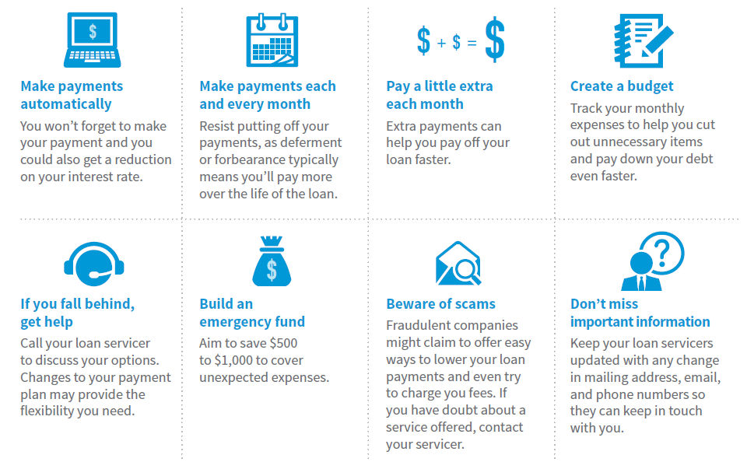
Tips for Managing Your Loans and Finances
Notes:
Speaker Notes

Slide 46
Questions

Slide 47
The information contained in this presentation is not comprehensive, is subject to constant change, and therefore should serve only as general, background information for further investigation and study related to the subject matter and the specific factual circumstances being considered of evaluated. Nothing in this presentation constitutes or is designed to constitute legal advise.
MKT9706 0714
Notes:
Speaker Notes

