Slide 1
Federal Repayment Plans and public service loan forgiveness
Presenter: Laura Dickerson, Sallie mae
Moderator: Nadine bailey, ultimate medical academy

Slide 2
Agenda
Traditional repayment plans
Income driven repayment plans
Public service loan forgiveness
Resources

Slide 3
Repayment options
9 repayment plans available
Choice adds to confusion
Knowledge and understanding can lead to savings

Slide 4
The Rise of IDR’s

Slide 5
Repayment plans
Traditional repayment plans
Standard
Graduated
Income sensitive ( federal only)
Extended
Income driven repayment plans
Income contingent ( direct only)
Income based repayment
Pay as you earn
Revised pay as you earn

Slide 6
Traditional plans
Standard Repayment (Federal and Direct Loans)
Level monthly payments that cover accruing interest and a portion of principal over a 10-year period
Higher monthly payments
Lowest overall cost
Graduated Repayment (Federal and Direct Loans)
Payments start low, increase over time
Interest only payments followed by standard principal & interest
Finish in 10 years
Higher overall cost – but provides lower initial payment amounts

Slide 7
Traditional plans
Income Sensitive Repayment (Federal Loans Only)
Payments are based on percentage of your monthly income
Payments must be sufficient to cover accruing interest
Finish in 10 years (may be extended to 15 years)
Extended Repayment (Federal and Direct Loans)
Available to borrowers who have accumulated more than $30K in Direct or FFELP Federal Stafford, PLUS & Consolidation loans first disbursed on or after October 7, 1998
Direct and Federal Loans are accumulated separately in determining eligibility
Repayment can be extended up to 25 years
Permits you to manage monthly cash flow needs, but will increase your cost

Slide 8
Income driven plans
Income contingent – 1994 (direct)
Income based – 2009 (federal/direct)
Pay as you ear (paye) – 2012 (direct)
Revised pay as you earn (repaye) - 2013 (direct)

Slide 9
Most IDR plans have two formulas –
for those that qualify, borrowers always pay the lesser of the two.

Slide 10
Additional things to consider
Interest subsidy, capitalization and forgiveness varies by plan
Loan program | Subsidy | Capitalization | Loan forgiveness | Spousal income | PSLF
ICR | 0% | Can cap annually | 25 years |  | X
IBR | 100% /3yrs | Leaving plan | 25 years |  | X
PAYE | 100%/3yrs | 10% in plan/ leaving plan | 20 years |  | X
REPAYE | 100/3yrs/ 50% remaining yrs | Leaving plan | 20 years | X | X
Amount forgiven is income for tax purposes.

Slide 11
Repayment sample
Assumes $200,000 in graduate loans over a 4 year period ($82,000 unsubsidized and $118,000 GradPLUS). Assumes current interest rate of 6.00% for all unsubsidized loans and 7.00% for all GradPLUS Loans, annual income of $55,000 and household size of 1. Note: The DOE Calculator rounds the interest rates down to 6% and 7% respectively.

Slide 12
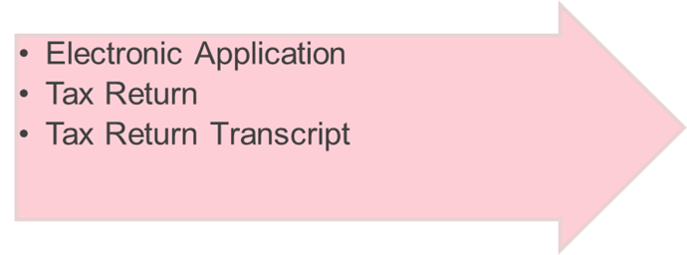
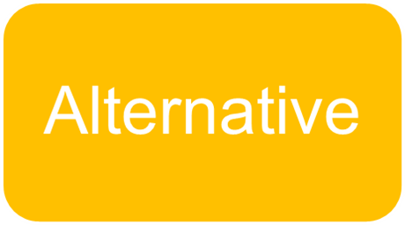
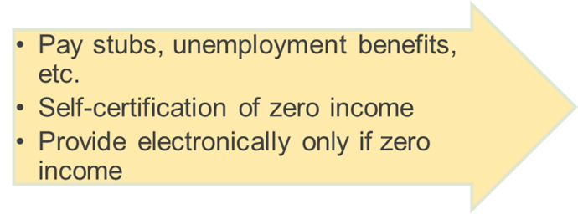
Income documentation

Slide 13
Failing to recertify
ICR | IBR | PAYE | REPAYE
STAYS IN PLAN | STAYS IN PLAN | STAYS IN PLAN | KICKED OUT OF PLAN
 | INTEREST CAPS | INTEREST CAPS | INTEREST CAPS
RETURNS TO 10 STANDARD REPAYMENT/AMT | RETURNS TO 10 STANDARD REPAYMENT/AMT | RETURNS TO 10 STANDARD REPAYMENT/AMT | Loan re-amortized over lesser of 10 years or time to forgiveness

Slide 14
PUBLIC SERVICE LOAN FORGIVENESS

Slide 15
WHAT IS Pslf?
Established to encourage individuals to enter and continue in full-time public service employment
Allows a student to receive forgiveness of the remaining balance of debt on Direct Loans after 120 qualifying monthly payments (10 years)
Student must work full time for a qualifying employer.
To receive forgiveness, the student must be employed with a qualifying employer at the time you apply for and receive forgiveness for your loans

Slide 16
PSLF eligibility
Eligibility limited to Federal Direct Student Loan Program (FDLP) Loans
FFELP Stafford, PLUS and Consolidation are not eligible
FFELP Borrowers may consolidate in the FDLP
Eligible loans include: Direct Stafford loans, Direct Parent Plus Loans, and Direct Consolidation Loans.
Perkins, FFELP loans are not eligible
Federal Direct
Student Loan

Slide 17
Qualified Employment
It matters where you work!
Students must be employed at a qualified 501© (3) ORGANIZATION
Other not-for-profit organizations providing specific qualifying services as primary purpose
GOVERNMENT ORGANIZATIONS

Slide 18
FULL TIME EMPLOYMENT REQUIRED
Full-time is the greater of:
Employer’s definition of full-time
30 hours per week
May work multiple qualifying part-time jobs that equal full-time
For borrowers at a non-profit organization, hours spent in religious instruction, worship services, or proselytizing do not count

Slide 19
QUALIFYING REPAYMENT PLANS FOR PSLF
10-Year Standard – WILL NOT GENERATE FORGIVENESS
IBR
ICR
Pay As You Earn
REPAYE
Income-driven plans are most likely to yield a balance for forgiveness

Slide 20
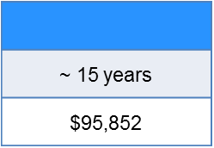
Repayment forgiveness example
~ 19 years
$116,181
20 years
$85,596
25 years
$130,021
ICR
IBR
PAYE
REPAYE
Time in Repayment
Total Paid
Total Forgiven
$0
$0
$49,021
$7,834
With PSLF
10 years
$45,252
10 years
$30,168
10 years
$30,168
10 years
$65,869
IBR
PAYE
REPAYE
ICR
ICR
Time in Repayment
Total Paid
Total Forgiven
$26,789
$54,922
$71,357
$67,523
Single dependent, AGI $40,000 with 5% annual increase
$65,000 loan debt, (23,000 sub)
5.5% Interest rate
Example provided by Dept of Ed FSA

Slide 21
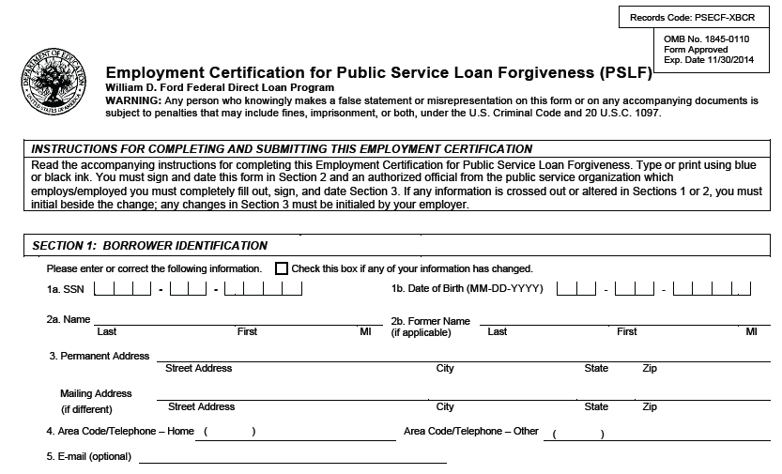
PSLF Employment Certification Form
It will take you at least 10 years to make the 120 qualifying payments necessary to receive PSLF
During this time you’ll want to track your periods of qualifying employment
The Employment Certification Form will allow you to get your employer’s certification of employment while you are still employed
Learn More: http://studentaid.ed.gov/publicservice

Slide 22
Common issues and misconceptions
Inaccurate or Missing End Date on ECF Form
Blank end date when the borrower is still employed vs. checking “still employed”
Missing required fields (such as EIN number)
Payment Tracking
Must submit an ECF for an updated qualifying payment count
Payments made to other servicers (not just FedLoan) can be counted toward PSLF
ELIGIBLE LOAN TYPES
All loans can be eligible through consolidation
EMPLOYER ELIGIBILITY
Employment for the PSLF Program is not about the specific job a borrower does, but rather, who the employer is
QUALIFYING LOAN PAYMENT PLANS
Repayment plans include all income-driven repayment plans and the 10-year Standard Repayment Plan
TRACKING PSLF PAYMENTS
Borrowers shouldn’t wait to submit an ECF until after they have made 10 years of qualifying payments

Slide 23
Interesting facts
Of borrowers who submitted at least one approved ECF:
Nearly 68% have submitted only one form;
19.4% have submitted two forms;
7.6% have submitted three forms; and
5.0% have submitted four or more forms.
For borrowers who have submitted only one ECF:
The average period of employment covered by the form is 4 years, 9 months.
The entire period of time will not necessarily provide credit towards PSLF.
The average period of time since the borrower submitted the form is more than 17 months.
Source: NSLDS as of January 2017.

Slide 24
What we learned
The first cohort occurred October 2017
66% approved, 34% denied
47% missing information on the application
32% loan eligibility issues
21% employers did not qualify
1,8864,377 Processed
Source: FedLoan Servicing

Slide 25
resources
StudentAid.gov/IDR* – IDR Info
StudentLoans.gov – IDR Application
StudentAid.gov/publicservice* – PSLF Info & Forms
StudentAid.gov/repayment-estimator – Calculator
StudentLoans.gov/repay – Find a student loan solution in 5 steps or less
http://go.usa.gov/cu8aV - Blog on choosing IDR plans
https://go.usa.gov/xnCQx – Blog on PSLF

Slide 26
Thank you for attending
Don’t forget to complete the session evaluation

Slide 27
Join us May 20 - 24, 2019 for FASFAA 2019 at the Hyatt Regency Coconut Point Resort & Spa

