Slide 1

SASFAA Update
Presenter:
Bryan Erslan
SASFAA President-Elect
Eastern Kentucky University (KY)

Slide 2

FASFAA President
Attended SASFAA Board Meetings with Voting Privileges
Updated Getting Involved PowerPoint
Reviewed and Completed State Presidents Guidebook
Highlighted State Accomplishments in Board Reports
Participated in SASFAA’s Fashion Show and After Party
Attended SASFAA’s Annual Conference
Selected Recipients of the SASFAA Making A Difference Scholarship
Voice on Behalf of FASFAA on the SASFAA Executive Board

Slide 3
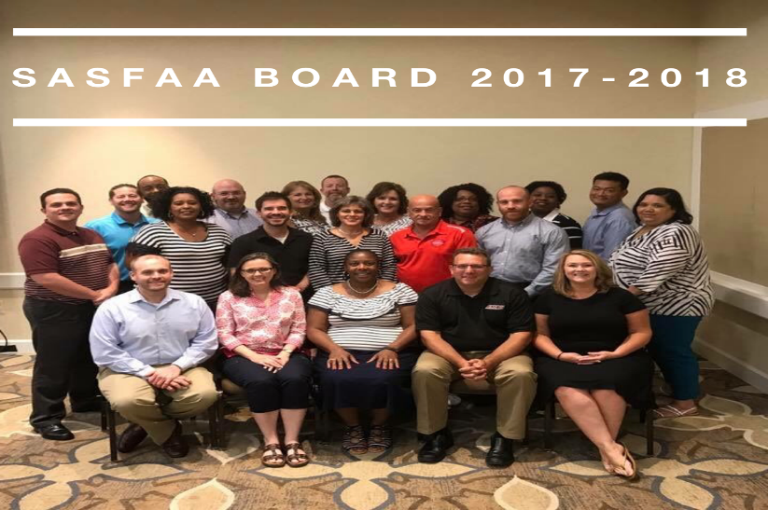
SASFAA Accomplishments for 2017-18
Conducted Several Membership Surveys
  Pre-Conference Topics
  Conference Topics
  Legislative Survey
Assessed New Aid Officer’s Workshop
Developed a 5-year Financial Plan
Inaugural Enrollment Management Forum
Developed and Awarded SASFAA Scholarship
Invited Members to Attend Congressional
Hill Visits
Live Streamed Awards Ceremony

Slide 4
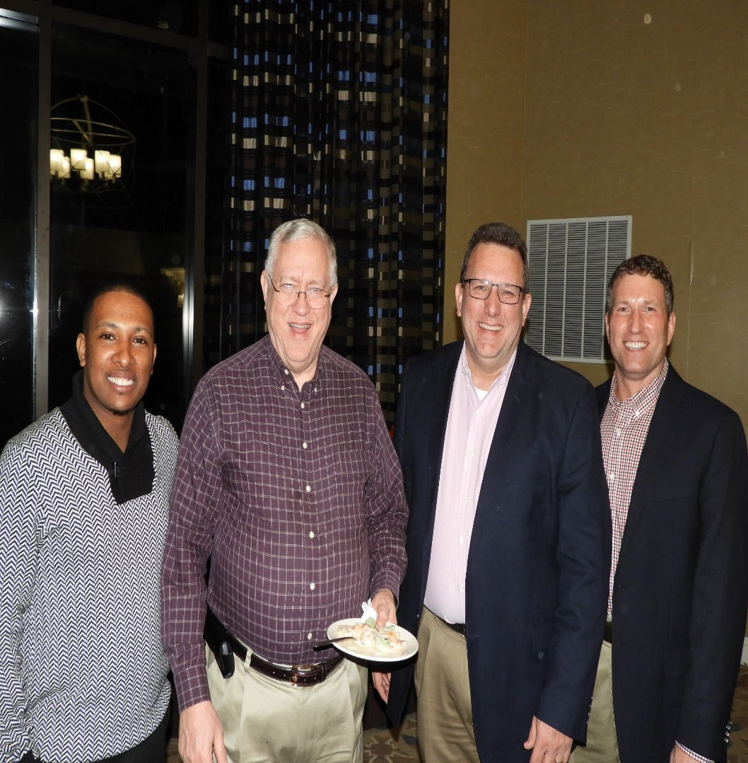
Membership Benefits
Training Sessions
Advocacy
Networking Opportunities
NASFAA Partnership

Slide 5
Training Sessions
Webinars
  Satisfactory Academic Progress – November, 2017
  Legislative Advocacy- Everything You Need to Know- November, 2017
  SAR comment Codes- February, 2018
  Professional Judgment, Best Practices and Practical Examples- March, 2018
Enrollment Management Forum
Pre-Conference Workshops
  Professional Judgement – “PJ in the Era of PPY”
  Excel for Financial Aid – “Going Beyond Worksheets”

Slide 6
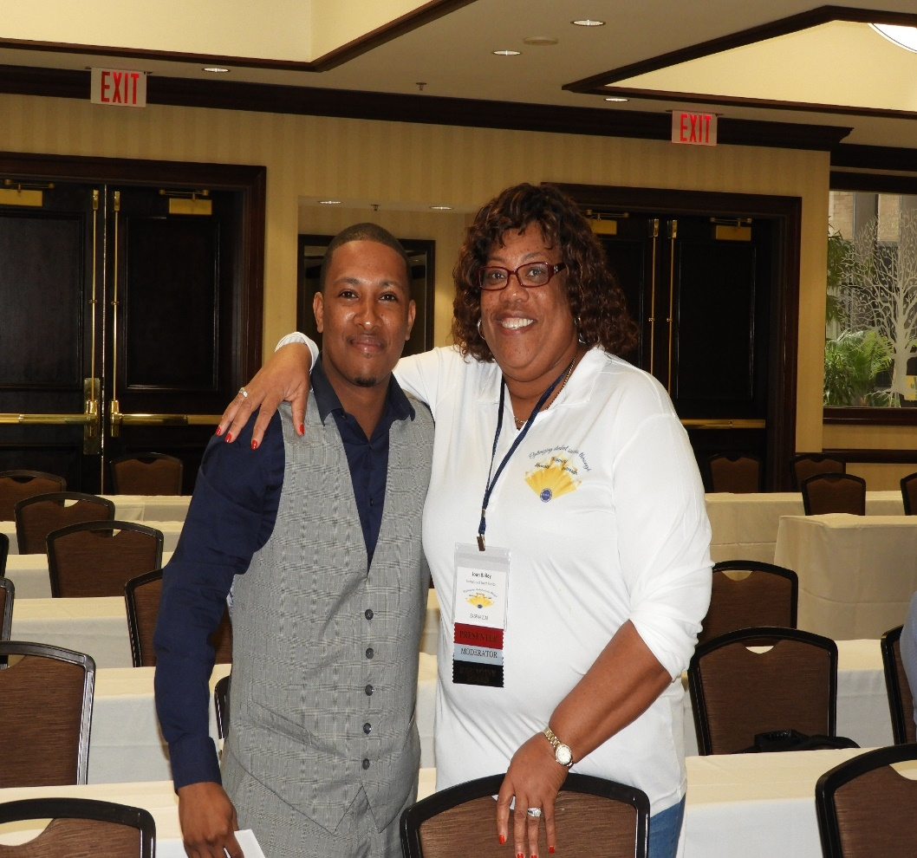
Training Sessions (Cont.)
55th Annual SASFAA Conference
February 11-14, 2018, Alexandria, VA
Over 350 attendees
33 Sponsors
General Sessions (5)
Department of Education Officials (6)
NASFAA Representatives (3)
Concurrent Sessions (Nearly 50)
Charity - The Possibilities Project
  Support Aged Out of Foster Care Youth
Keynote Speaker – A. Hasan Davis, J. D.
Regional Exchange - RMASFAA President

Slide 7
Spring Training Events
Webinars
Credit Education with Experian- April 5, 2018
“Tax Reform: How it Affects Students, Parents and Colleges” – April 19, 2018
Summer New Aid Officer’s Workshop –120 Participants(Capacity)
Unique Training Opportunity
One Week of Hands on Financial Aid Training
Designed for Relatively New Financial Aid Professionals or
Refresher for Experienced Professionals

Slide 8

Summer Training Event
Wofford College - Spartanburg, SC
June 3-8, 2018
SASFAA.org/NAOW2018

Slide 9
Advocacy
SASFAA Hill Visits
  Held during the Annual Conference
  18 SASFAA Members Participated
  5 Senators
  11 House of Representatives
NASFAA Leadership Conference
  SASFAA Members

Slide 10
Advocacy Topics and SASFAA Position
SASFAA Endorsed
Create a Super Pell
Ability to Reduce Loan Limits for Categories of Students
Elimination of Origination Fee
Eliminate Private Sector Caps and Community Service Requirements for Work-Study
SASFAA Encouraged Reconsideration of these Proposals
One Grant, One Loan
Aid as a Paycheck
Loss of Graduate Plus
Loss of Interest Subsidy

Slide 11
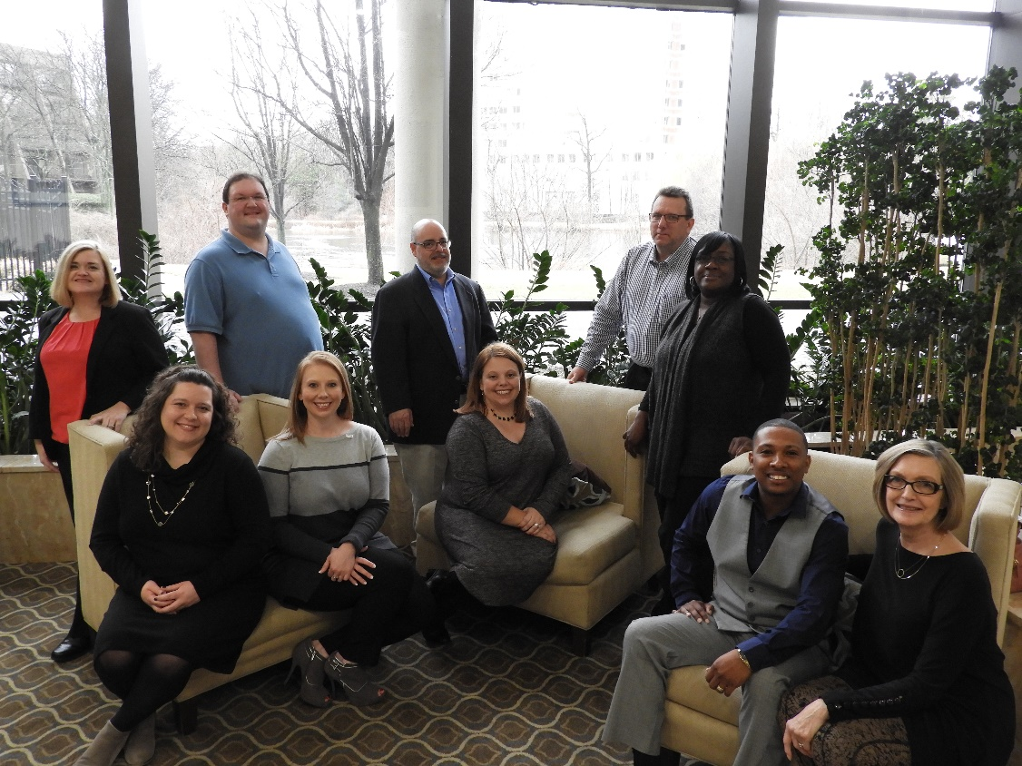
Networking Opportunities
Learn innovative techniques to administer FA
Engage with Colleagues
Chat with New Professionals
Discuss FA Changes
  Privacy and Security
  Third Party Entities New Guidance
  Verification above 30%
  Pell Increase
Develop Lifetime Friendships

Slide 12


NASFAA Partnership
Advocate Key Federal Issues 2018 NASFAA National Conference
  Department of Education Officials Location: Austin, TX
  Congressional Leaders Dates: June 24-27, 2018
    PROSPER
    Verification High Selection Rate
    Third Party Entities
Conduct Leadership Workshop/Training
Presenters for Annual Conference
Host Regional Presidents Meeting

Slide 13
SASFAA Making A Difference Scholarship
Criteria
  Undergraduate Student
  Attending a college in AL, FL, GA, KY, MS, VA, TN, SC, or NC for 2017-18
  GPA of a 2.50 or higher
  Complete SASFAA’s Making A Difference Scholarship Application
  Upload video (2-5 minutes) sharing how financial aid has made a difference in the applicant’s collegiate experience
  32 Eligible Applicants

Slide 14
Scholarship Applicants by State

Slide 15
Making A Difference Scholarship Winners

Slide 16

Florida Volunteers
David Alexander – Executive Board- State President
Joan Bailey – Global Issues, Awards, Conf., Comm. & Outreach
Daniel Barkowitz – Professional Advancement
Lisa Bascurt – Communication and Outreach
Nathan Basford – Legacy –LRP, Professional Advancement
Katie Conrad – Site Selection and Professional Advancement
Nichole Crowley – Communication and Outreach
Jeff Daniels – Professional Advancement
Arminta Johnson – Electronic Services

Slide 17
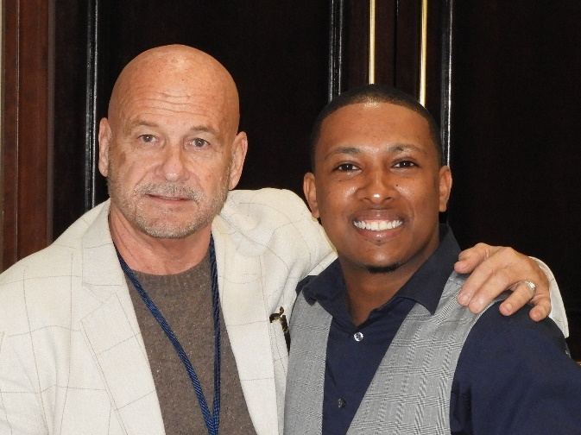
Florida Volunteers (Cont.)
Sean Johnson – Global Issues
Sara Kaufman – Professional Advancement
Donna Kolb – Budget and Finance
Wayne Kruger – Executive Board and Bylaws
Jeremiah McMahon – Electronic Services
William “Bill” Spiers – Conference, Legislative Relations,
GAP and Professional Advancement

Slide 18
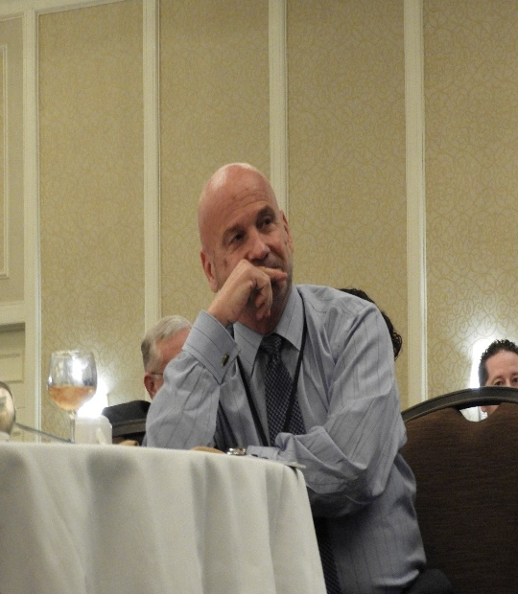
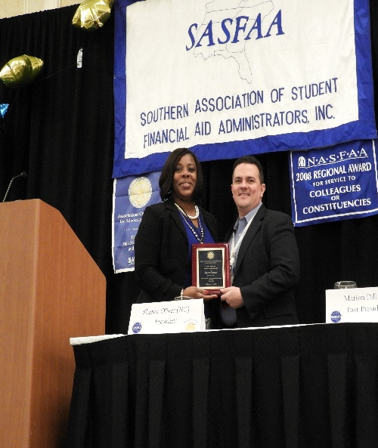
Special Recognition
SASFAA Past-Presidents
SASFAA Former Officers
  Vice President
  Treasurer
  Secretary
SASFAA Former Committee Chairs

Slide 19

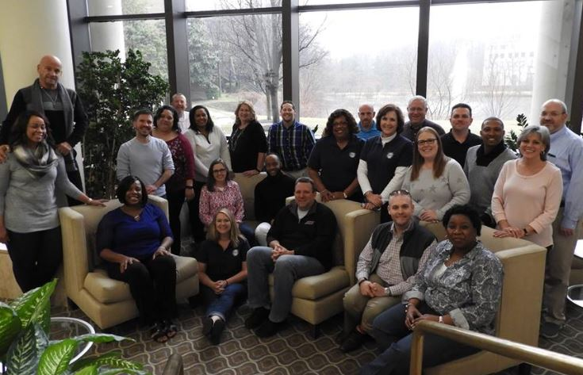
SASFAA Board Members 17-18
Elected Officers
Sharon Oliver, President (NC)
Bryan Erslan, President-Elect (KY)
Marian Dill, Past-President (TN)
Celena Tulloss, Vice-President (TN)
Wayne Kruger, Secretary (FL)
Jenelle Handcox, Treasurer (NC)

Slide 20
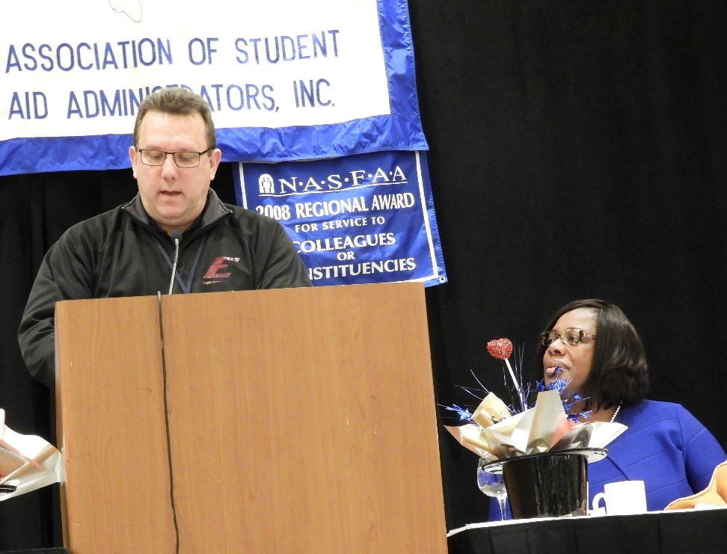
SASFAA Elected Officers
2018-19
Bryan Erslan, President (KY)
William “Bill” Spiers, President-Elect (FL)
Sharon Oliver, Past President (NC)
Celena Tulloss, Vice-President (TN)
Tarik Boyd, Secretary (VA)
Jenelle Handcox, Treasurer (NC)
Leah Louallen, Treasurer-Elect (TN)

Slide 21


Conference Sites
Atlanta, GA
  Grand Hyatt Buck Head
  February 17-20, 2019
  Conference Chair – Katie Harrison (SC)
Norfolk, VA
  Hilton Norfolk The Main
  February 9-12, 2020

Slide 22
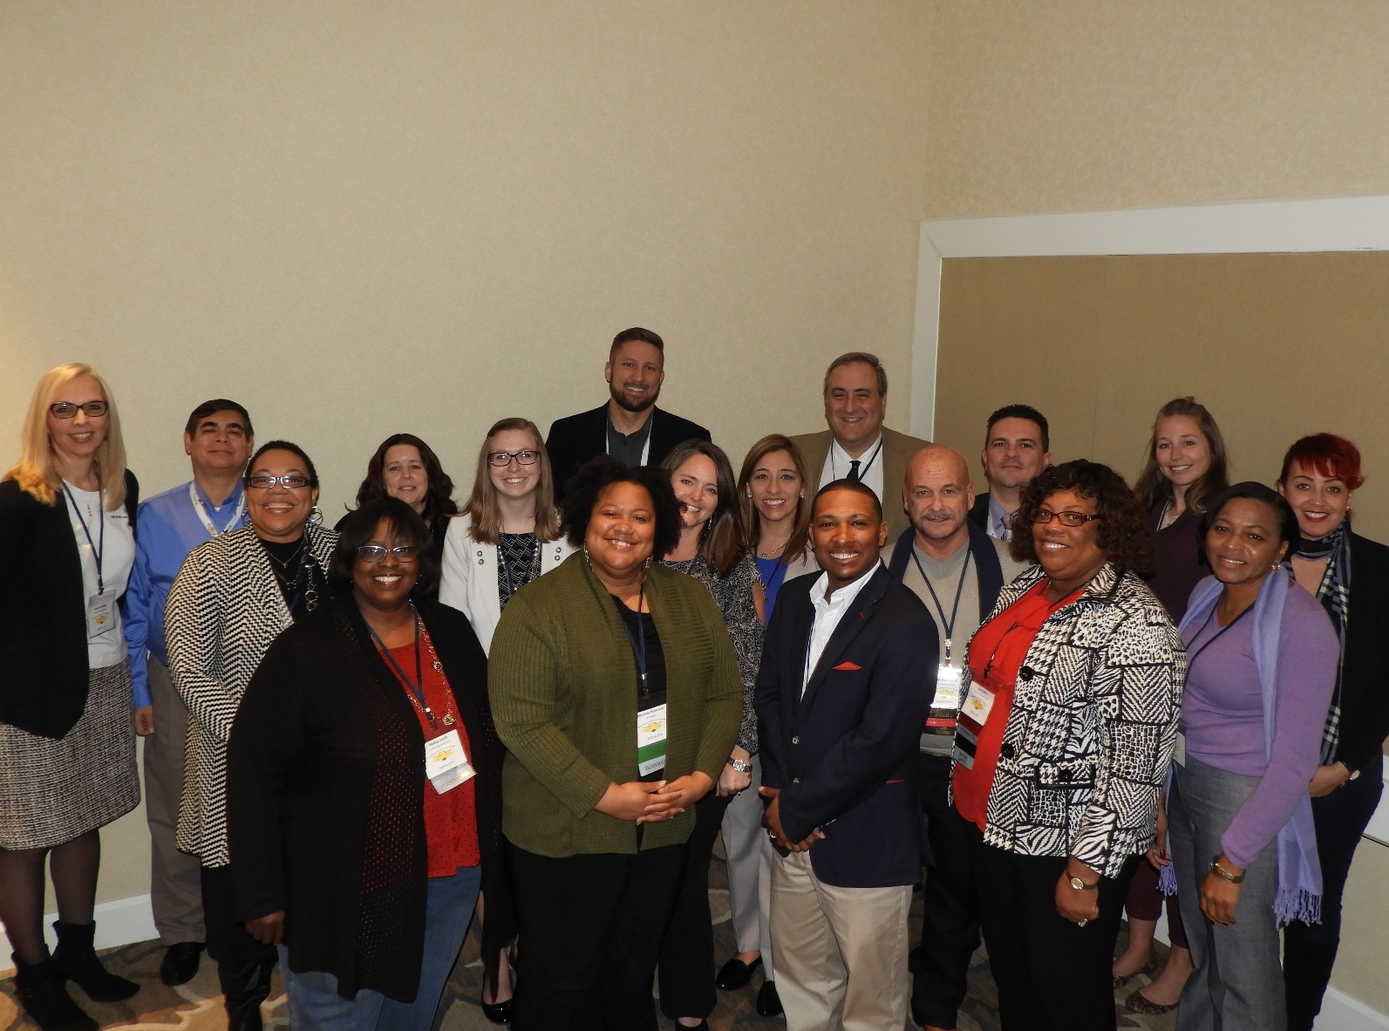
Thank You FASFAA
for
Supporting SASFAA!

Slide 23

Please VOLUNTEER
for
FASFAA & SASFAA
2018-19

