Slide 1
KINDness is Professional Judgement (and Verification is Not… PJ) Daniel T. Barkowitz Wedensday, June 1, 2022

Slide 2
Disclaimer
Members of the Association recognize that one of the purposes of the Association is to provide training and informational services to its members through training conferences and periodic written material. While the Association shall utilize its best efforts to provide its members with the most current information available, there can be no assurances or warranty that its interpretation of any rule, regulation or statue will be in conformance with any present or future interpretation of such rule, regulation or statute by any appropriate governmental authority. Accordingly, each member shall hold the Association harmless from any claims, damages, or liability resulting from such member’s use of any information, data, or interpretations as provided to such members by the Association.

Slide 3
KINDness is Professional Judgment… (And Verification is not… PJ)
Daniel Barkowitz
Assistant VP of Financial Aid & Veterans Affairs
Valencia College

Slide 4
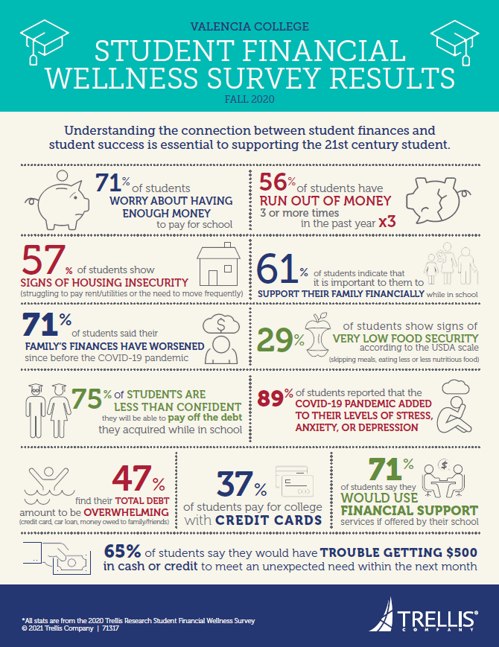
Why this review?
Fundamental principles:
Hoping to make PJ a welcoming and manageable process.
Noticed a trend in asking for lots of documentation and slowing down the process.
Students are struggling
Trellis survey (2020) results
Numbers of PJ requests have doubled this year

Slide 5
KINDness
Keep the intention of PJ in mind
Independent judgment means independence
No need to Verify when doing a PJ
Do what is right in each case.

Slide 6
Keep the intention of PJ in mind…
Authorized by HEA Sec. 479A(a):
“IN GENERAL—Nothing in this part shall be interpreted as limiting the authority of the financial aid administrator, on the basis of adequate documentation, to make adjustments on a case-by-case basis to the cost of attendance or the values of the data items required to calculate the expected student or parent contribution (or both) to allow for treatment of an individual eligible applicant with special circumstances.”
“Nothing… limit(s) the authority…”
“…on the basis of adequate documentation…”
“…individual eligible applicant with special circumstances.”
PJ is a muscle that must be developed and used to master.

Slide 7
Independent Judgment means Independence
Your professional judgment is a form of independence and your independence is not auditable / cannot be questioned.
Auditors may request to see your documentation and notes, but they cannot disagree with your judgment AS LONG AS:
Case-by-case
Whatever you consider adequate documentation

Slide 8
No Need to Verify when Doing a PJ
Professional Judgment IS NOT verification!
If a student is selected for Verification, must verify before completing PJ.
Documentation needs and standards are different between PJ and Verification.
Adequate documentation is your call, not the Department’s.
Remember for 2021-22, PPY is 2019, but PJ could be based on 2020, 2021, 2021-2022, or any 12 month period.

Slide 9
Do What is Right in Each Case
Take each case on its own merits.
Try to remove your own bias / step into your student’s (or their parents’) shoes.
Confront your own ideas about choice, and whether the reason matters.
Understand the context.

Slide 10
Case #1
Separation PJ request
Student filed 2019 taxes as married, but as of FAFSA filing date (3/23/2021) reported marital status as separated (as of 1/2019).
Is this a PJ?
No, it is a correction: “If the student or her parent was married in 2018 but is separated, divorced, or widowed when the application is signed, the student or parent excludes the income and assets for that spouse even though the information may be on the 2018 tax forms. “ – FSA Handbook
Student however provided 2019 tax returns in her appeal. So if using 2019 tax information to update form, it would be a PJ.
If she had become separated after the filing date of the FAFSA, then it would have been a PJ request.
Is this a verification?
Not selected for verification, even though she used only her income and did not use DRT.

Slide 11
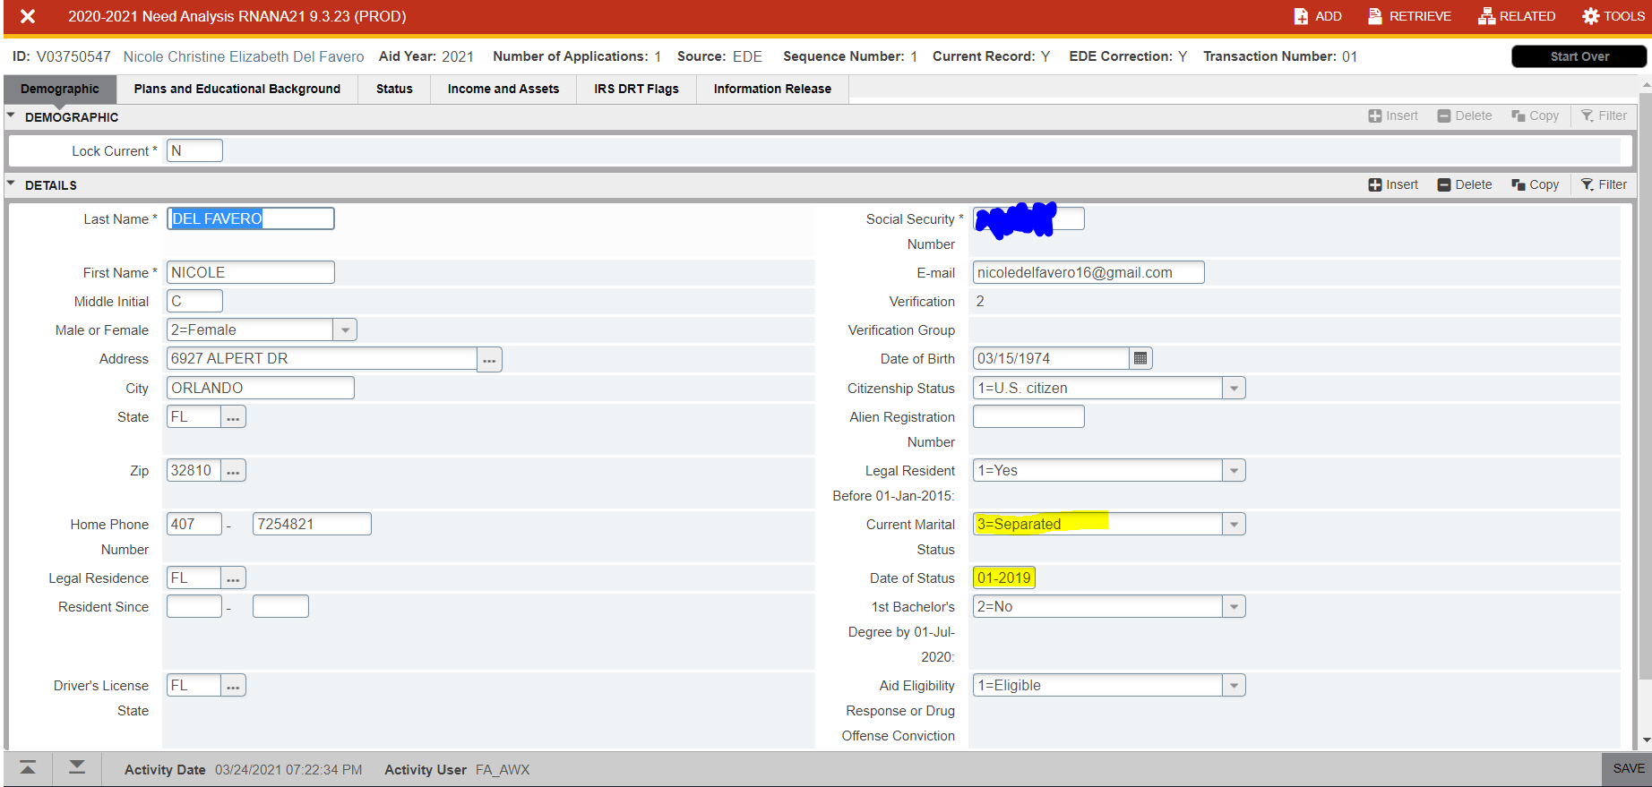
Separation

Slide 12
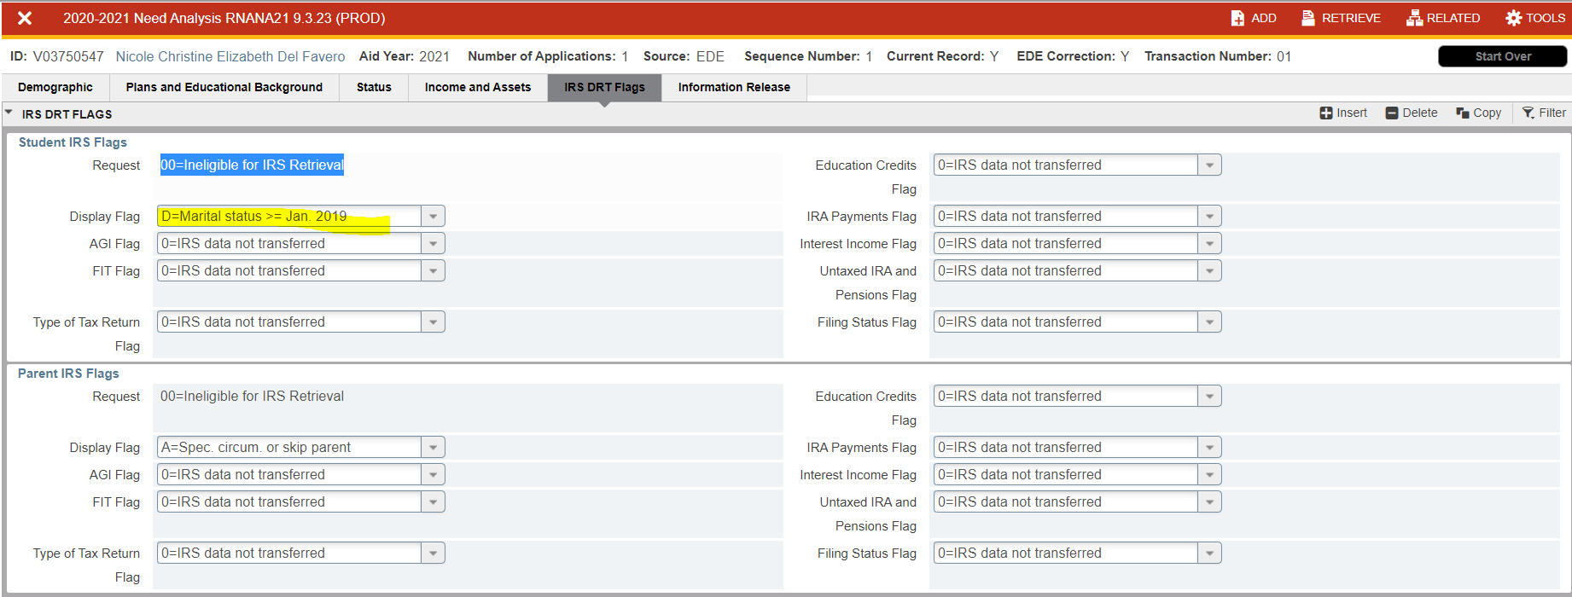

Slide 13
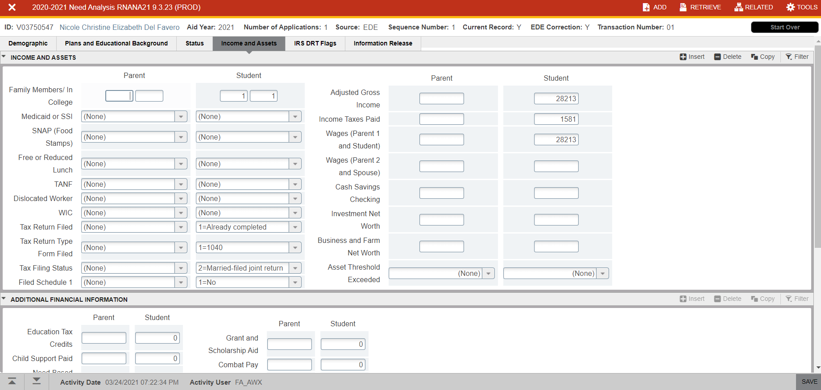

Slide 14
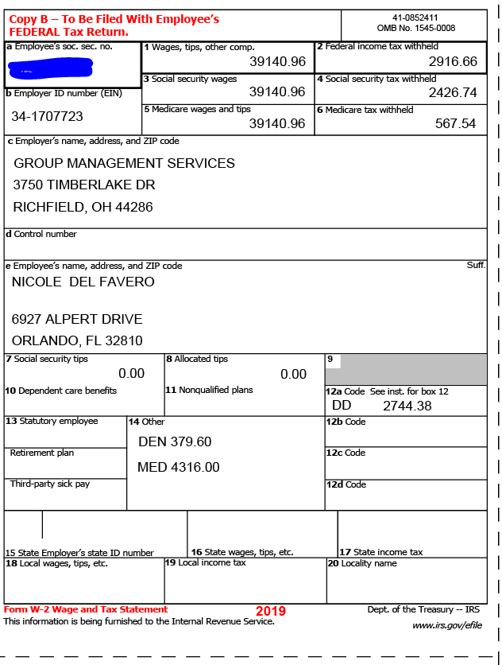
PJ Information
PJ documentation provided shows higher income for student in 2019 ($39,141) vs. 2018 on FAFSA ($28,213).
Leaving as is since this is most generous treatment, and noting file.
Will reach out to student to explain.

Slide 16
Case 2
Unemployment – Income reduction
Student is reporting unemployment compensation in 2020.
Is this a PJ?
Yes, student would like us to use 2020 income instead of 2018 or 2019.
Is this a verification?
Yes. Student was selected for verification.
Tax information transferred using DRT.

Slide 17
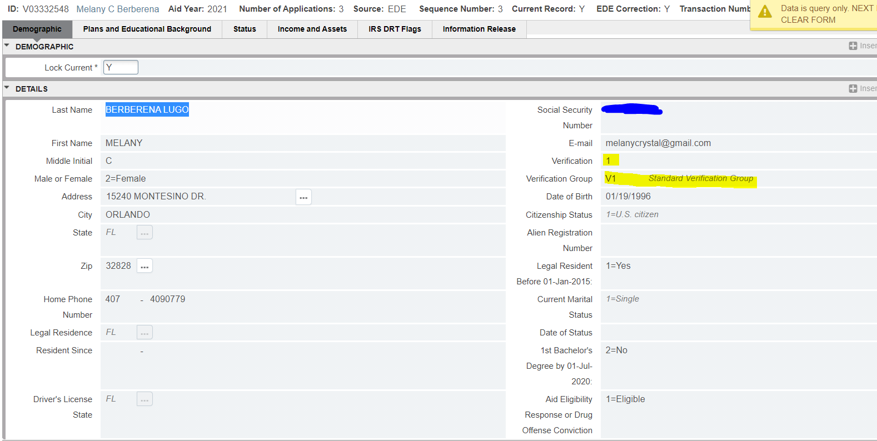

Slide 19
Case 2
What do we need?
Required – filing for unemployment, letter of explanation from student
Optional (depending on situation) – tax information for completed year, letter from employer, final paycheck, etc.
Not needed – 2018 tax return. Student was selected for verification but used DRT!
Are PJ requests “tedious”?

Slide 20
Documents Received
Originally:
2020 Earnings from Unemployment – 1099-G
Supplement:
Letter of separation
2018 Federal Tax Return (why?)
2020 Federal Tax Return
PJ Form

Slide 21
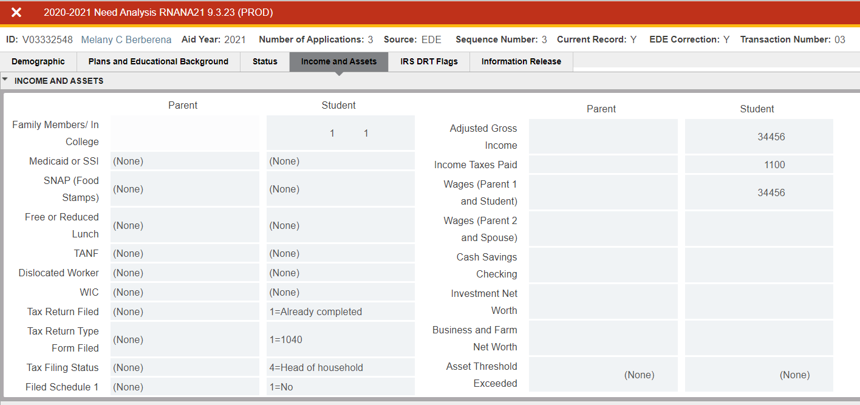
Current income

Slide 22
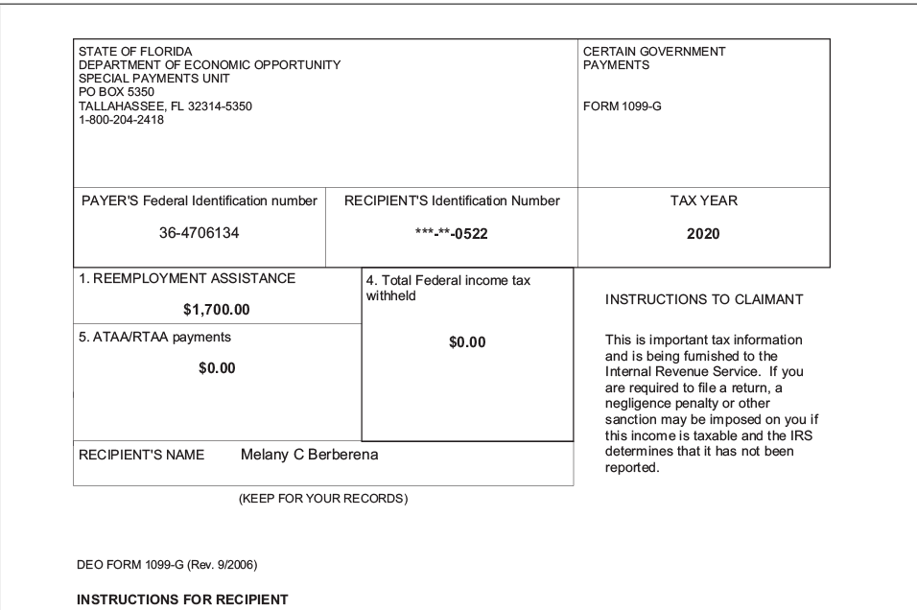
1099-G

Slide 23
Student income verified
Options:
0 out student income. Student received unemployment in 2020.
Use 2020 income. Student provided 2020 tax return. It is not signed, but that is OK (not a verification item).
Use a 12 month income period of your choice. Separation date was September 4, 2020. Do you ask student to estimate an income year of July 1, 2020 to June 30, 2021.
As long as the year ends by June 30, 2021!
September 3, 2021 would be after the end of the award year (2020-21).
Recommendation:
I would do what is most generous. 0 out income.

Slide 24
What do you mean by 12 month period?
Imagine the termination date was 4/1/2020 (no unemployment income, just changed jobs and lost their ½ their income). And we are looking at the 2020-21 academic year (FAFSA based on 2018 income). What are my income options?
January to December 2020 income (example: tax return OR paystub OR projection)
Benefit is you can use taxes to document depending on the timing
April 1, 2020 to March 31, 2021 year (example: new job - paystub/W2 for 2020 and paystub closest to 3/31/21 OR projection)
Benefit is reflect the lower income for 12 months. Is there severance?
July 1, 2020 to June 30, 2021 year (example: projection)
Benefit is this corresponds to when I am in school (imagine the student is moving to a part-time schedule when school starts)

Slide 25
Let’s see what the EFC would be if we used the 2020 actual income (RNAPR21)

Slide 26
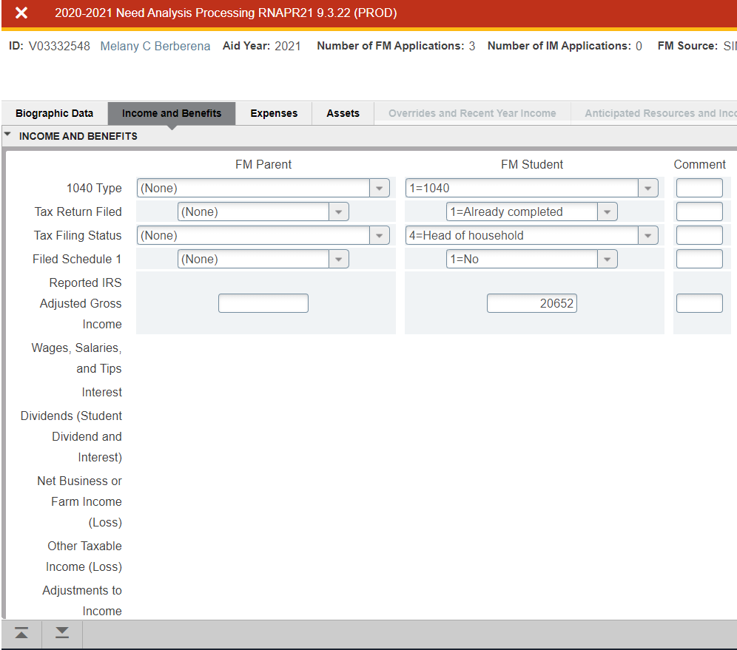
Must unlock record if verified, but DO NOT SAVE changes

Slide 27
Calculate Need – DO NOT CLICK SAVE!!!!!!!!!

Slide 28
Would provide Pell

Slide 29
Instead, we are going to 0 income

Slide 30
Make SURE to document PJ used

Slide 31
Close out the record (RHACOMM, RRAAREQ, RUAMAIL)

Slide 32
Case 3
Student left his job in Naples, FL in January 2021.
Request is for PJ adjustment due to reduction in income.
Is this a PJ?
Yes, student is experiencing loss of income and asking for review.
Is this a verification?
Was selected for verification and already was verified. No need to redo verification.
Did not use DRT (looked at it, but did not transfer information).

Slide 33
Documents provided
Required (in this case):
PJ Form
Something to show the income (in this case using the letter of explanation)
Optional:
Letter of separation from the company
2020 W-2
Not needed
2018 tax return (again)

Slide 34
What 12 month period am I using?
Can I use 2020 income?
No. Income change happened in 2021.
Can I use 2021 income?
No. If I do, it will cross into 2021-22 school year.
For student benefit, best period is July 1, 2020 to June 30, 2021
WE HAVE TO PROJECT!!!!!!
Does the reason matter?
Student says he left based on termination (he moved)
Employer says he left voluntarily
No unemployment documentation, but he was not eligible.

Slide 35
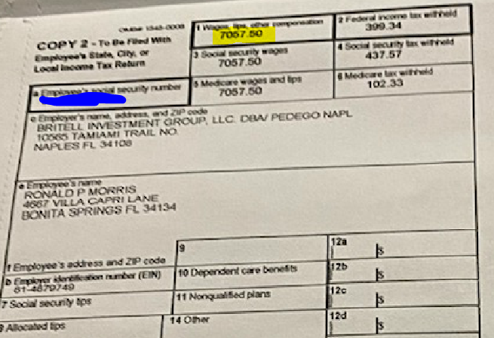
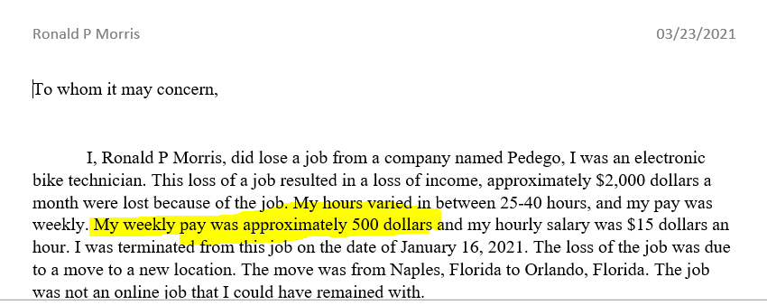
Let’s project income
July 1, 2020 to January 16, 2021 – we will use his stated income.
He states $500/week. W-2 (if we assume 52 weeks), shows $135.72 per week. Calculation of hourly with average hours (32.5 hrs per week X $15 per hour) is $487.50 per week).
Income for 2018 was $25,000

Slide 36
Projection of income
July 1 to December 31, 2020, using $500 per week.
$500 x 52 weeks divided by 2 = $13,000
January 1 to January 16, 2021, using $500 per week.
$500 x 2 weeks = $1000
January 17 to June 30, 2021, using $0
Total income for 12 months - $14,000.

Slide 37
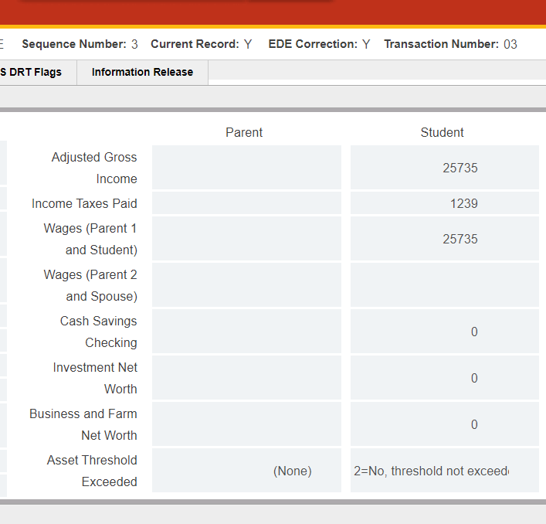
Projection of taxes using percentage method
2018 income was $25,735
2018 taxes was $1,239
Taxation percentage = 1239/25735 = 4.8%
Income we are using is $14,000
Applying 4.8% tax percentage = 14000 x 4.8% = 672 for Federal Taxes paid

Slide 38
Make the change!

Slide 39
Document your changes
Calculate Need / run Pell
Add RHACOMM
Add PJ indicator
Move PJEVAL to V
Add RUAMAIL

Slide 40
Case 4
Medical expenses. Student provides information about dental expenses.
Is this a PJ?
Yes, since student is showing 2020 medical expenses, can use them (do not need to collect 2020 taxes)
No! Because the student already has a $0 EFC (wah wah).
Is this a verification?
No. Student is not selected for verification
Since this is a $0 EFC, can we go home now?
No! We are going to show how we would treat it if we did have a EFC.

Slide 41
Medical expenses
Paid expenses or billed expenses?
We use paid expenses since this really represents the out of pocket expenses.
We do not currently use the billed amount.
Remember that 11% of the IPA (Income Protection Allowance) is already set up to cover medical expenses.
Just because we are using 2020 medical expenses does not mean that we need to use 2020 income.

Slide 42
Paid expenses vs billed expenses
Expense name | Paid amount | Billed amount
Endotherapy molar (Darren Sinopoli) | $300 | $764.50
Retreat – previous RTC | $0 | $1,348.20
Shannon Orthodontics | $500 | $5,200
Kasem Dental (various dates) | $544.50 | $544.50
Various collection accounts | $0 | $2,268
TOTALS | $1,344.50 | $10,125.20

Slide 43
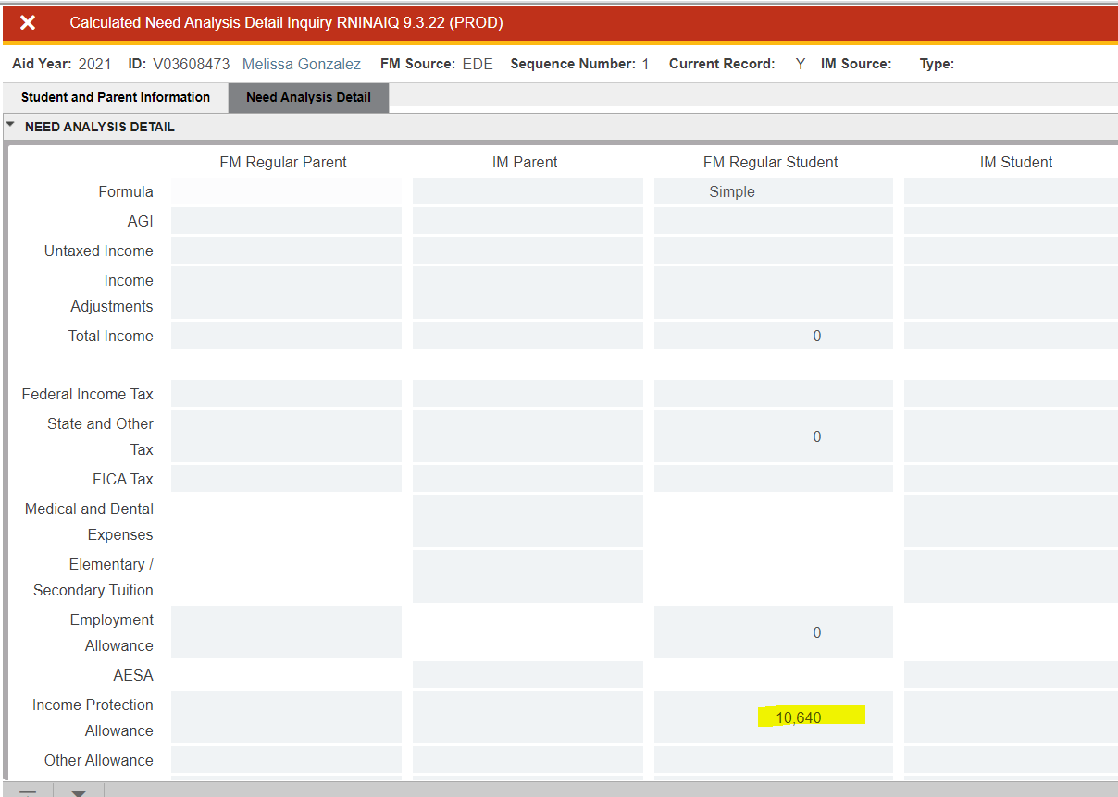
Where do I find the IPA (other than the bar)?
RNINAIQ
11% of $10,640 = $1,170.40.
Paid expenses were $1344.50 so that is greater than the 11% of the IPA. Amount to add is the difference between $1,344.50 - $1,170.40 = $174.10.
And we would place that difference on Fed Taxes Paid (DO NOT reduce income).
IF the family had paid expenses, then you would use difference between $10,125.20 and $1,170.40.
And we would place that difference on Fed Taxes Paid (DO NOT reduce income).

Slide 44
Fed guidance on PJ in an era of COVID-19
April 3, 2020 – UPDATED Guidance for interruptions of study related to Coronavirus (COVID-19))
“Section 479A of the HEA gives an institution’s financial aid administrator (FAA) the authority to use professional judgment to make adjustments on a case-by-case basis to the cost of attendance or to the values of the items used in calculating the EFC to reflect a student’s special circumstances. The Department encourages FAAs to use professional judgment to reflect more accurately the financial need of students and families affected by the COVID-19 pandemic. In making case-by-case determinations, the FAA must obtain and retain in the affected student’s file documents that supporting and substantiating the reasons for any adjustment.
Institutions must make and document professional judgment determinations on a case-by-case basis without regard to how broadly an event may affect its student population. The use of professional judgment in the Federal Methodology need analysis is discussed in the Federal Student Aid Handbook. Additionally, FAAs must report to the Central Processing System (CPS) as a “correction” transaction and with the “PJ” indicator any professional judgment decisions that affect a student’s eligibility for a Federal Pell Grant.”

Slide 45
Fed guidance on PJ in an era of COVID-19 (cont.)
Section 479A is amended by the Consolidated Appropriations Act of 2021 (aka CRRSAA):
(f) Special Rule Regarding Professional Judgment During a Disaster, Emergency, or Economic Downturn.
(1) In general.--For the purposes of making a professional judgment under this section, financial aid administrators may, during a qualifying emergency-- (A) determine that the income earned from work for an applicant is zero, if the applicant can provide paper or electronic documentation of receipt of unemployment benefits or confirmation that an application for unemployment benefits was submitted; and (B) make additional appropriate adjustments to the income earned from work for a student, parent, or spouse, as applicable, based on the totality of the family's situation, including consideration of unemployment benefits.

Slide 46
Business Partners

Slide 47
Questions?

