Slide 1
Inclusion, Diversity, Equity, and Access
Kamia “Mia” Mwango Wed. June 1, 2022

Slide 2
Disclaimer
Members of the Association recognize that one of the purposes of the Association is to provide training and informational services to its members through training conferences and periodic written material. While the Association shall utilize its best efforts to provide its members with the most current information available, there can be no assurances or warranty that its interpretation of any rule, regulation or statue will be in conformance with any present or future interpretation of such rule, regulation or statute by any appropriate governmental authority. Accordingly, each member shall hold the Association harmless from any claims, damages, or liability resulting from such member’s use of any information, data, or interpretations as provided to such members by the Association.

Slide 3
Inclusion, Diversity, Equity, and Access

Slide 4
Session Objectives
Define
Explore
Discuss
Continue…

Slide 5
Inclusion
A sense of belonging. A process that engages each individual and makes people feel valued as being essential to the success of an organization
Diversity
Any dimension that can be used to differentiate groups and people from one another
Equity
Creating fairness by providing people with individualized resources, treatment, and support in order to compensate for differences between individuals
Access
Equitable access to services, equipment, and accommodations necessary for productivity in the workplace
IDEA
Inclusion
Diversity
Equity
Access

Slide 6
Inclusion
A sense of belonging. A process that engages each individual and makes people feel valued as being essential to the success of an organization

Slide 7
Diversity
Any dimension that can be used to differentiate groups and people from one another

Slide 8
Equity
Creating fairness by providing people with individualized resources, treatment, and support in order to compensate for differences between individuals

Slide 9
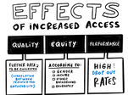
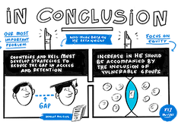
Access
Equitable access to services, equipment, and accommodations necessary for productivity in the workplace
www.iesalc.unesco.org

Slide 10
Why do we need IDEA?
Better decision-making
Expanded creativity and problem-solving
Increased employee satisfaction and retention
Improved employee engagement and performance
Lifts organizational performance

Slide 11
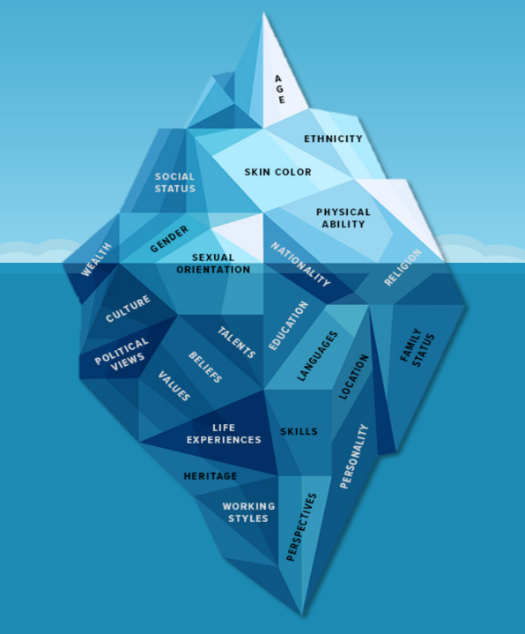
Your Iceberg
What does your iceberg look like?
Discussion
Which of your dimensions are at the tip of your iceberg?
Which of your dimensions are kept below your waterline?
Where do you set your waterline to feel safe?
How does this change in different contexts?

Slide 12
Inclusive Leadership
Unaware
Active
Advocate
Aware
Intent vs impact
Humility
‘Splaining
Common deflections
Biases
Types
Identify personal biases
Overcome
Finding support
Understand privilege
Stories of origin
Intersectional allyship
Interrupting bias
Mentoring
Centering underrepresented colleagues
Get feedback
Identify other areas to work on
Self-care
Understand and articulate why changes are beneficial to the progress of the organization

Slide 13
Discussion

Slide 14
What can we do?
As a supervisor, you are in a unique position to promote, engage, and encourage an environment that values inclusion, diversity, equity, and access
Inclusive Leadership
Visible commitment
Humility*
Awareness of bias**
Curiosity about others*
Cultural intelligence
Effective collaboration

Slide 15
Discussion

Slide 16
Biases
A tendency, inclination, prejudice toward or against something or someone
Implicit vs cognitive
What biases can people have?
Halo effect
Anchoring
Confirmation bias
Fundamental attribution error
Groupthink
Resource alert!!!! Harvard Implicit Bias Test: https://resources.lmu.edu/dei/initiativesprograms/implicitbiasinitiative/whatisimplicitbias/testyourimplicitbias-implicitassociationtestiat/

Slide 17
Discussion

Slide 18
Interrupting Biases
Picking Your People
Establish objective criteria, define culture fit, demand accountability
Managing Day-to-Day
Set up rotation for office “housework”, no volunteers
Mindfully design and assign people to high-value projects
Developing Your Team
Clarify evaluation criteria
Insist on a diverse pool
Limit referral hiring
Interview w/skills-based questions
Acknowledge the importance of lower-profile contributions
Respond to double standards, stereotyping
Schedule meetings inclusively
Equalize access proactively
Separate performance from potential and personality from skill sets
Level the playing field with respect to self-promotion
Explain how training, promotion, and pay decisions will be made, and follow those rules
Ask people to weigh in

Slide 19
Discussion

Slide 20
Remember…
Ongoing process
May go back to biases in times of stress
Think it out before reacting
Keep learning
Be open-minded
Set boundaries

Slide 21
Discussion

Slide 22
Think about the term, “Lift as you climb”? What can a leader do to accomplish this?
Psychological safety is a belief that one will not be punished or humiliated for speaking up with ideas, questions, concerns, or mistakes (A. Edminson, professor at Harvard Business School). What are your experiences with this? How can one contribute to creating this safety in the workplace as a leader?
Have you witnessed biases in the workplace? Do you recognize biases you may hold personally and professionally?
We lie on different areas of the inclusive leader spectrum, depending on the focus. What areas can you find yourself further along on the spectrum. What areas might you be able to improve upon?

Slide 23
Discussion

Slide 24
Leadership Competencies
Practical ways to promote IDEA and effectively lead organizational transformation

Slide 25
Organizational Leadership
Leading teams (formally or informally)
Serving as a role model & coach
Efforts that improve the organization and produces results

Slide 26
Vision
Creates a shared vision of the organization; promotes wide ownership.
Creates a shared vision of the organization’s future.
Promotes wide ownership of the organization’s vision.
Understands and analyzes the broad perspective or big picture.

Slide 27
Creative Thinking
Develops new insights and novel solutions; embraces innovations and fosters innovative thinking in others.
Develops insights into situations and applies innovative solutions to make improvements.
Creates an environment that encourages employees to be inventive, imaginative, and resourceful.
Stimulates nontraditional approaches to tasks and assignments.
Synthesizes diverse information, suggestions, and solutions into innovative approaches.

Slide 28
External Awareness
Stays informed on policies, priorities, trends and special interests and uses this information in making decisions; considers external impact of statements, decisions, and actions.
Keeps up-to-date with laws, regulations, policies, procedures, trends, and developments that may affect areas of responsibilities.
Considers the external impact of statements or actions.
Reviews and makes recommendations for revisions of policies, procedures, regulations, and laws affecting area of responsibility.
Considers non-technical factors, such as political and socioeconomic developments, the media, and special interests in decision-making.
Implements administrative priorities and initiatives in accomplishing organizational goals and activities.

Slide 29
Diverse Workforce
Recognizes the value of cultural, ethnic, gender, and other individual difference; provides employment and development opportunities for a diverse workforce.
Recognizes the value of cultural, ethnic, gender, and other individual differences at all levels of the organization.
Promotes inclusivity.
Provides employment and development opportunities for a diverse workforce.
Increases the sensitivity of others to diversity issues through formal and informal means.

Slide 30
Human Performance Management
Ensures effective systems for employee selection, placement, development, performance appraisal, recognition, and disciplinary action. Promotes positive labor relations and employee well-being.
Plans for needed or mandated changes in the size and composition of staff.
Takes an active role in recruiting and retaining staff.
Exercises judgment within regulations when selecting for reassignment, promotions, and other routine employee actions.
Determines needs and provides opportunities for employee orientation as well as for career development through counseling and training.
Identifies performance expectations, assesses employee performance, gives timely feedback, and conducts formal performance appraisals.
Recognizes and rewards performance based on standards and organizational goals.
Takes appropriate corrective or disciplinary actions.
Uses HR practices that promote good labor management and employee relations.
Supports programs and activities aimed at employee well-being such as safety, health, and family life.

Slide 31
Planning and Evaluation
Establishes policies, guidelines, plans, priorities; plans and coordinates with others; aligns required resources; monitors progress and evaluates outcomes; improves organizational efficiency and effectiveness.
Establishes policies or guidelines for the organization or program area.
Sets priorities and coordinates work of the staff to meet goals.
Ensures that activities, services, and products meet organizational mission, management policies, and customer needs.
Identifies, obtains, and uses the resources required to meet objectives,
Coordinates with other parts of the organization to accomplish goals.
Identifies how organizational or program results will be measured.
Monitors programs and activities to assure that discrepancies are identified and corrected, as necessary.
Participates in the evaluation of program and project accomplishments.
Contributes to improving organizational and program efficiency and effectiveness.

Slide 32
Financial Management and Budgeting
Understands budget process; prepares and justifies budgets; monitors expenses; manages profit / loss ratios as appropriate.
Prepares budgets for own organization, projects, and activities.
Applies an understanding of the roles and functions of diverse groups in the budget process.
Explains or justifies budget requests.
Tracks expenses and monitors budget to ensure cost-effective resource management.
Oversees or participates in the procurement of equipment, facilities, supplies, and services.
Monitors work done by contractors or grantees.
Fosters an environment where cost benefit ratios are continually improved.

Slide 33
Technology Management
Stays informed about new technology; applies new technologies to organizational needs; ensures staff is trained and able to use technology required for the job.
Encourages staff to stay current and informed about technological changes, scientific research, and automation.
Apples evolving technologies and methodologies to organizational needs.
Makes certain that staff are trained and capable in using new technology.

Slide 34
Strategic Thinking and Planning
Advocates and participates in strategic planning to define and achieve organizational goals.
Thinks strategically as well as long term.
Develops and adjusts strategic and other long-term plans.
Develops and implements clearly defined goals and objectives based on the organization’s mission and overall strategic plan.
Adjusts strategic plans, goals, and objectives based on changes in environment, policy, customer feedback, and other new information.

Slide 35
Management Controls
Ensures the integrity of the organization’s processes; promotes ethical and effective practices.
Exercises necessary management controls to ensure the integrity of the organization’s processes.
Promotes and models ethical and effective practices in all organizational activities.

Slide 36
Wrapping up…
We’re almost there!

Slide 37
Inclusion
A sense of belonging. A process that engages each individual and makes people feel valued as being essential to the success of an organization
Diversity
Any dimension that can be used to differentiate groups and people from one another
Equity
Creating fairness by providing people with individualized resources, treatment, and support in order to compensate for differences between individuals
Access
Equitable access to services, equipment, and accommodations necessary for productivity in the workplace
IDEA
Inclusion
Diversity
Equity
Access

Slide 38
Why do we need IDEA?
Better decision-making
Expanded creativity and problem-solving
Increased employee satisfaction and retention
Improved employee engagement and performance
Lifts organizational performance

Slide 39
Leading Change
Leads organizational transformation and change efforts; champions organizational change.
Initiates and facilitates cultural and technological change in the organization; acts as a change agent.
Respects and adapts to change.
Creates an environment that empowers and supports others in a change process or changing organization.

Slide 40
Business Partners

Slide 41
Questions/Comments?

