Slide 1
Elevating Onboarding: Fostering Connection and Competence in a Remote Work Environment
Egan Hanson, Global Head of Compliance and Institutional Effectiveness
Schiller International University
Tamika Martin, Director of Financial Aid Services
Valencia College
Shareece Moore, Assistant Director of Financial Aid
Valencia College

Slide 2
Onboarding Staff
Employers are becoming more innovative in their approach to onboarding staff during remote work periods.
The traditional, in-person onboarding processes have been adapted and transformed to fit the remote work environment, ensuring that new employees are integrated effectively into the office.

Slide 3
Bio - Egan Hanson
Egan currently serves as the Global Head of Compliance and Institutional Effectiveness for Schiller International University. In his role he is based out of the institution’s Tampa, Florida location and is also responsible for his areas of operation at the school’s 3 campuses in Europe. With oversight of the Financial Aid functions, Egan also manages the institution’s compliance and institutional effectiveness plans as well as its accreditation.
Egan has 20 years of experience in financial aid and prior to being appointed to his current role, he has held various other positions such as financial aid planner, business office representative, regulatory affairs analyst, financial aid manager, financial aid director, and Vice President of Financial Aid. In addition to his professional experience, he has served on the FASFAA Board the past two years, currently as the Federal and State Legislative Chair and previously as the Global Issues Chair.

Slide 4
Schiller International University
Locations
Tampa, FL
Heidelberg, Germany
Paris, France
Madrid, Spain
4-year, Private for-Profit Institution
Enrollment:
Staff Size:
Remote Work Arrangements:

Slide 5
Bio – Tamika Martin
Tamika Martin is a financial aid administrator with over two decades of financial experience which spans a career at Daytona State College, Seminole State College, and presently, Valencia College. In her current role, she serves as Director of Financial Aid Services at Valencia College, which has an enrollment of over 70, 000 students across 11 locations. As Director of Financial Aid Services, this work entails leading a team of over twenty in all aspects of FAFSA completion and outreach, customer service, updates on federal rules and regulations to the team college-wide and promoting professional development for all.
She is passionate about finding ways to streamline and automate processes by working smarter, not harder, and creating access for all students wanting to obtain a college degree or certificate. When she is not thinking of ways to simplify processes, build partnerships throughout the college, and empower team members, she enjoys lazy days by the pool spent with her “circus” of a family. She has three children, 30, 26, and 11 as well as a 4-year-old granddaughter who lovingly refers to her as “Honey”.

Slide 6
Bio - Shareece Moore
Shareece is a seasoned professional in the realm of financial aid, currently serving as the Assistant Director for Valencia College’s West Region, encompassing the innovative Valencia-UCF Downtown Campus, where cutting-edge education meets urban vibrancy. With a rich background spanning over 14 years, Shareece’s expertise began in a proprietary college, managing clock hour programs. Her career trajectory saw a significant transition to state college, where she was the Scholarship Coordinator at Lake Sumter State College, overseeing athletic, merit & high school scholarships while fostering partnerships with the Foundations department.
During her nearly decade-long tenure at Valencia College, Shareece has been instrumental in the implementation of pivotal initiatives such as Banner Back to Basics and Campus Logic functions. She manages a dynamic hybrid staff of 14, including work-study students, ensuring seamless operations and student support.
In her previous capacities, Shareece’s meticulous oversight of the Return of Title IV (R2T4) processes, alongside her management of the Financial Literacy Program contributed to her success in her current role. Her multifaceted role also includes a variety of critical responsibilities that contribute to the college’s success and the financial well-being of its students.
Her motto is” Let’s change lives one student at a time.”

Slide 7
Valencia College
Location:
Orlando
11 Campuses
2-year, state college that offers 6 Bachelor of Science Degrees and 100 certificates
Enrollment- 70,906
Staff Size- 47
Remote Work Arrangements: Frontline Staff- Hybrid Processing Staff- Fully Remote

Slide 10
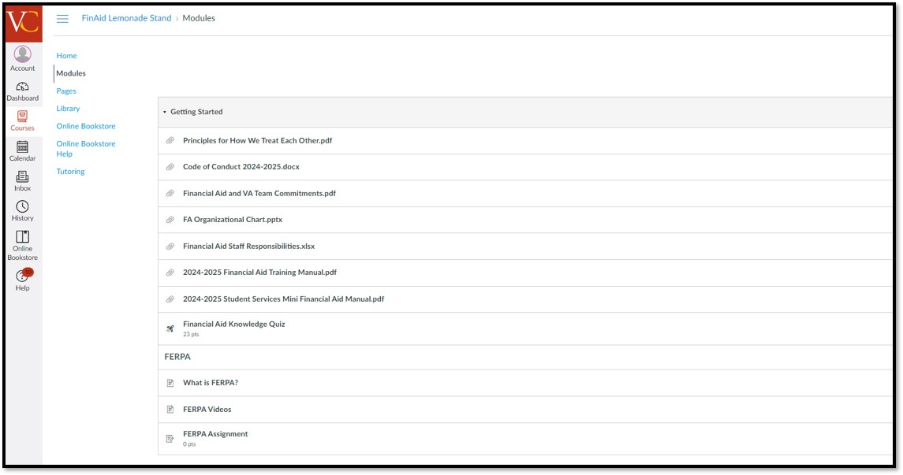

Slide 11
