Slide 1
Financial Value Transparency and Gainful Employment Update April 2024
Daniel Barkowitz, AVP Financial Assistance & Student Employment, University of Miami

Slide 2
Agenda
Overview, updates, & college strategy
FVT Reporting
Timeline and Next Steps
Questions and Answers

Slide 3
Gainful Employment (GE) Overview: Background
Third effort in a trilogy, but this feels different
Negotiated Rulemaking efforts in 2021 but no consensus
New rules introduced July 2023, effective October 2023, work starts in 2024
Subject to political whims, but accountability seems bipartisan
New measurements for GE career certificate programs and ALL other higher education degree programs termed Financial Value Transparency (FVT) rules
I will often refer to FVT and GE rules package as “GE” but it is both and it’s really different

Slide 4
GE Overview: WHY is GE happening?
Higher education programs value in question
Some IHE’s advertise dubious value statements
Cost of college is rising
Student loan debt is rising
Students borrow but don’t complete programs
No good data is MEASURED and shared to protect consumers and identify poor program outcomes
No good way to MANAGE the IHE programs with poor outcomes

Slide 5
GE Overview: WHO Are the GE Players?
Department of Education
Other federal agencies
All Institutions of Higher Education—IHE’s (not just for-profits)
Consumers (students, parents, borrowers)
Consumer Advocates
Accrediting Agencies
Taxpayers
Multiple Departments on Campus (Financial Aid, Admissions, Institutional Research, Provost/Accreditation Experts, Career Services, Compliance, Others)

Slide 6
GE Overview: WHAT is ED’s GE strategy?
Accountability
Protection of higher education consumers
Stewardship of taxpayer dollars
Gather data from IHE’s and federal agencies
Share metrics that have never been shared before
Describe value of ALL higher education programs (not just career certificates) with completion data, debt data, and starting salary data
Hold IHE’s accountable for ALL program results
Remove federal aid eligibility for poor career program results

Slide 7
GE Overview: WHEN will GE plan begin?
2024 data collection
2025 data analysis
2026 ED website launch
2026 some career certificates become ineligible for federal student aid if failure to meet expectation metrics
New Details Out April 2024
New October 1, 2024 deadline for reporting
New Q and A recently released

Slide 8
GE Overview: Challenges
GE could be extreme administrative burden for IHE’s
GE is effectively an institutional “audit” of IHE program values but may be viewed as a financial aid office issue
GE measures value of programs with data from completers ONLY so no protection of borrowers who don’t complete programs (most likely defaulters)
Some evidence most at-risk students could be hurt by GE implementation (i.e., cosmetology)
Some doubt GE consumer acknowledgments will be effective
GE will lead to debate on the value of liberal arts programs, liberal arts colleges, and higher education in general

Slide 9
GE Overview: Opportunities
GE could reveal poor IHE program outcomes like never before
GE could assist accreditors and IHE’s identify questionable program outcomes
GE could protect unwitting consumers/borrowers
GE could help aid offices inform consumers/borrowers that “better choices” may be available to them

Slide 10
GE Overview: Campus Implementation
Inform campus leadership of program value “audit”
Consult with campus institutional research team
Attend training events with partners beyond NASFAA and the FAA’s
Associate of Institutional Research (AIR) has great stuff
https://www.airweb.org/collaborate-learn/webinars/fvt
https://www.airweb.org/docs/default-source/documents-for-pages/webinars/fvt-example-institution-workbook.xlsx?sfvrsn=486bb0be_1

Slide 11
GE Overview: Campus Implementation
Campus-wide responsibility like Federal Program Participation Agreement (PPA) for Title IV Aid
Multiple campus departments may be involved, but the big three are…
Institutional Research, Financial Aid, Registrar
Others:
Student Accounts, Admissions, Career Services
Provost/Accreditation/Licensure Experts
Compliance and Consumer Information Experts

Slide 12
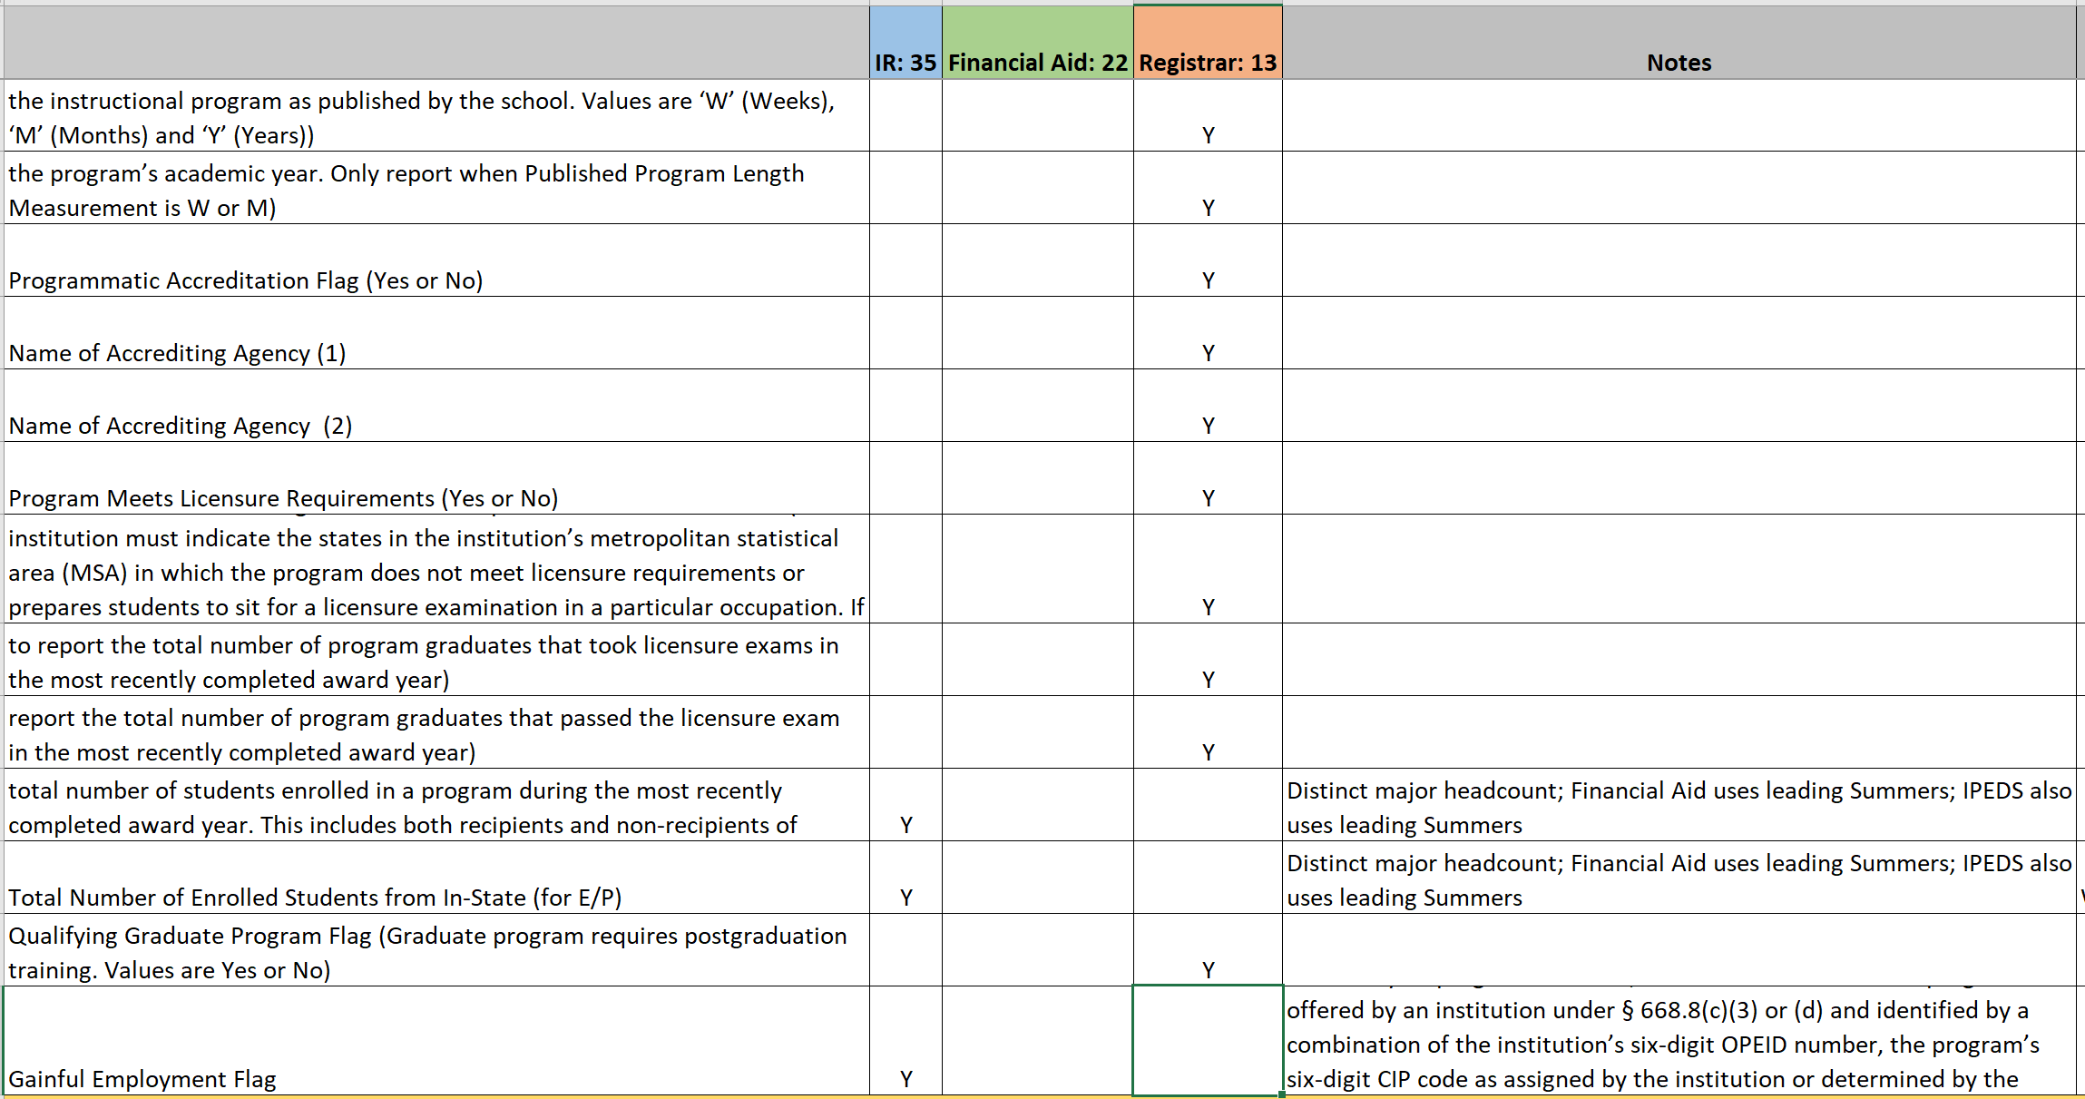
GE Overview: AIR Template – How Many Fields Per Office?

Slide 13
“The FVT regulations are designed to improve the quality and availability of information provided directly to students about the costs, sources of financial aid, and outcomes of students enrolled in all title IV, HEA (Title IV) eligible programs.”
-ED

Slide 14
Reporting Overview: the “What”
Officially under “Financial Value Transparency”
‘GE’ refers to certain types of programs
AND the ‘accountability framework’
FVT is the reporting and the disclosure
For all GE and “Eligible Non-GE” programs
Program data
Title IV Student: Cost, enrollment, aid data
Student Completer/Withdraw data
Used to
Create ED’s future consumer info website (July 1, 2026 or beyond or never)
Provide all non-income information ED will use for EP & D/E metrics

Slide 15
Reporting Overview: the “What”
Programs that offer a credential but exempt:
Comprehensive Transition & Postsecondary (CTP)
Prison Education Programs (PEP)
Programs that do not offer a credential:
Post-bac teacher cert w/ no credential awarded
Preparatory Coursework
“Programs at least two academic years in length acceptable for full credit toward a Bachelors” (34 CFR 668.8(c)(2)
Exempt programs:
Note: This does NOT include 2 year degree programs which are covered in 34 CFR 668.8(c)(1)

Slide 16
Reporting Overview: example programs
Eligible non-GE
Associates Degrees
Auto Collision Repair AAS
Nursing
Building Constr.
Transfer Degrees
University Xfer
AAOT
GE
2 year certificates
Auto Collision Repair Cert
Aviation Maint.
1 year certificates
Accounting Clerk
<1 year certs
Building Constr.
Neither:
Preparatory Coursework
Non-credit programs
Community Ed
<15 weeks / 24 quarter credits
Report!
Report!
Don’t Report!

Slide 17
FVT 2024 Reporting Elements
Part 1: Programs
Program name, CIP code, credential level, and length
Total # of weeks in the academic year
Whether the program is programmatically accredited and, if so, name of the accrediting agency
Whether the program meets licensure requirements or prepares students to sit for a licensure examination in a particular occupation for each State in the institution’s metropolitan statistical area
The total number of students enrolled in the program during the most recently completed award year, including both recipients and non-recipients of title IV, HEA funds
Yellow means it’s included in GEN-24-04 but wasn’t in the regs

Slide 18
FVT 2024 Reporting Elements
Part 1: Programs
6. Total number of graduates who took a licensure exam
7. Total number of those who passed said licensure exam
8. Question pertinent only to For-profit degree programs*
9. Whether the program is a qualifying graduate program whose students are required to complete postgraduate training programs, as described in the definition under § 668.2;**
*There is a narrow exception for certain for-profit degree programs to fall outside GE **We’ll get to why this is relevant

Slide 19
FVT 2024 Reporting Elements : Part 2: All Title IV Students
TBD
(i) Information needed to identify the student and the institution;
(ii) The date the student initially enrolled in the program
Presumed to be the first date of their first term for term-based programs
(iii) The student's attendance dates and attendance status (e.g., enrolled, withdrawn, or completed) in the program during the award year;
(iv) The student's enrollment status (e.g., full time, three-quarter time, half time, less than half time) as of the first day of the student's enrollment in the program;
Reg
Note: All of this section falls in 34 CFR 668.408(a)(2)

Slide 20
FVT 2024 Reporting Elements : All Students
Cost-related data:
(vii) The student’s residency tuition status by State or district;
(vi) The total tuition and fees assessed to the student for the award year;
(v) The student’s total annual cost of attendance (COA);
(viii) The student’s total annual allowance for books, supplies, and equipment from their COA under HEA section 472;
(ix) The student’s total annual allowance for housing and food from their COA under HEA section 472;
Adm/Reg
Billing
FA

Slide 21
FVT 2024 Reporting Elements : All Students
Aid Received:
(x) The amount of institutional grants and scholarships disbursed to the student;
(xii) The amount of any private education loans disbursed to the student for enrollment in the program that the institution is, or should reasonably be, aware of, including private education loans made by the institution;
(xi) The amount of other State, Tribal, or private grants disbursed to the student; and
FA
FA
Billing/FA

Slide 22
FVT 2024 Reporting Elements : All Students
New stuff in Gen-24-04:
Enrolled in CTP yes/no
Enrolled in PEP or 2nd-chance Pell program yes/no

Slide 23
FVT 2024 Reporting Elements : Students Withdrawn or Complete
(i) The date the student completed or withdrew from the program;
(ii) The total amount the student received from private education loans…that the institution is, or should reasonably be, aware of;
(iii) The total amount of institutional debt…the student owes any party after completing or withdrawing from the program;

Slide 24
FVT 2024 Reporting Elements : Students Withdrawn or Complete
(iv) The total amount of tuition and fees assessed the student for the student's entire enrollment in the program;
(v) The total amount of the allowances for books, supplies, and equipment included in the student's title IV, HEA COA for each award year in which the student was enrolled in the program, or a higher amount if assessed the student by the institution for such expenses; and
(vi) The total amount of institutional grants and scholarships provided for the student’s entire enrollment in the program;

Slide 25
FVT 2024 Reporting Elements : Students Withdrawn or Complete
New stuff in Gen-24-04:
Withdrew from or complete a CTP program yes/no
Whether the student was enrolled in a prison education program or was incarcerated and enrolled in a program under the Second Chance Pell experiment;

Slide 26
FVT Reporting Deadlines - Standard the ‘When’
“For programs other than qualifying graduate programs”
When: *Oct 1* 2024
What: “2nd through 7th award years prior to July 1, 2024”
Plus: Most recent award year
Q. Which are the 2nd through 7th award years prior to July 1, 2024?
For a typical AY institution: 22-23, 21-22, 20-21, 19-20, 18-19, 17-18
*Similar to 2014 GE
The Count’s favorite number: 34 CFR 668.408(b)

Slide 27
FVT Standard Reporting for ‘Qualifying Grad Programs’
For qualifying graduate programs you will report an extra year’s data (if using Standard option)
What programs are “Qualifying”
Covered in ‘668.2 Definitions’
Graduate Program
Postgraduate study of at least three years required for licensure
ED’s argument that they need a longer data window to actually capture post-program/post-licensure earnings vs. other programs
What are the 2nd through 8th years? For a school on a standard AY calendar: 22-23, 21-22, 20-21, 19-20, 18-19, 17-18, 16-17

Slide 28
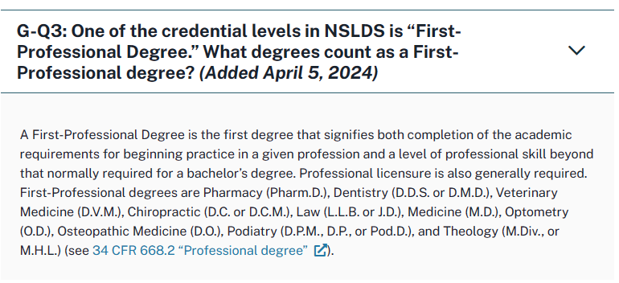
FVT Standard Reporting for ‘Qualifying Grad Programs’
Frequently Asked Questions | Knowledge Center

Slide 29
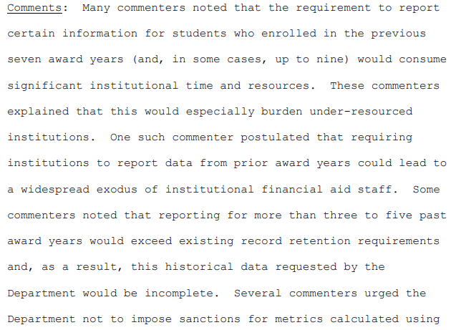
Transitional Reporting
ED response, paraphrasing only slightly:
“Y’all are crazy and wrong on all these points but…”
pp. 275-277
TLDR: Originally conceived as an option just for non-GE programs, ED extended the option to GE programs in response to public comment to the the draft rule.

Slide 30
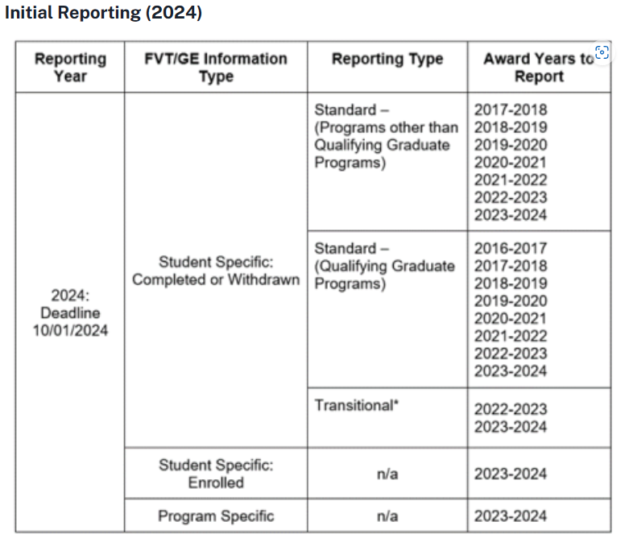
GE-24-04: Charts!

Slide 31
GE-24-04: Charts!
NSLDS Professional Access – NSLDS Financial Value Transparency and Gainful Employment Reports (Updated April 22, 2024) | Knowledge Center

Slide 32
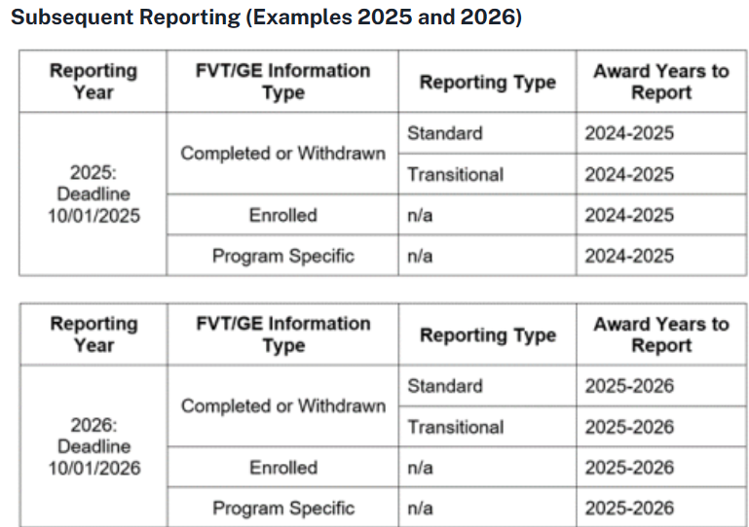
GE-24-04: Charts!

Slide 33
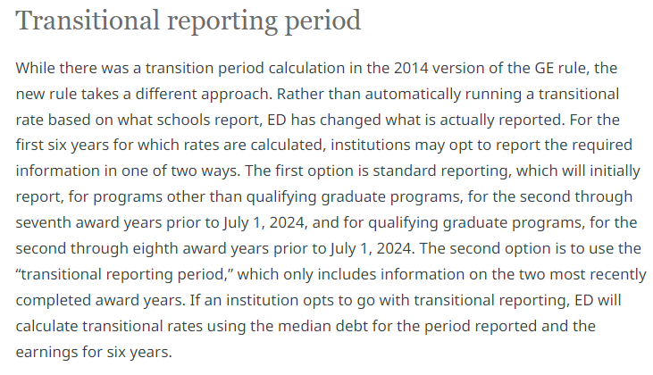
Q. Should your school choose transitional reporting?
A. Definitely maybe?

Slide 34
Q. Should your school choose transitional reporting?
What do we actually know?
You cannot choose by program – whichever choice you make is for all programs at the institution – all transitional, or all standard.
Per G-Q11 from the FAQ, for transitional reporters ED will use the debt levels for students in the reported cohorts and instead compare those to earnings data for completers in the same cohorts as with Standard would utilize.
For small programs that don’t have 30 completers in the 2-yr window, transitional would delay calculation and consequence, perhaps.
If you expect all programs to pass (or perhaps fail) regardless of method, transitional is clearly a lower reporting burden.
Sum: Schools may settle on transitional at least for most programs just based on time pressure and logistical hurdles, but I think the conversation about which is more advantageous downstream for particular institutions is just getting started.
Notes:
Poll!

Slide 35
GE/FVT 2024: Non-Reporting
668.408(b)(2)
“For any award year, if an institution fails to provide all or some of the information required under paragraph (a) of this section, the institution must provide to the Secretary an explanation, acceptable to the Secretary, of why the institution failed to comply with any of the reporting requirements.”
School responsibility, ED authority pattern
Consequences not stated
Possible Scenarios?
Contracting college, new institution
Natural disaster
Data retention regs 34 CFR 668.24

Slide 36
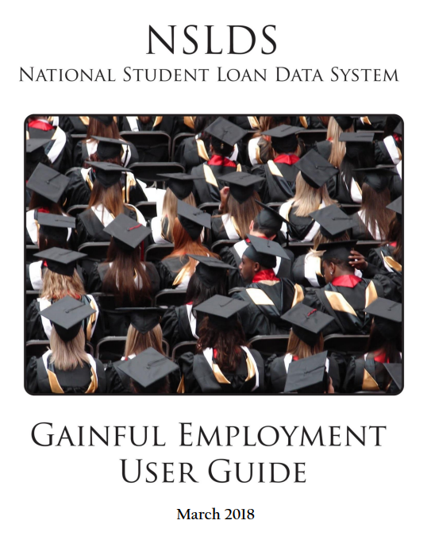
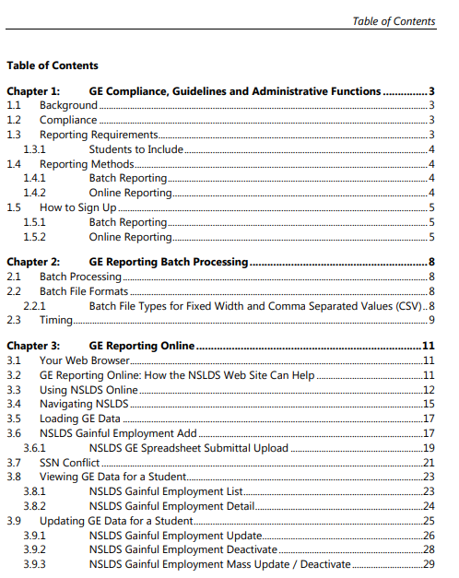
2018 GE User Guide

Slide 37
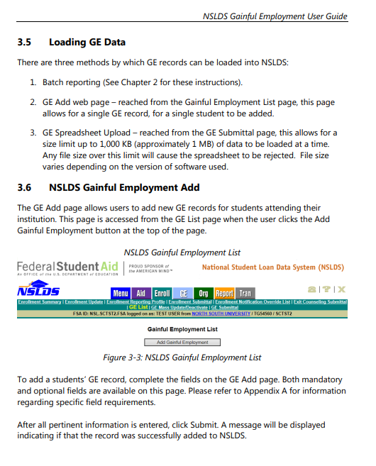
GE 2024 Submission: What we know/guess
2018 GE User Guide: 3 upload options:

Slide 38
2024 PPA: One more critical task!
§ 668.604 Certification requirements for GE programs
December 31, 2024
Two options:
If you will be recertifying between July 1 & Dec 31, just do that
Under 668.604(2)
If not, “transitional certification for existing programs”
Under 668.604(a)(1)
Procedures to be established by the Secretary
“Most senior executive” certifies that all GE programs have required approvals - 668.604(d)

Slide 39
GE Reporting Summary:
Key Points
Ms. Financial Value Transparency if you’re nasty
Reporting due 10/1/24
a) Current + 2nd through 7th for most programs;
b) Current + 2nd through 8th for qualifying grad programs
c) Transitional option
Update your PPA between 7/1 & 12/31, 2024

Slide 40
Timeline and Next Steps
Federal Student Aid is providing new NSLDS reports to assist schools with identifying completers, missing program-level data, and other issues. A webinar about these reports was provided on May 1
The Department will provide a list of completers for the appropriate cohort for each program
Schools will have 60 days to review and respond if errors are found
Final completer lists will reflect which students are matched with earnings data
April/May
July
Completer Lists
Notes:
Let’s look at our timeline of what we need to take care of over the next few months, then what this will result in over 2025 and 2026. We will start with completer lists, which are key to establishing the D/E and EP rates, on which the FVT/GE accountability measures are based in conjunction with the standard/transitional reporting. New NSLDS reports were announced as recently as April 22, and a webinar will be provided on May 1. The 60-day review period of ED’s provided completer lists may end prior to the October 1 data reporting date!

Slide 41
Timeline and Next Steps
October 1, 2024
Calculation of Debt-to-Earnings (D/E) Rates
Reporting Complete
Early 2025
Completer Lists Finalized
Calculation of Earnings Premium (EP) Rate
?, 2024
Notes:
Let’s look at our timeline of what we need to take care of over the next few months, then what this will result in 2025. First, D/E and EP rates will be published in early 2025. ED will also notify schools of any failing programs and of any voluntarily discontinued programs for which CIP areas no new programs can be offered for three years since discontinuation.

Slide 42
Cohorts
The number of (matched) completers will determine the cohort of completers used in the D/E and EP calculations
30
Notes:
30 is the magic number!

Slide 43
Cohort Periods
Two-year
30 or more completers
3rd and 4th completed award years prior to the earnings year
(2017-2018 and 2018-2019)
Four-year
Fewer than 30 completers in the two-year period
3rd, 4th, 5th and 6th completed award years prior to the earnings year
(2015-2016, 2016-2017, 2017-2018, and 2018-2019)
No-year
Fewer than 30 completers in the four-year period
No D/E or EP calculated
Notes:
Remember to ‘add three’ for qualifying graduate programs for the earnings period. For standard reporters, these are the cohorts for both D/E and EP calculations.

Slide 44
Extended Cohort Periods
To receive the extended earnings measurement period for qualifying graduate programs, institutions must attest that:
At least half of the program’s graduates obtain licensure in a state where post-graduation requirements apply
If necessary for licensure, the program is accredited by an accrediting agency that meets state requirements

Slide 45
Cohort Periods: Transitional Reporting
Year one D/E calculations (to be published 2025)
30 or more completers
Two most recently completed award years
(2022-2023 and 2023-2024)
If fewer than 30 completers, D/E rates will not be calculated
Year two D/E calculations and beyond (2026 and later)
30 or more completers
Up to the four most recently completed award years
Year two; 2022-2023, 2023-2024 and 2024-2025
Year three: 2022-2023, 2023-2024, 2024-2025 and 2025-2026
Notes:
Remember that for transitional reporters, the reported years will provide debt information whereas earnings information will be pulled from already reported data.

Slide 46
Median Annual Earnings
The Department will obtain from a federal agency (expected to be the IRS):
Median annual earnings for completers
Earnings years will reflect the appropriate cohort
The number of students who could not be matched to identify earnings
Notes:
Remember that for transitional reporters…they’ll look at earnings from the past and debt from the more recent period, so to speak.

Slide 47
Annual Loan Payment
Calculated by determining the median loan debt of students who completed the program during the applicable cohort and amortizing that debt
Includes institutional and private loan debt
Excludes parent PLUS loans and converted TEACH Grants
Capped at the lesser of the following, less any institutional grant or scholarship funds:
Total debt the incurred for the program; or
Total of student’s tuition and fees, books, equipment, and supplies

Slide 48
Exclusions
Number of completers without an earnings match
Number of loan debt records excluded from the median calculation
35 completers
5 do not match
The 5 highest loan debts are excluded
Notes:
Remember the ‘vanishing’ taxpayers.

Slide 49
Debt to Earnings (D/E) Rates
Annual Rate: Annual loan payment Median annual earnings
Discretionary Rate:
Annual loan payment
Median annual earnings > 150% of poverty level
Notes:
ED will calculate two D/E rates.

Slide 50
Pass or Fail: D/E
Pass
Annual D/E < or = 8%
OR
Discretionary D/E < or = 20%
Fail
Annual D/E > 8%
AND
Discretionary D/E > 20%
High debt burden

Slide 51
Earnings Premium (EP)
Median annual earnings Earnings threshold
The EP is meant to measure whether completers of the program are earning more than those with only a high school diploma.
Based on census data
Earnings threshold reflects those aged 25-34 who worked during the year or were unemployed and looking for work
Based on the institution’s state, or nationally if fewer than 50% of students live in the state

Slide 52
Pass or Fail: EP
Pass
EP > 0
Fail
EP < or = 0
Low earning

Slide 53
Pass or Fail: Transitional Reporting
If a program using transitional calculations has sufficient completers in the debt cohort but not the earnings cohort, D/E and earnings premium metrics will not be calculated for the program, but median debt information will be included on the Department’s program information website

Slide 54
Pass or Fail: Transitional Reporting
If a program using transitional calculations has sufficient completers in the earnings cohort but not the debt cohort, the Earnings Premium metric will be calculated and included with median earnings information on the program information website
A program receiving an EP result without D/E rates is still subject to the same potential consequences for failing the EP metric
Warnings or loss of program eligibility

Slide 55
Student Exclusions
Students are excluded from the D/E and EP calculations if:
One or more of the student’s Title IV loans are under consideration or have been approved for a total and permanent disability (TPD) discharge
The student enrolled full-time in any other eligible program at the same institution or another institution during the calendar year in which earnings were measured
The student completed a higher-level undergraduate or graduate program at the institution
The student enrolled in an approved prison education program (PEP) or comprehensive transition and postsecondary (CTP) program
The student died

Slide 56
Institutional Exclusions
Schools with no programs or groups of programs with at least 30 completers over the past four award years are not subject to these provisions.

Slide 57
July 1, 2026
Department program information site to be published
Acknowledgements requirement effective
Warnings requirement effective
Loss of program eligibility provisions effective

Slide 58
Acknowledgements
Effective July 1, 2026, students must acknowledge they have viewed the Department’s Financial Value and Transparency site information for a program that fails the Debt-to-Earnings metric. The Department will manage this process, which must be completed prior to the institution entering into an agreement to enroll the student.
This does not apply to undergraduate degree programs.
Notes:
Applies to GE and non-GE programs other than undergraduate degrees and the regular exclusions (e.g., CTP programs, PEPs, etcetera). Acknowledgements are not required when a program only fails the EP metric.

Slide 59
Warnings
Effective July 1, 2026, an institution must provide warnings to current and prospective students for any year the Department notifies the institution that the GE program has failed its D/E rates or EP measure.
Notes:
Warnings apply to GE programs since they are about enrolling students in programs that could lose eligibility for Title IV aid.

Slide 60
Loss of Eligibility
Programs that fail either the D/E or EP measures in two of any three consecutive years are expected to lose eligibility. Loss of eligibility may be appealed if, and only if, the Department made an error in the determination.
If D/E or EP measures are not calculated in a given year, the school will simply remain in the same status as the previous determination. Measures are disregarded if calculated more than five years prior.
Notes:
Remember that for voluntarily discontinued programs, schools may not initiate a similar program in the same CIP family for at least three years.

Slide 61
FVT/GE Reporting Resources
FSA Topic Page: FVT/GE Final Rules, Publications and Resources
https://fsapartners.ed.gov/knowledge-center/topics/financial-value-transparency-and-gainful-employment-information
GEN-24-04: https://fsapartners.ed.gov/knowledge-center/library/dear-colleague-letters/2024-03-29/regulatory-requirements-financial-value-transparency-and-gainful-employment
2023 FSA Conference material
2018 GE User Guide:
https://fsapartners.ed.gov/sites/default/files/attachments/nsldsmaterials/NSLDSGainfulEmploymentUserGuide.pdf
NCES CIP Information:
https://nces.ed.gov/ipeds/cipcode/default.aspx

Slide 62
Additional Resources
NASFAA’s Gainful Employment resource page: nasfaa.org/ge
Third-party policy analyses:
Center for American Progress
The Online and Professional Education Association
Holland & Knight and other law firms

Slide 63
Questions?

Slide 64
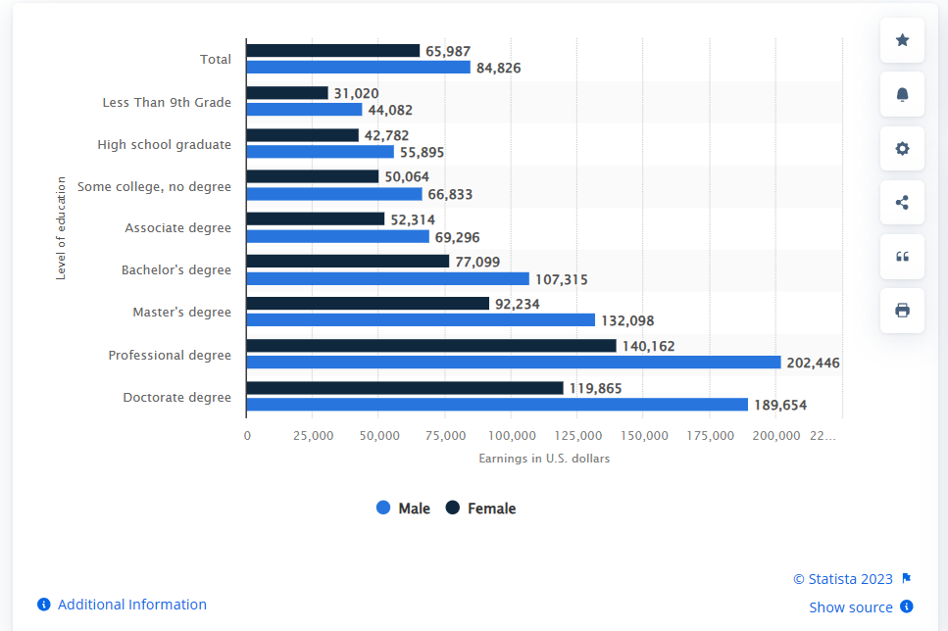
U.S.: earnings by educational attainment and gender 2021 | Statista
All high school grads: $55,895 Female Associate degree: $52,314

