Slide 1

Satisfactory Academic Progress
Region 1 Workshop
Thomas Vo
VoT@scf.edu
941-752-5434

Slide 2

Satisfactory Academic Progress (SAP)
668.34 (a) Satisfactory Academic Progress policy
An institution must establish a reasonable satisfactory academic progress policy for determining whether an otherwise eligible student is making satisfactory academic progress in his or her educational program and may receive assistance under the Title IV, HEA programs.

Slide 3
SAP Compliance Concerns
  Failure to develop a policy that meets minimum Title IV requirements
  Misalignment of pace of progression and maximum timeframe
  Applying a different policy than the official written SAP policy
  Failure to properly monitor and/or document satisfactory progress
  Failure to comply with the Program Integrity regulations, effective 7/1/2011
Notes:
Consistently in the top ten audit and program review findings

Slide 4

SAP Standards
Reasonable
Consistently applied
Applies to all Title IV programs
  If not meeting SAP, not eligible for any TIV program
  Cannot say eligible for Pell but not eligible for Loans
“ED provides the outline; schools fill in the details”
  Schools have a lot of flexibility

Slide 5
“As Strict or Stricter”
Having an SAP policy “as strict or stricter” then other school policies refers to the actual measurements used to monitor qualitative and quantitative standards - GPA and pace of progression
It does NOT refer to the frequency in which the school checks SAP
  Therefore academics might check GPA every term but financial aid can check GPA for SAP purposes annually

Slide 6
Policy Q & A - Different Policies
SAP-Q9: Is an institution required to use the same SAP policy for all students?
SAP-A9: No, the policy must explain the qualitative (grade-based) and quantitative (time-related) standards the institution uses to check SAP; however, an institution is permitted to establish different SAP standards for different programs or categories (e.g., full-time, part-time, undergraduate, and graduate students) which must be applied consistently to students in that category or program.

Slide 7
SAP Evaluation Items
At each formal SAP evaluation point, a school checks:
  Qualitative measure (grade-based)
    Remedial coursework qualitative measure may be part of or separate from regular qualitative measure
    Qualitative measure for programs greater than two years
  Quantitative measure (pace of progression)
  Maximum timeframe

Slide 8
SAP Policy Requirements
Must specify that if a student is not meeting the standards, he or she is not eligible to receive Title IV aid
Warning and probation statuses must be described if included in school’s policy
Students must be notified of determinations that impact their Title IV aid
Required elements include:
  Measurement of student’s progress at each official evaluation point
    GPA student must achieve
    Pace of progression

Slide 9

SAP Policy – Other Key Items
Policy must include the following -
  Describe how student’s GPA and pace of completion affected by:
    Incompletes
    Withdrawals
    Repetitions
    Transfers of credits
      Transfer credits accepted toward completion of student’s program must count as both hours attempted and hours completed

Slide 10
Policy Q & A – Non-Accepted Credits
SAP-Q6: SAP regulations require credit-hours accepted toward student’s program count as both attempted and completed when calculating pace for SAP. Can an institution’s policy include non-accepted credits as attempted credits for purposes of these calculations?
SAP-A6: Yes. The treatment of these credits would be up to the institution. The SAP regulations do not address non-accepted credits.
  May refer to transfer credits or credits earned in other academic programs at your school

Slide 11

Qualitative Measure
Definition: To access quality of academic work using standards measureable against a norm
  Grades; work projects; etc.
Must be cumulative
May use a graduated or fixed standard
Can be more restrictive and have payment period measurements in addition to cumulative measures
  Could have an overall cumulative program or school GPA and a semester GPA requirement

Slide 12
Policy Q & A - Remedial
SAP-Q3: How are remedial courses treated for SAP purposes?
SAP-A3: The institution's SAP policy should describe how remedial courses are treated. An institution may, but is not required to, include remedial coursework in determining pace. However, the school must evaluate remedial coursework under the qualitative factor, though it does not have to be part of the GPA. If not part of the GPA, the school must have some other measurement process to evaluate remedial coursework (passing courses, meeting course requirements, etc.).

Slide 13

Quantitative Measure
Definition: To measure progress toward program completion
Must be cumulative
May use a graduated or fixed standard
Can be more restrictive and have payment period measurements in addition to cumulative measures
  Could have an overall cumulative completion pace and a semester completion requirement

Slide 14
Quantitative Measure
Pace of progression required to make sure student completes within maximum timeframe
Calculate the pace at which the student is progressing by
  Dividing the cumulative number of hours the student has successfully completed by the cumulative number of hours the student has attempted:
Cumulative hours completed
Cumulative hours attempted
  For clock-hours you are evaluating cumulative clock- hours required to complete as expressed in calendar time

Slide 15
Quantitative Measure
  School may use standard rounding rules when calculating percentages under the quantitative measurement
      Clock-hour or credit-hour programs
      Example – 66.5% could be rounded up to 67%
  Rounding is optional within SAP policy
  Program integrity Q & A website under the SAP topic, question R-Q9 (clock-hour example)

Slide 16
Maximum Timeframe
Limits of Maximum Timeframe
  For undergraduate programs, must be no longer than 150% of published length of educational program
  For graduate programs, school defines the maximum based upon length of program
Example:
  Degree program requires 120 credits for completion
  120 x 150% = 180 attempted credits is maximum timeframe
Quantitative measure (tied to max timeframe)
  120 credits / 180 credits = 66.6% (usually rounded to 67%)
    Student must earn 67% of credit-hours attempted

Slide 17
Maximum Timeframe
Must be measured at each evaluation point
  Student is ineligible at the evaluation point where indicated will exceed max timeframe NOT at the point when they actually reach the max timeframe
Example
    At end of payment period (SAP evaluation checkpoint) student has attempted 160 credit-hours out of a possible 180 credit-hours allowed under max timeframe but has 25 hours left to earn to complete his degree
    The student is not meeting SAP due to exceeding the max timeframe because he has more hours to earn than what is allowed to graduate within the maximum timeframe

Slide 18

Checking SAP
  Student’s SAP evaluations, whether each payment period, annually or less often than each payment period, must occur at the end of a payment period
    Official evaluation period cannot be less than a payment period

Slide 19
SAP – Clock-Hours
School must establish one review option for a program
Evaluation “at end of payment period”
  Schools have three options
    1) At the point when the student’s scheduled clock- hours for the payment period have elapsed, regardless of whether the student attended them; or
    2) At the point when the student has attended the scheduled clock-hours; or
    3) At the point when the student successfully completes the scheduled clock-hours for that payment period.

Slide 20
SAP (Non-term Credit-Hours)
Evaluation “at end of payment period”
  Schools have two options
    1) On the date when the student was scheduled to earn the credit-hours; or
    2) When the student successfully earns the credit-hours
School must establish one review option for a program; cannot start with one option and then after the first review, switch to a different option for that cohort of students.

Slide 21

How Often is SAP Evaluated?
Frequency of evaluation determines options
  School must evaluate SAP at end of each payment period for programs of study that are one academic year or less in length
  For programs of study longer than one academic year
    School must evaluate at least annually to correspond with end of a payment period
    School may evaluate at end of each payment period

Slide 22

SAP Evaluations
Each official evaluation must include evaluation of the qualitative (grade-based), quantitative (time-related) and maximum timeframe standards
Financial aid warning and probation statuses only last for one payment period, no matter how frequently SAP is evaluated
“Financial aid warning” and “Financial aid probation” must have the same definitions as described in regulation

Slide 23
Financial Aid Warning Period
For an institution that chooses to evaluate SAP at the end of EACH payment period, a “financial aid warning” status may be used (optional)
  Student may continue to receive Title IV aid for one payment period
  No appeal necessary
  Note: Possible for student to receive more than one warning period during academic career just NOT consecutively

Slide 24
Financial Aid Probation
To be placed on Financial Aid Probation, a student must:
  Appeal and have it approved by the school; AND
  Student expected to be making SAP in next payment period; OR
  Be successfully following an academic plan designed to ensure student will be able to meet SAP by a specific point in time
    Not required to develop academic plans
    Can set conditions on developing plans
    ED does not define what office(s) must develop and oversee

Slide 25
Financial Aid Probation
A student on Financial Aid Probation may only receive Title IV funds for ONE payment period
A student on F/A Probation may not receive Title IV funds for the subsequent payment period UNLESS:
  Student is now making SAP; or
  Institution determines student met requirements specified by the school in the academic plan and student still covered by academic plan
SAP must be checked at the end of the probationary payment period (even if SAP is normally checked annually)

Slide 26
Policy Q & A – Academic Plans
ACP-Q3: Can the academic plan be the same for all students or the same by student categories or must the plan be created individually for each student?
ACP-A3: According to the regulations, the academic plan is developed by the institution and the student individually. It is possible that a general plan could be used for students in a similar circumstance and then customized, as needed, for each student’s particular circumstance.

Slide 27
Policy Q & A – Academic Plans
ACP-Q4: Must the academic plan be mathematically set to graduate student within 150% timeframe?
ACP-A4: The academic plan must be designed to ensure that the student is able to meet the institution's satisfactory academic progress standards by a specific point in time. In some cases, this could mean that the maximum timeframe would be extended based on the student's approved appeal.

Slide 28
Policy Q & A – Financial Aid Probation
PROB-Q4: How many times may a student be placed on probation for failing to meet SAP standards?
PROB-A4: A student may be placed on probation for one payment period per appeal. It is possible that a student could be placed on probation more than once in his or her academic career.

Slide 29
Appeals
  Process by which student who is not meeting school’s SAP policy petitions for reconsideration of eligibility for Title IV
  Policy must specify the conditions under which a student may appeal
    Appeal must include:
      Why the student failed to make SAP; AND
      What has changed that will allow the student to make SAP at the next evaluation
  ED does not define what office must oversee appeals or how appeals are reviewed (individuals, committees, etc.)

Slide 30

Policy Q & A – Appeal Documents
APP-Q2: What documentation is required for a student appeal?
APP-A2: That is up to the institution. An institution may choose to request additional documentation when a particular student circumstance warrants it. The institution may decide to require more extensive documentation on an initial appeal and an update statement on a subsequent appeal.

Slide 31
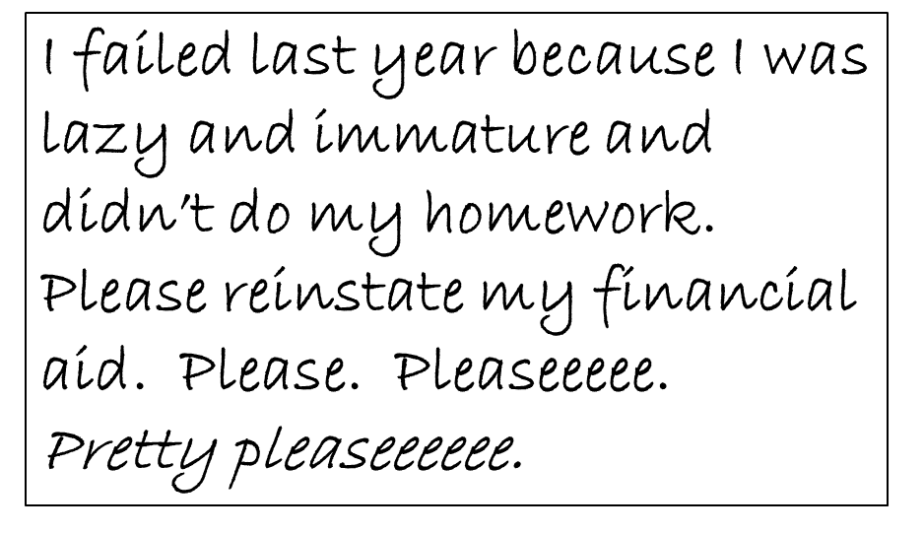

Which Appeal Would You Consider?

Slide 32
Which Appeal Would You Consider?
December 1, 2015
Dear Financial Aid Office:
I failed all my classes last semester because I was in a major motor vehicle accident on March 15, 2015 in Santa Barbara, CA. Documentation is attached. I was in the hospital (White Memorial Medical Center-L.A.) from March 15 to April 3, 2015. Documentation is attached. I have now recovered and have included a medical clearance form from Dr. Marcus Welby. I will not text and drive any more because my parents cancelled my cell phone contract and smashed my cell phone with a 10 # sledge hammer.
Sincerely, John Q. Student enclosures

Slide 33
Appeal Notification
Notification to students
  Must notify student of results of SAP review that impacts student’s eligibility for Title IV aid
  If institution has an appeal process, must describe the specific elements required to appeal SAP
    May specify how often and how many appeals are allowed
  Regardless as to whether or not you have an appeal process, you must always describe how a student who has failed SAP can reestablish eligibility for Title IV aid

Slide 34
Monitoring SAP
If measure each payment period –
  Following a payment period in which the student did not make SAP, the school may:
    Place the student on Financial Aid Warning; or
    Place the student on Financial Aid Probation (with proper appeal approvals)
  If already on Financial Aid Warning -
      After ONE payment period, student must:
        Make SAP; or
        May be placed on probation after successful appeal

Slide 35
Monitoring SAP
If evaluate SAP annually or less often than each payment period -
  Following a payment period in which the student did not make SAP, the school may:
      Place the student on Financial Aid Probation (with proper appeal approvals)
“Annually” means a 12-month period
  An institution is expected to review a student’s SAP at least once every 12 months (for programs allowed to be checked annually)

Slide 36
Implementation Questions
Will you have fixed or graduated standards?
Will you have different standards for different categories of students?
How will you treat course incompletes, withdrawals, and repetitions?
How will you treat transfer credits?
How will you treat remedial courses?
Will your policy permit appeals, and if so, how many?
Who will review appeals?
If you have academic plans, who will develop, approve, and monitor compliance with academic plans?

Slide 37
Resources/References
FSA Assessments, Student Eligibility section:
  http://ifap.ed.gov/qahome/qaassessments/studentelig.html
668.16, 668.34 (SAP)
2015-16 FSA Handbook Vol. 1, Chapter 1
Electronic Announcement - September 2, 2011
  Policy Q & A Webpage on program integrity regulations
  http://www2.ed.gov/policy/highered/reg/hearulemaking/2009/integrity-qa.html
  Upper right-hand side of IFAP

Slide 38
QUESTIONS?

