Slide 1
Financial Aid Strategies to Impact Student Retention and Graduation
Shana Gore

Slide 2
Re-thinking Work Study
WHY?
Old process was not student or supervisor centered and very labor intensive for the FAO
Metrics made us analyze how we were spending our limited funds
What are some issues with your current work study process you feel “don’t work?”

Slide 3
Re-thinking Work Study
WHAT?
Research showed that students who were employed on campus were retained at significantly higher rate than students employed off campus and students who did not work
UWF data showed 8% higher rate (with just federal funding, we were able to have about 80 work study students.)
We surveyed work study students and supervisors
Why do you think students employed on campus are retained at a higher rate? What do you think your work study students and supervisors would say about your current process?

Slide 4
Re-thinking Work Study
HOW?
Secure additional funding to offer more positions (supervisors were requesting more student workers and we had the opportunity to submit budget requests)
Create a database for supervisors to post job descriptions and application procedures, allow students to “apply” for work study positions (benefits of this?)
Automate the process to reduce paperwork for all parties, create an online orientation for student workers and online resources for supervisors
Increase work study opportunities with Community and Corporate options.
If our work study students were already retained at a higher rate, if we actually streamlined the process, offered more positions and the process led to a better fit, results could be even higher! In additional to impacting retention, we would also impact graduation rates and student employment rates post graduation.

Slide 5
Re-thinking Work Study
Every institution is different, what changes could be realistic for your college/university?

Slide 6
Emergency Grant
We worked in conjunction with Student Affairs/Case Management to establish and Emergency Grant Program
If students have an unexpected emergency, such as a needed car repair, would giving a small grant prevent them from withdrawing?
We believe that a small grant, at the right time can have a big impact. (NASFAA sessions and report Investing in Student Completion, http://wihopelab.com/publications/investing-in-student-completion-wi-hope_lab.pdf
Do you have any current Emergency Programs?

Slide 7
Emergency Grant
Concerns
How to balance quick delivery funds with verifying the emergency/need
Was emergency one-time or on-going?
How to prevent misuse?
Do we “advertise?”
What concerns would you have about an Emergency Grant program at your institution?

Slide 8
Emergency Grant
NASFAA’s five recommendations for emergency grant programs:
Establish and communicate clear criteria for eligibility while also providing flexibility for determinations in unusual circumstances.
Collect and analyze program data to help guide practice.
Coordinate financial aid and emergency aid when it makes sense and avoid doing so when this doesn't help students.
Equip emergency aid program administrators with information about other forms of support for students (benefits, food pantries, emergency housing).
Evaluate the impact of emergency aid programs to improve performance and buttress funding.

Slide 9
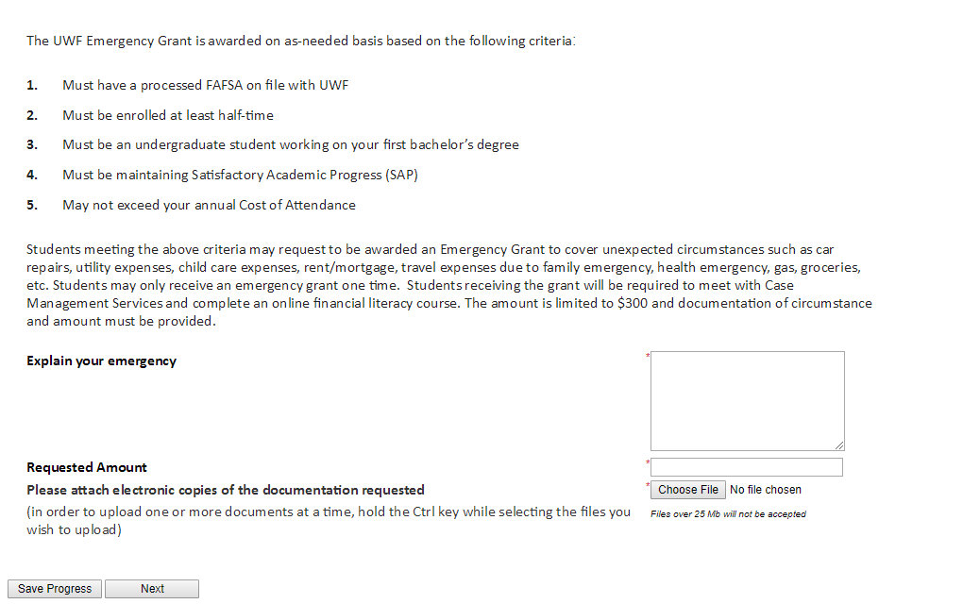
Emergency Grant

Slide 10
Emergency Grant
Started spring 2017
Allocated $30,000
Spent $6075 to 24 students ($253 average award)
23 of the 24 students completed the semester
21 of the 24 are currently enrolled (87.5% retention)
We have allocated $60,000 for 2017-2018, so far we have awarded 8 students a total of $2400 and 7 were Irma related
We require recipients to complete a Financial Literacy Course

Slide 11
Emergency Grant
Do we look at SAP?
Do we look at unmet need?
Do we limit amount?
What should be considered an emergency?
Do we limit amount of times students are eligible to receive?

Slide 12
Shana Gore – sgore1@uwf.edu

