Slide 1
Don’t leave your CDR to chance
Tips for taking control of your default prevention efforts
Shannon R. Cross
Senior Manager, Strategic Partnerships

Slide 2
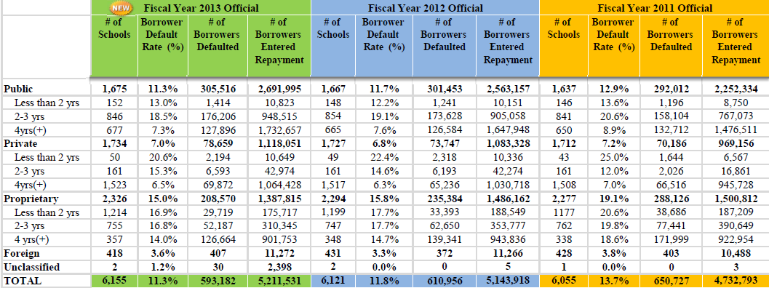
Results are in
2013 cohort default rates
Notes:
Need to update chart when info is released

Slide 3
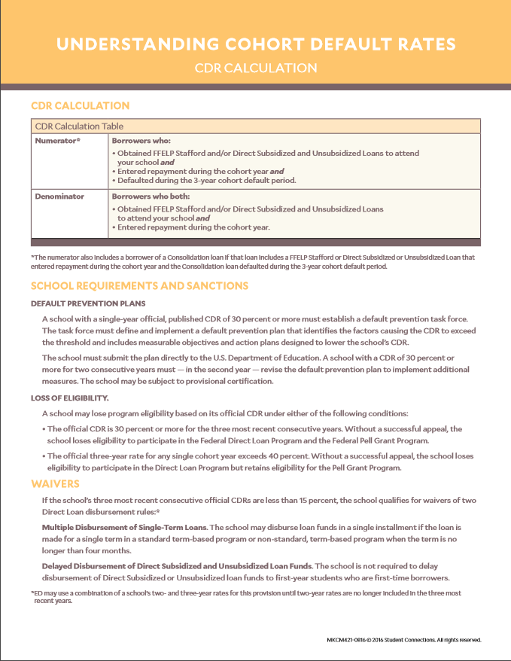
The Basics
Student Connections resource

Slide 4
Tips for taking control of your cdr efforts
Processes and Activities
Processes
Enrollment reporting
Data review
NSLDS Date Entered Repayment
Late Stage Delinquency Assistance
Loan Record Detail Report
Budget
Activities
Reflect
Analyze
Aspire
Counsel
Educate
Communicate
Succeed

Slide 5
Tips for taking control of your cdr efforts
Activities
Reflect
Analyze
Aspire
Counsel
Educate
Communicate
Guide

Slide 6
Tips for taking control of your cdr efforts
Activities
Reflect
Set a philosophy for your default prevention efforts
Mission
Values
Alignment

Slide 7
Tips for taking control of your cdr efforts
Activities
Analyze
LRDR
Includes the correct borrowers and loans
Challenge incorrect data (draft rates)
Student Information System
High school attended
Program of study
Demographics
Grades
Common characteristics
Process review if indicated

Slide 8
Tips for taking control of your cdr efforts
Activities
Aspire
Set a goal
CDR?

Slide 9
Tips for taking control of your cdr efforts
Activities
Aspire
Set a goal
CDR?
Scorecard?

Slide 10
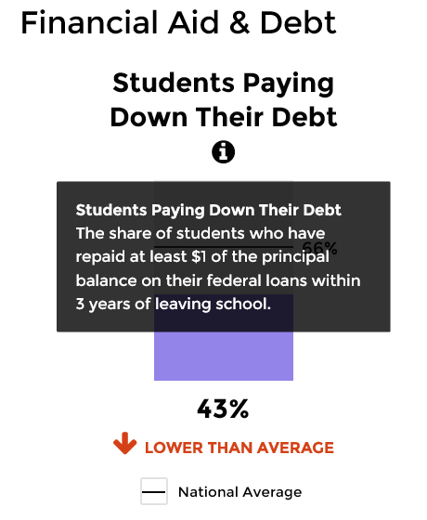
Tips for taking control of your cdr efforts
Activities
Aspire
Set a goal
CDR?
Scorecard?

Slide 11
Tips for taking control of your cdr efforts
Activities
Aspire
Set a goal
CDR?
Scorecard?
Both!

Slide 12
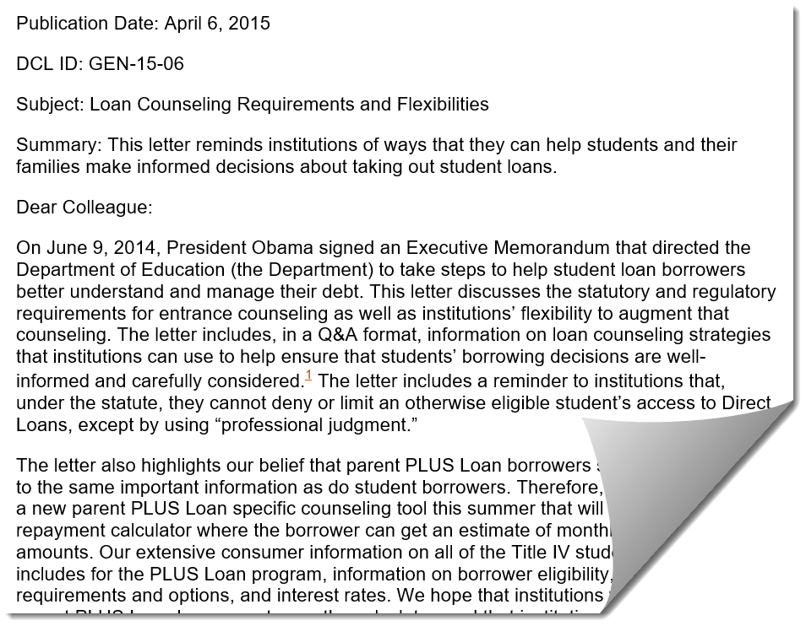
Tips for taking control of your cdr efforts
Activities
Counsel
Provide student loan borrowers with the information they need to successfully manage their loans
Entrance and exit counseling
Dear Colleague Letter (DCL ID: GEN-15-06)
Experimental sites

Slide 13
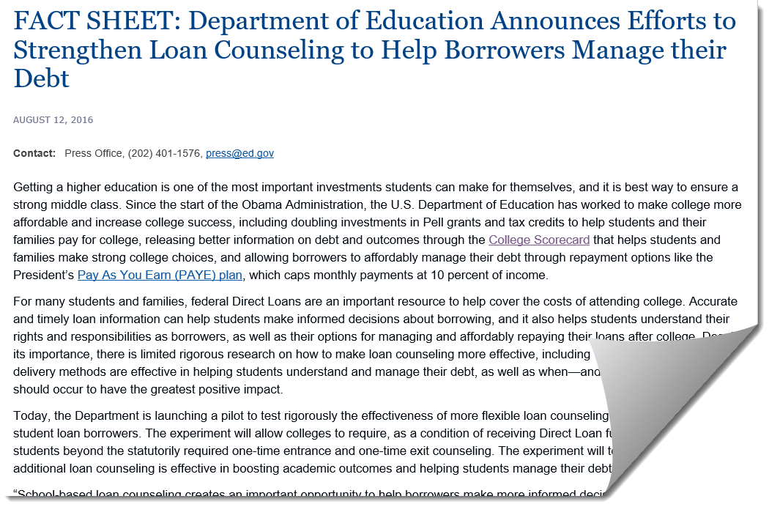
Tips for taking control of your cdr efforts
Activities
Counsel
Provide student loan borrowers with the information they need to successfully manage their loans
Entrance and exit counseling
Dear Colleague Letter (DCL ID: GEN-15-06)
Experimental sites

Slide 14
Tips for taking control of your cdr efforts
Activities
Counsel
Provide student loan borrowers with the information they need to successfully manage their loans
Entrance and exit counseling
Dear Colleague Letter (DCL ID: GEN-15-06)
Experimental sites
Key messages

Slide 15
Tips for taking control of your cdr efforts
Activities
Counsel
Provide student loan borrowers with the information they need to successfully manage their loans
Entrance and exit counseling
Dear Colleague Letter (DCL ID: GEN-15-06)
Experimental sites
Key messages
Student Connections Resources
4 Questions to boost your entrance counseling
Grace Period Counseling: A good start for repayment

Slide 16
Tips for taking control of your cdr efforts
Activities
Educate
Provide your students, their families and the campus community with information on how to manage their finances
Financial literacy
Not how do we make them consume this information, but how do we make them WANT to consume it
Easy to access, easy to consume
Ongoing
Audiences and topics
Peer Mentoring

Slide 17
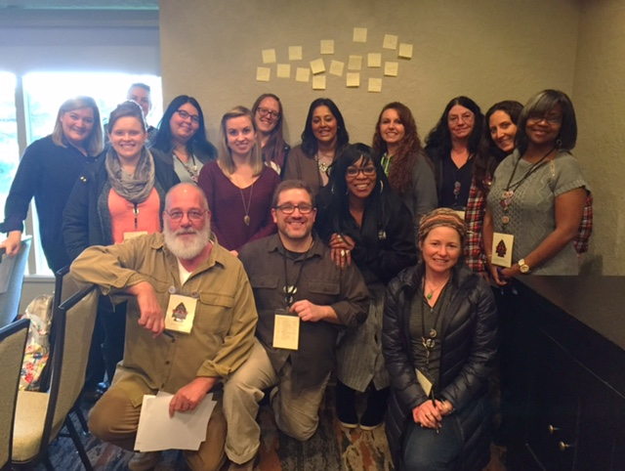
Tips for taking control of your cdr efforts
Activities
Educate
Provide your students, their families and the campus community with information on how to manage their finances
Financial literacy
Not how do we make them consume this information, but how do we make them WANT to consume it
Easy to access, easy to consume
Ongoing
Audiences and topics
Peer Mentoring
Student Connections Resources
Connecting Students to Money Management Education
Unleashing the power of financial aid storytelling in Oregon
Product Innovation

Slide 18
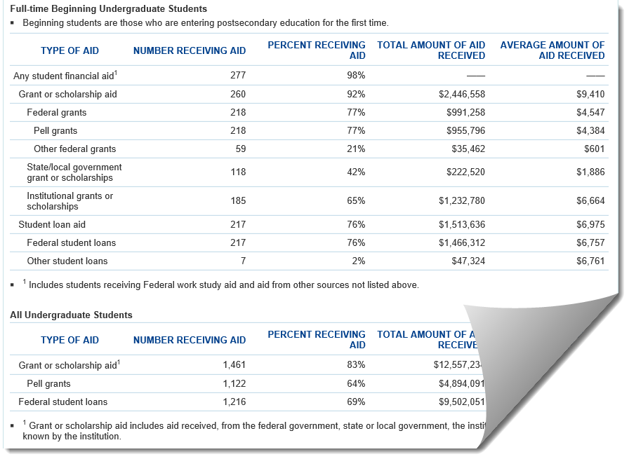
Tips for taking control of your cdr efforts
Activities
Educate
Provide your students, their families and the campus community with information on how to manage their finances
Financial literacy
Not how do we make them consume this information, but how do we make them WANT to consume it
Easy to access, easy to consume
Ongoing
Audiences and topics
Peer Mentoring
Student Connections Resources
Connecting Students to Money Management Education
Unleashing the power of financial aid storytelling in Oregon
Product Innovation
Campus community
Risk
Goals, roles, process

Slide 19
Tips for taking control of your cdr efforts
Activities
Communicate
Audience
Method
Message
Measure

Slide 20
Tips for taking control of your cdr efforts
Activities
Communicate
Audience
Method
Message
Measure
Student Connections Resources
Finding the right options for borrowers’ individual situations
Guiding Borrowers on the path to repayment

Slide 21
Tips for taking control of your cdr efforts
Activities
Succeed
Persistence
Progression
Graduation

Slide 22
Tips for taking control of your cdr efforts
Activities
Succeed
Persistence
Progression
Graduation
Student Connections Resources
Big ideas for student retention (part 1)
Big ideas for student retention (part 2)

Slide 23
Tips for taking control of your cdr efforts
Processes and Activities
Processes
Enrollment reporting
Data review
NSLDS Date Entered Repayment
Late Stage Delinquency Assistance
Loan Record Detail Report
Budget
Activities
Reflect
Analyze
Aspire
Counsel
Educate
Communicate
Succeed

Slide 24
Tips for taking control of your cdr efforts
Processes and Activities
Processes
Enrollment reporting
Data review
NSLDS Date Entered Repayment
Late Stage Delinquency Assistance
Loan Record Detail Report
Budget
Activities
Reflect
Analyze
Aspire
Counsel
Educate
Communicate
Succeed
Email me: Shannon.cross@studentconnections.org
706-266-8397 Call me anytime on my cell phone

Slide 25
Student Connections
Borrower Connect
Analyze data
Contact and counsel
Track results
Request a demo

Slide 26
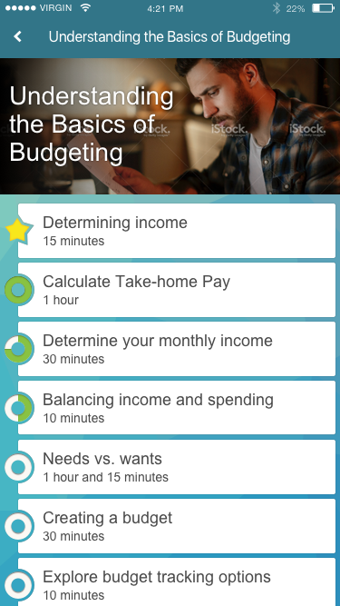
Student Connections
Success Center
Collaborative
Developed and continuously improved with input from advisory boards of students and academic experts.
Student-centric
Interactive, multi-platform engagement creates a virtual personal assistant that accommodates students’ diverse learning styles and schedules.
Innovative and Experienced
Game-changing insight and technology grounded in decades of experience designing student success curricula that improve student outcomes.

Slide 27
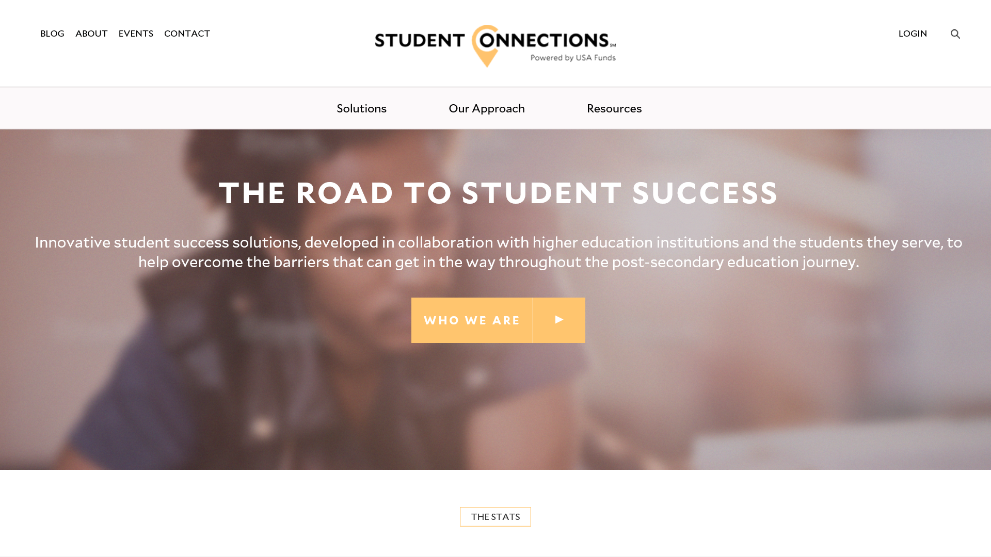
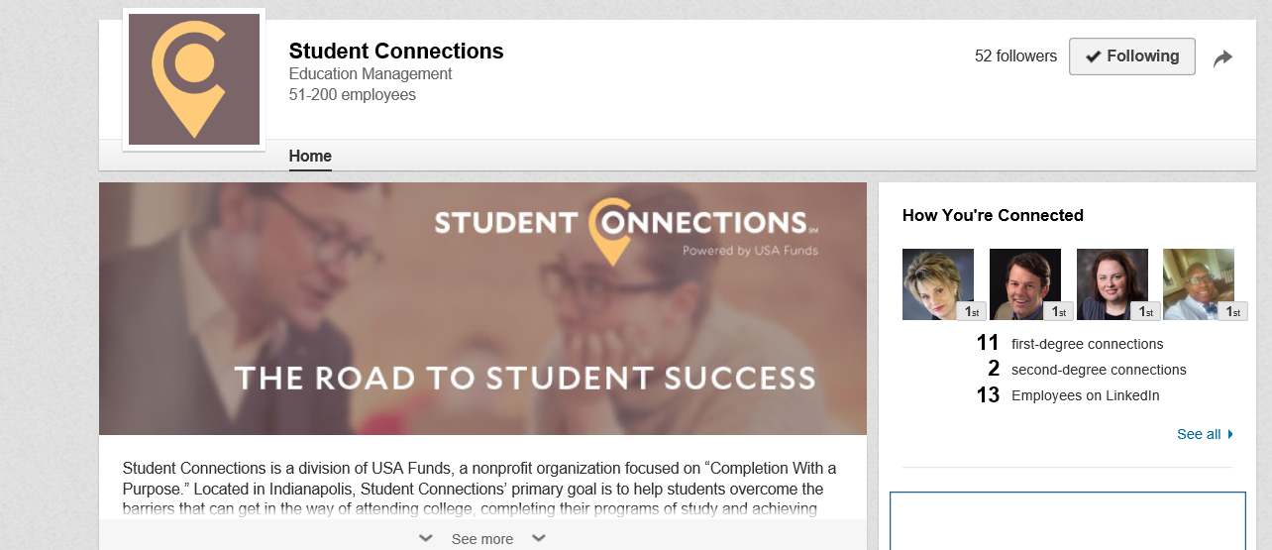
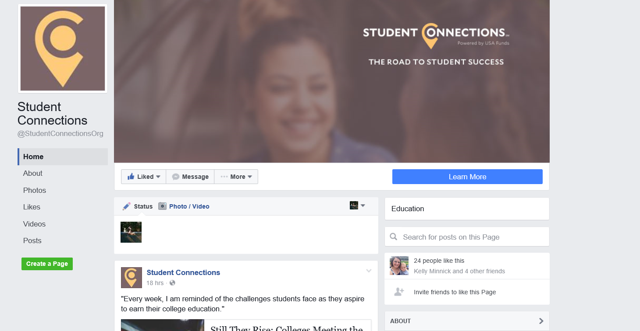
Student connections
Easy Resources

