Slide 1
Student Loan Debt: Good or Bad?
Dameion Lovett
FASFAA Outreach Coordinator/Financial Literacy/Debt Management

Slide 2
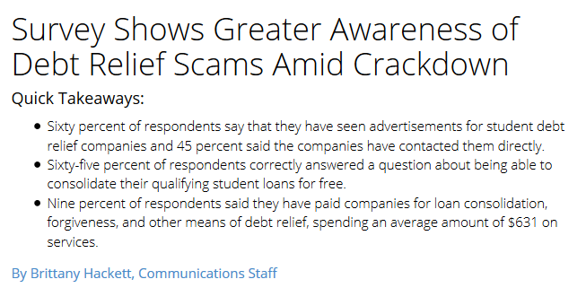

Slide 3
State of Florida Public 4 Year & Private Non-Profit 4 Year Institutions
Average Debt National Average Debt
$24,947 $29,400
Proportion w/Debt Proportion w/Debt
$54% 69%
From Institute for College Access Project on Student Debt, 2014

Slide 4
Is There A Student Loan Debt Crisis?

Slide 5
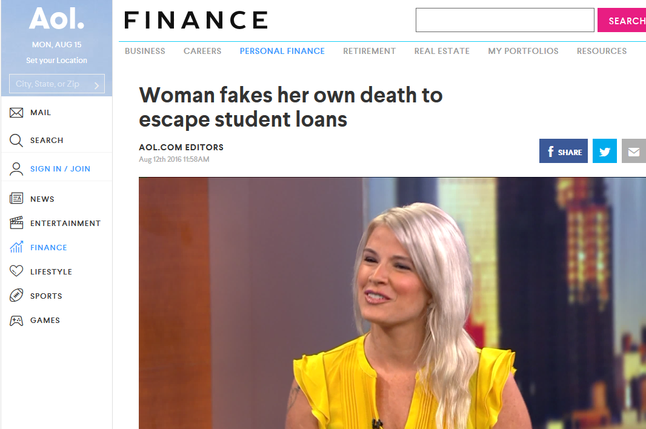

Slide 6
The Obvious Isn’t Always True…
“College educated people should understand their finances”
“How hard can it be to add and subtract?”
“If you don’t have it, don’t spend it”
“Didn’t your parents teach you this?”

Slide 7
Student Beliefs
42% said finances caused them not to participate in an activity
26% regularly skip meals to save money
40% frequently investigated working more hours to pay for expenses
12% frequently investigated withdrawing from school due to costs
(Source: National Survey of Student Engagement, 2011)

Slide 8
Is It Common Sense?
You may know this, but your students probably don’t…
Students don’t recognize what’s happening to them and where the problems are coming from
Students make poor choices
Stress eating
Stress spending
Working more to have more spending money; supplying wants instead of needs
Tend to look for instant gratification & short term results

Slide 9
College Grads Buried In Student Loan Debt but Unwilling to Give Up Luxuries
NASFAA Today’s News 4/13/16

Slide 10
“If You Think Education Is Expensive, Try Ignorance”
Derek Bok

Slide 11
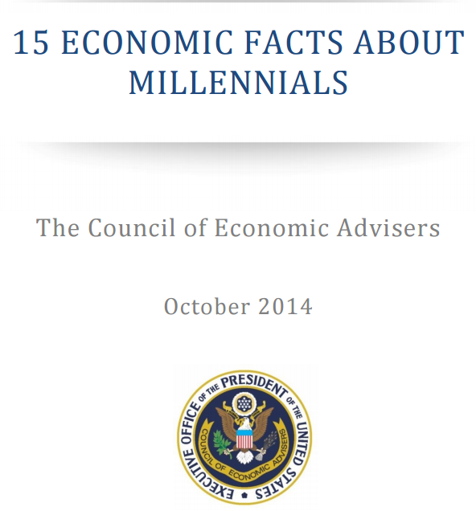
Understand A Millennial
Millennials are now the largest, most diverse generation in the U.S. population
Millennials have been shaped by technology
Millennials value community, family, and creativity in their work
Millennials have invested in human capital more than previous generations
College-going Millennials are more likely to study social science and applied fields
As college enrollments grow, more students rely on loans to pay for post-secondary education
Millennials are more likely to focus exclusively on studies instead of combining school and work
As a result of the Affordable Care Act, Millennials are much more likely to have health insurance coverage during their young adult years
Millennials will contend with the effects of starting their careers during a historic downturn for years to come
Investments in human capital are likely to have a substantial payoff for Millennials
Working Millennials are staying with their early-career employers longer
Millennial women have more labor market equality than previous generations
Millennials tend to get married later than previous generations
Millennials are less likely to be homeowners than young adults in previous generations
College-educated Millennials have moved into urban areas faster than their less educated peers
(Source: White House Report on Millennials)

Slide 12
All Students Aren’t Created The Same!
Generation X and Baby Boomer students have different needs than millennial students
Typically enroll in online programs
Increasing number of undergraduates are 25+
Attends part-time
Works full-time
Is considered financially independent
Has dependents
Is a single parent
Does not have a high school diploma (NCES)

Slide 13
How Do We Make An Impact In Reducing Loan Debt?
Behavior Change!!!
Understanding the connection between mental health and finances
Active participation in loan borrowing education

Slide 14
Momma Made Me Do It!
Parents have greatest influence on developing positive financial attitudes & behaviors in young adults, until long-term romantic relationships become larger influence
Source (Financial Behavior, Debt, and Early Life Transitions (2014), University of Arizona)

Slide 15
Financial Abstraction
Money isn’t real so it doesn’t matter if we know how to manage it…

Slide 16
The World Is Bigger Than Our Anxieties!
Life altering decisions are made with as little understanding based on taking the minimum amount of time possible
18% say money is a taboo subject in their family
36% say talking about money makes them uncomfortable
69% say financial problems and conflicts are their primary cause of anxiety
(Source: American Psychological Association, 2014)

Slide 17
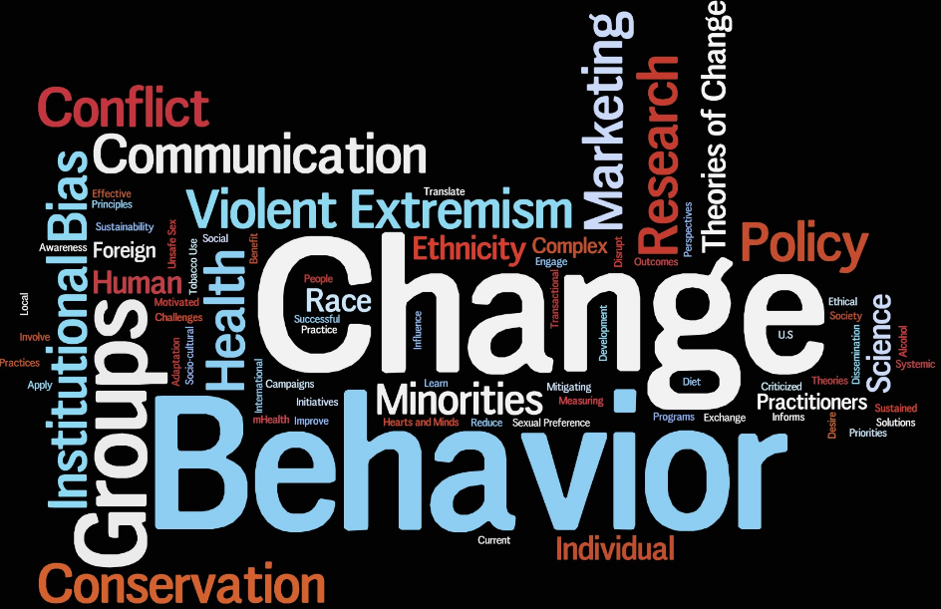
Behavior Change

Slide 18
Can You Change Your Behavior?
Stand Up
Cross Your Arms
Let’s Talk…

Slide 19
Mental Health & Finances

Slide 20
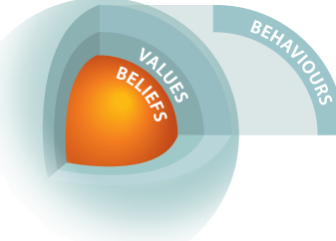
Address The Stress
Understand what we think and feel
Fears about money
Relationship with money
Understand how it affects us
Overall stress
Influence on personal relationships
Influence on work, school performance
Understand how to deal with the effects
Development of healthy coping skills
Stress management
Understand the consequences of decisions

Slide 21
Effective Loan Borrowing Education

Slide 22
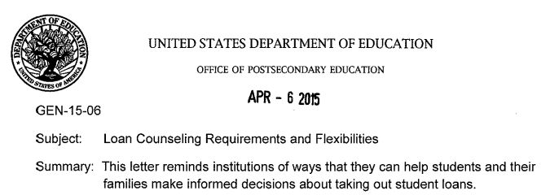
Loan Borrowing Education
Loan Borrowing Budgeting Basics
COA-Aid=Do You Need to Borrow or Do You Want to Borrow for Extras
Enhance Entrance Counseling
GEN 15-06
FACT
Beef up Exit Counseling
One on One Sessions
Grace Period Outreach
Delinquent Outreach

Slide 23
Effective Entrance Counseling
Texas Guarantee Research “A Time To Every Purpose: Understanding and Improving the Borrower Experience with Online Student Loan Entrance Counseling”

Slide 24
Effective Exit Counseling
Texas Guarantee Research “From Passive To Proactive: Understanding and Improving the Borrower Experience with Online Student Loan Exit Counseling”
Texas Guarantee Research “Above and Beyond: What Eight Colleges Are Doing to Improve Student Loan Counseling”

Slide 25
Pending Legislative Relief
HR 3179: Empowering Students Through Enhanced Financial Counseling Act (Not a Law)
Change the one-time entrance counseling requirement to an annual counseling requirement
Must be completed before the student accepts the loan(s)
Passive confirmation of subsequent loans would no longer be permitted
Students must, annually, actively accept every loan by either signing a MPN or by signing a statement accepting the loan

Slide 26
Pending Legislative Relief
HR 3179: Empowering Students Through Enhanced Financial Counseling Act (Not a Law)
Contact information for the servicers of each of the borrower’s loans
Summary of the outstanding balance of principle & interest due on loans made to the borrower
Information on the repayment plans available, including a description of the different plans’ features based on the borrower’s outstanding balance—showing the anticipated monthly payments, the difference in interest paid and total payments under each plan

Slide 27
Simple Solutions
Provide a number of financial literacy related information (programs, events, services)
Offer information in a variety of formats (in person, online, group settings)
Partner with admissions, housing, counseling & health services, student affairs, student organizations, career services, orientation
Link loan borrowing to earnings and
budgeting after graduation
to maximize understanding and lifelong
habit formation
Understand your drop/stop-outs

Slide 28
Barriers
Eliminate the stigma of seeking help
It’s not sexy!
Having open discussions of needs vs wants
Time
Resources

Slide 29
Little Things Add Up Over Time…

Slide 30
Resources/References
http://www.ticas.org/posd/map-state-data-2015#
http://www.tgslc.org/research/counseling.cfm
http://digitalcommons.georgefox.edu/cgi/viewcontent.cgi?article=1008&context=gfsb
Money Savvy Students: www.moneysavvy.com/summit
Colinryanspeaks.com
National Summit on Collegiate Financial Wellness www.nscfw.org
https://www.whitehouse.gov/sites/default/files/docs/millennials_report.pdf
National Endowment for Financial Education
http://www.tgslc.org/research/counseling.cfm
http://www.forbes.com/sites/elizabethharris/2016/08/31/the-real-answer-to-the-student-loan-crisis-changing-borrower-behavior-says-study/2/#a13b8c1cf3ab

Slide 31
QUESTIONS
Dameion Lovett
Campus Director
University of South Florida
dlovett@usf.edu
Financial Education@USF “Bull2Bull”
www.usf.edu/fin-ed

